Slide 1
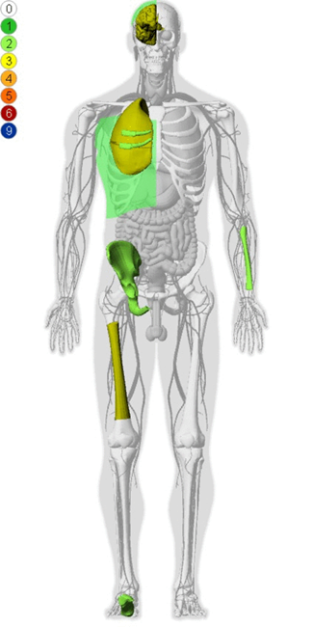

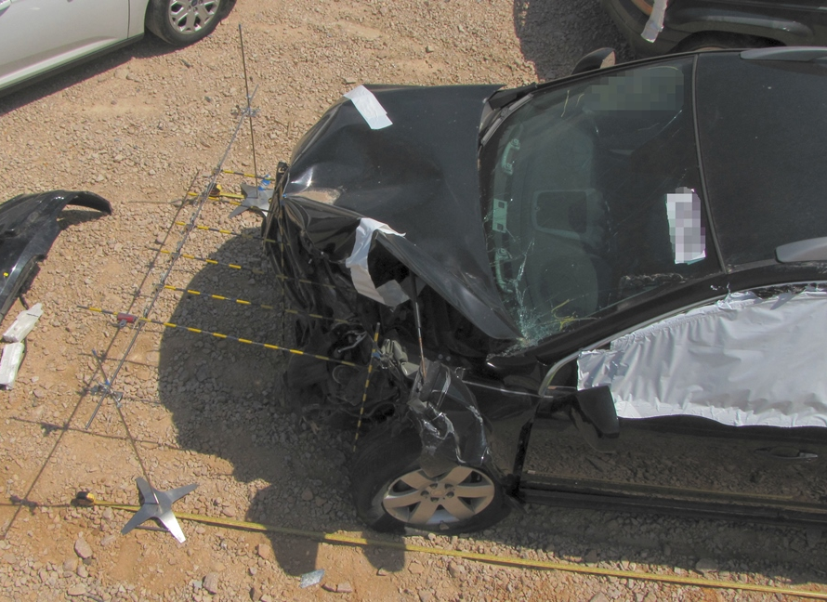
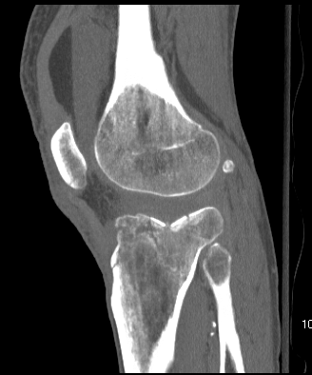
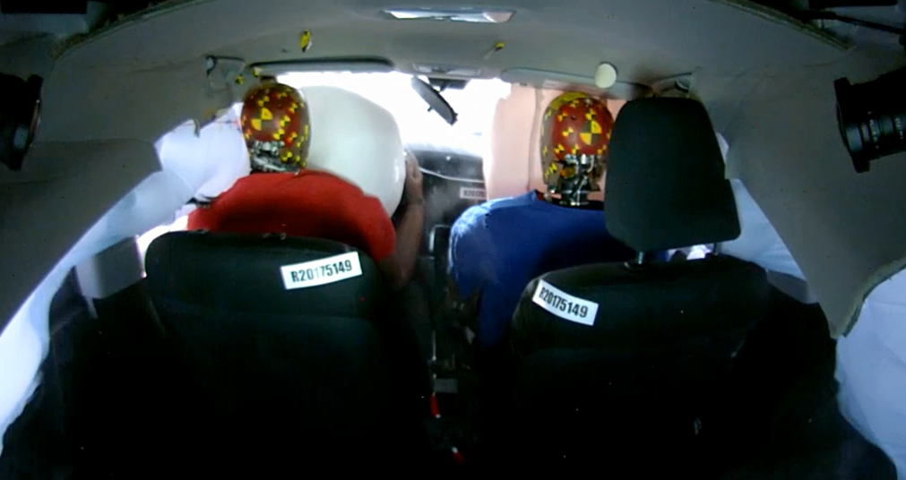
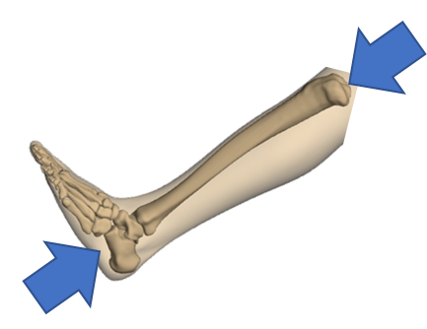
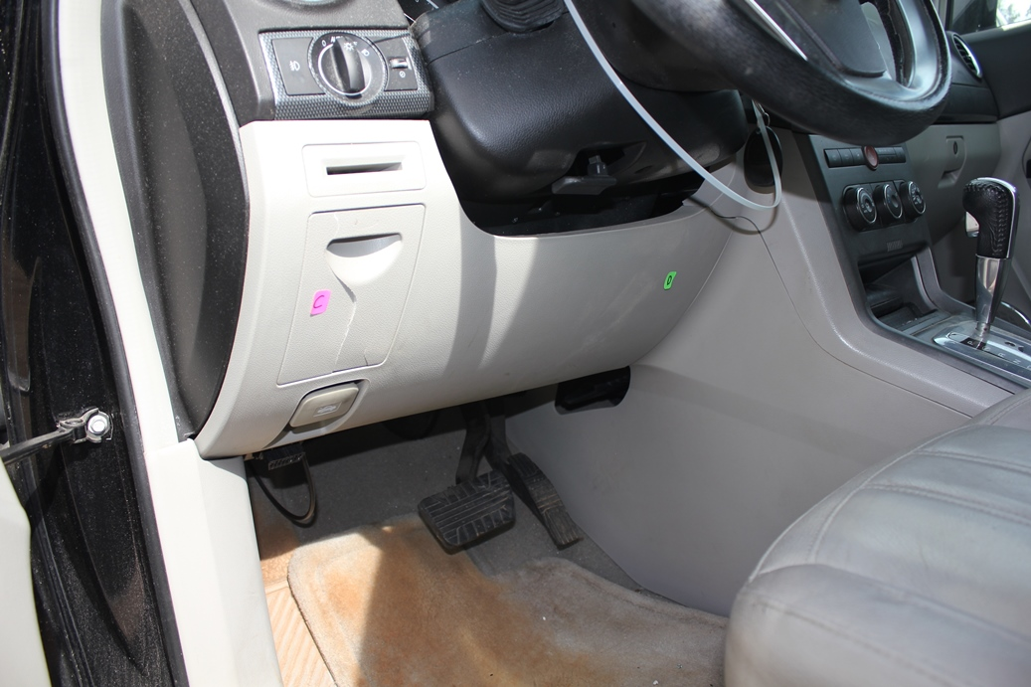
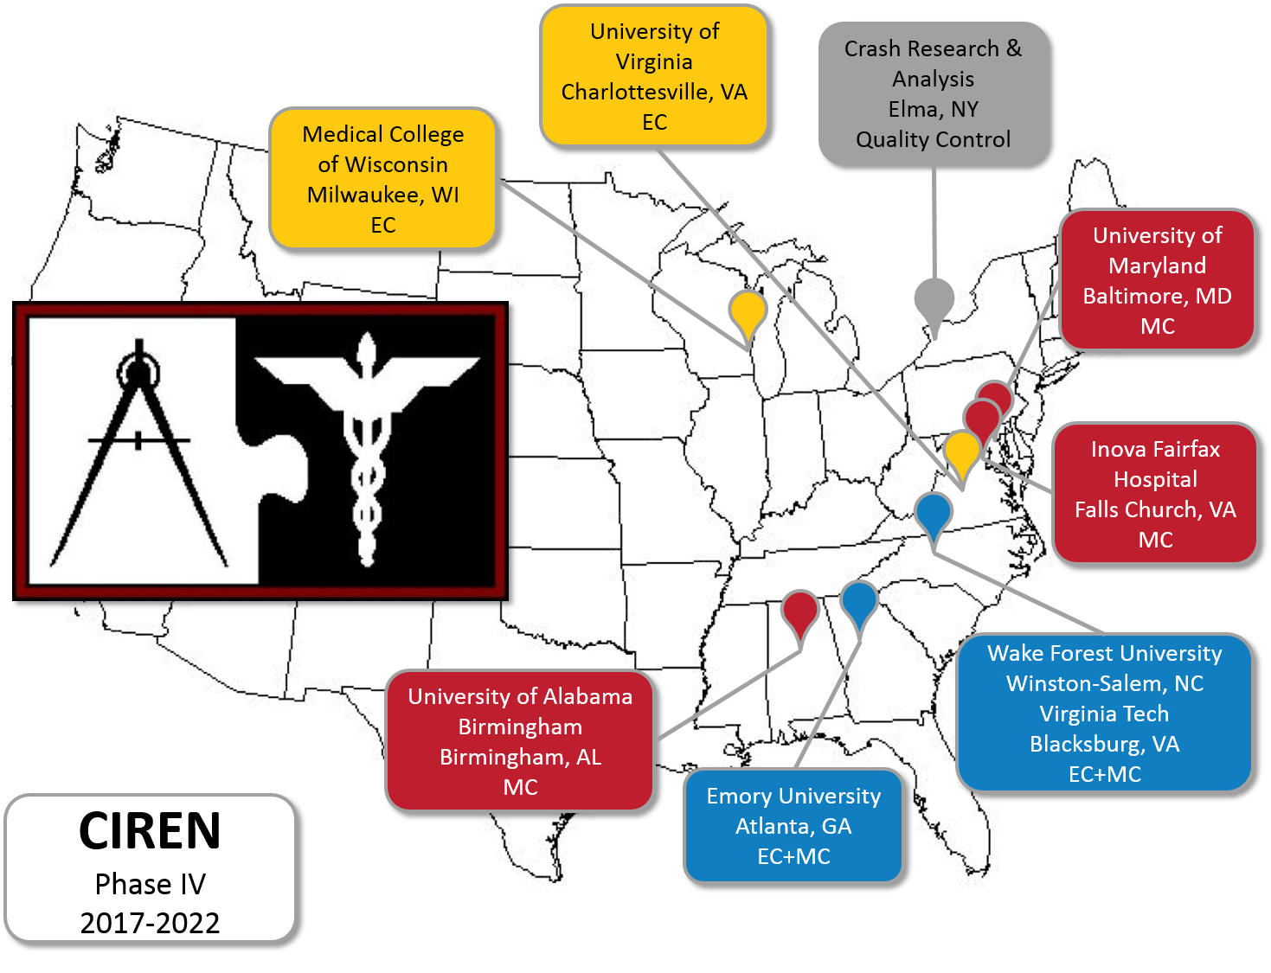
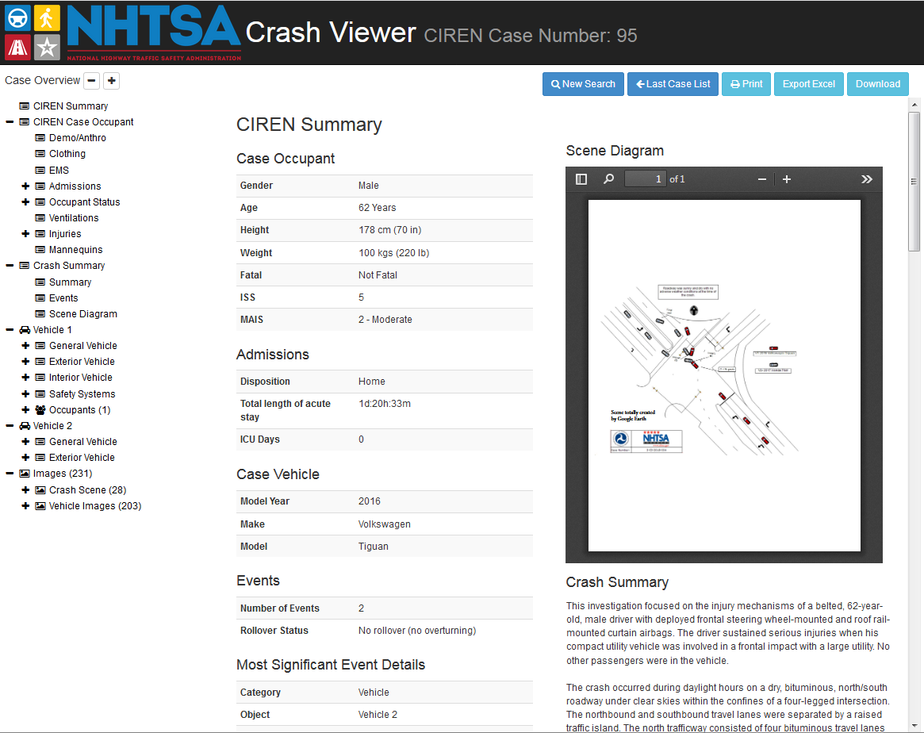
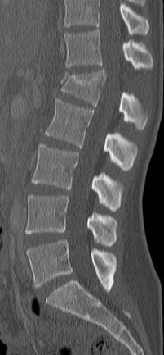
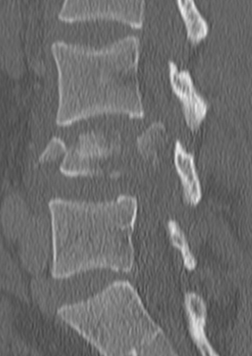
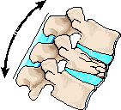

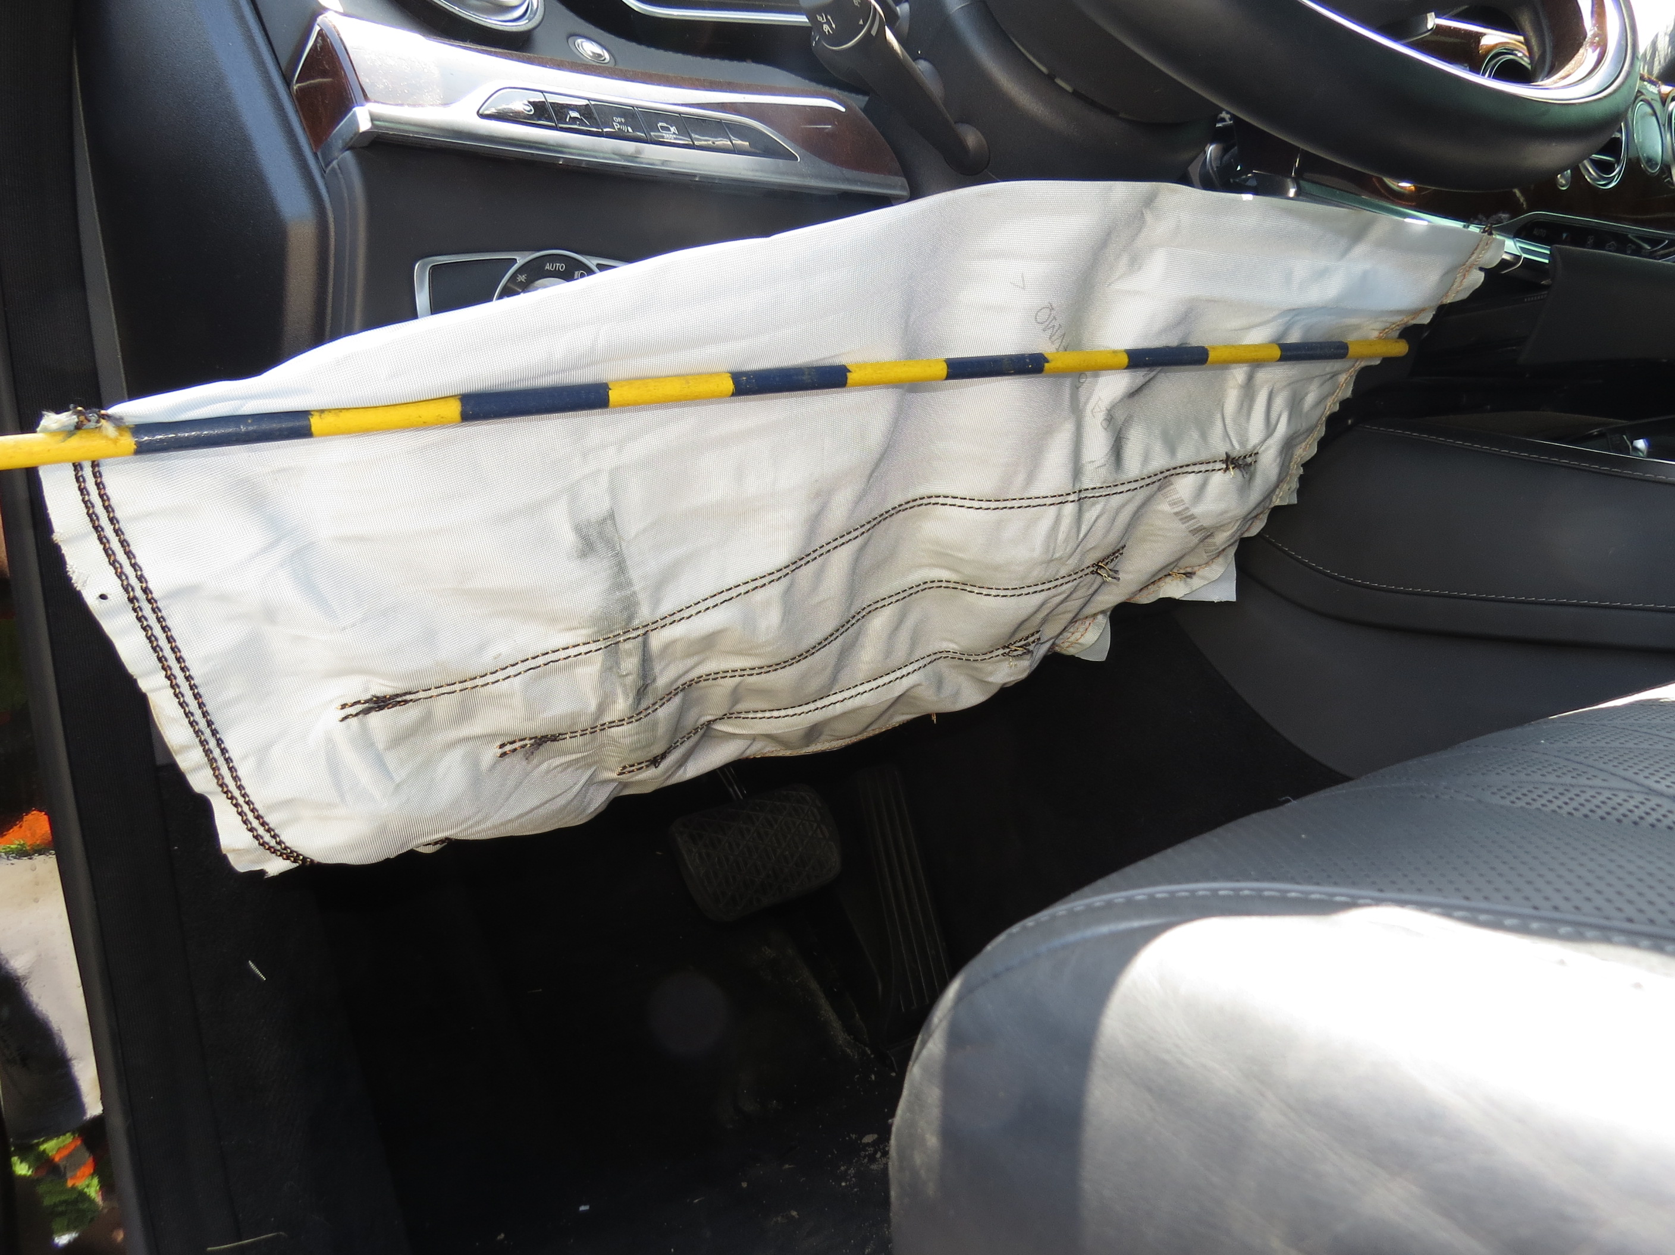
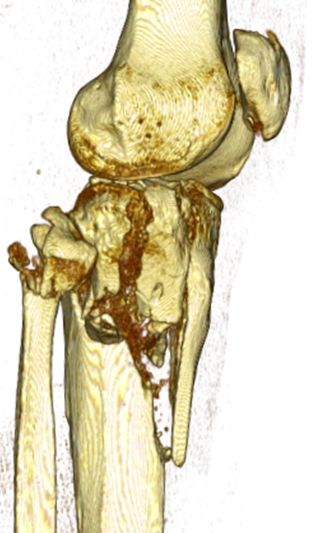
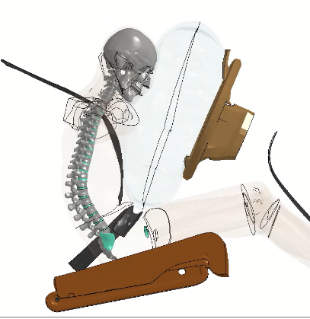
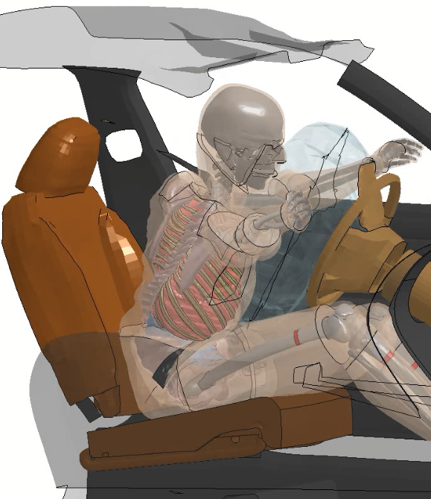

Crash Injury Research and Engineering Network
Overview
How does CIREN work?
CIREN is a real-world crash investigation program focusing on detailed assessment of injury causation
CIREN has primarily focused on motor vehicle occupants, but has begun a study of injured pedestrians as well
Case subjects are identified and enrolled at trauma centers, and participant consent yields full access to medical records
Crash investigation protocols are identical to other NHTSA field data collection systems (CISS, SCI) with few exceptions
Biomechanical engineers and medical doctors conduct in-depth review of data and develop injury causation scenarios
Case reviews are presented in web meetings involving the CIREN center, NHTSA, and other interested parties
CIREN provides engineers in academia and automobile manufacturers with detailed injury causation data to support improved safety countermeasure development
CIREN is led by the Human Injury Research Division with cooperation from the National Center for Statistics and Analysis
Collaboration between the medically- and engineering-oriented participants in CIREN leads to a better understanding of the issues related to injury causation and treatment for the medical side, and enables the engineers to develop better designs for automobiles, restraint systems, test devices, and evaluation criteria. Involvement in the system provides a rich learning experience, and the real-world knowledge contributed from involved parties cannot be found in a textbook. CIREN enables constructive discourse among various professionals, including vehicle designers, social workers, and first responders, that leads to a better overall understanding of the injury causation in investigated cases. CIREN brings together many facets of the motor vehicle crash and provides a more comprehensive overview of the effects of motor vehicle trauma.
What is CIREN?
1) Data Collection
• Obtain consent from crash victim
• Inspect vehicle and scene
• Collect medical records
CIREN is a sponsor-led multi-center research and data collection program involving a collaboration of clinicians and engineers in academia, industry, and government pursuing in-depth studies of crashes, and the resultant injuries and treatments, to improve processes and outcomes. CIREN centers are based at Level One Trauma Centers and biomechanics research laboratories. CIREN’s mission is to improve the prevention, treatment, and rehabilitation of motor vehicle crash injuries to reduce deaths, disabilities, and human and economic costs. The CIREN process combines prospective data collection with professional multi-disciplinary analysis of medical and engineering evidence to determine injury causation in every crash investigation conducted. The injury data collected under the CIREN program includes radiological images, operative notes, and pre-existing conditions that may play a role in injury severity and long-term outcome. This data is collected and reviewed by highly-regarded professionals from the medical and engineering fields. Establishing detailed biomechanical causation of all serious injuries is a key function CIREN, and is serves as a starting point for further injury and vehicle safety research.
Program History
2) Engineering Review
• Establish occupant kinematics
• Compare to crash tests, literature
• Assign injury mechanisms and factors
Hospital Studies
(four sites)
Phase I
(ten sites)
Phase II
(eight sites)
Phase III
(six sites)
Phase IV
(five enrollment sites)
1990
2000
2010
2020
GM fuel tank settlement
(dedicated funding)
Database structure created
Formalized biomechanics coding created
Peer review process and web-based case reviews initiated
New NHTSA data system
3) Joint Review
• Web meeting with centers and NHTSA
• Presentation of case details
• Deliberate injury causation
CIREN created
Initiation of pedestrian pilot study
Who is CIREN?
4) Quality Control and Publishing
• Third-party review of case content
• Final review by NHTSA
• Case published on NHTSA website
How does CIREN enhance research?
Enhanced injury causation coding
• CIREN developed a comprehensive method to document injury causation in crashes (now used in CISS and SCI)
• Access to detailed medical documentation enhances overall injury causation assessment
• Identifies biomechanical loading to relate crash injury to laboratory testing
• Cites relevant evidence used to support final assessment
Wedge
Burst
Medical Center (MC) – enrolls patients and investigates crashes (UMD, UAB, Inova)
Engineering Center (EC) – conducts biomechanical analysis of cases (UVA, MCW)
Integrated Center (EC+MC) – performs both Medical Center and Engineering Center roles (WFU, Emory)
Flexion of torso over lap belt?
Compressive load oriented along spine axis?
Core Functions
Database
~200 cases/year
>5,500 total cases since inception
Detailed biomechanics coding
DICOM (digital radiology) repository
Shared design (CDAN: CISS, SCI)
Public case viewer
Sentinel
Early problem identification
Quick response to NHTSA directives
Safety experts getting first look
Catalyst
Drives hypothesis generation
Supports research initiatives
Critical link between real-world and crash lab
Knowledgebase
Physicians
Engineers
Epidemiologists
Crash investigators
Industry
Students
NHTSA
In-depth review of safety systems
• Understanding the specific injury mechanism is critical to understand real-world restraint system performance
• Reveal unintended consequences
• Inspire deeper investigation
CIREN Study Criteria
Occupants
Pedestrians
Newer vehicles in clean crashes
• Goal is to assess the latest safety system designs
• Simple, single-event crashes preferred – similar to crash tests
Upright pedestrians on foot
• First contact with vehicle forward of top of a-pillar
• Generally enrolling occupants with moderate to fatal injuries
Restrained occupants with serious injuries
• Focus on belt- and airbag-protected occupants
• Generally enrolling occupants with moderate to fatal injuries
Newer vehicles moving forward
• Interest in modern vehicle front end design and crash avoidance technology
• Passenger cars, light trucks, and vans
• Pedestrian impact is only event for striking vehicle
Rich data for reconstruction
• Extensive medical detail
• Expert reconstruction talent
• Leads to better understanding of injury mechanisms
• Facilitates exploration of crash, restraint, and occupant factors
Cases with research value
• Support computational modeling efforts
• Interesting injury patterns
• Purposive sample, not statistically representative
Pilot study (2019-2020)
• Testing different approaches to case identification
• Evaluation of new scene documentation techniques
• Updating field protocols for crash avoidance
• Developing pedestrian-specific kinematics and injury causation coding methods
More information at https://www.nhtsa.gov/research-data/crash-injury-research
Case viewers available at https://crashviewer.nhtsa.dot.gov

