Slide 1
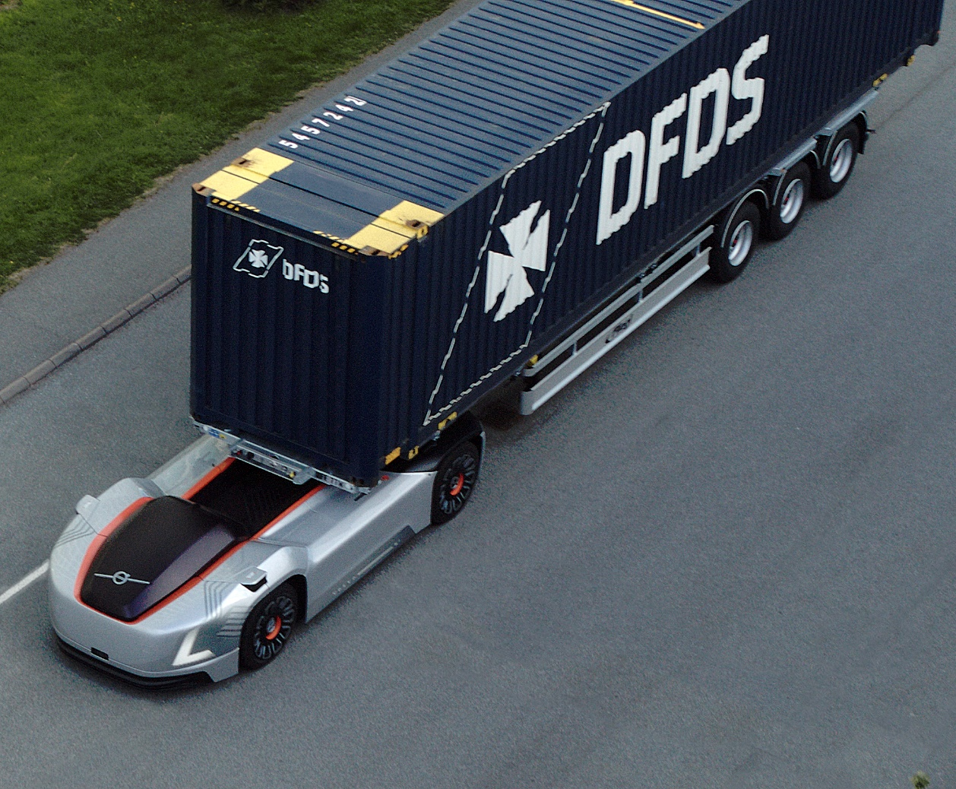
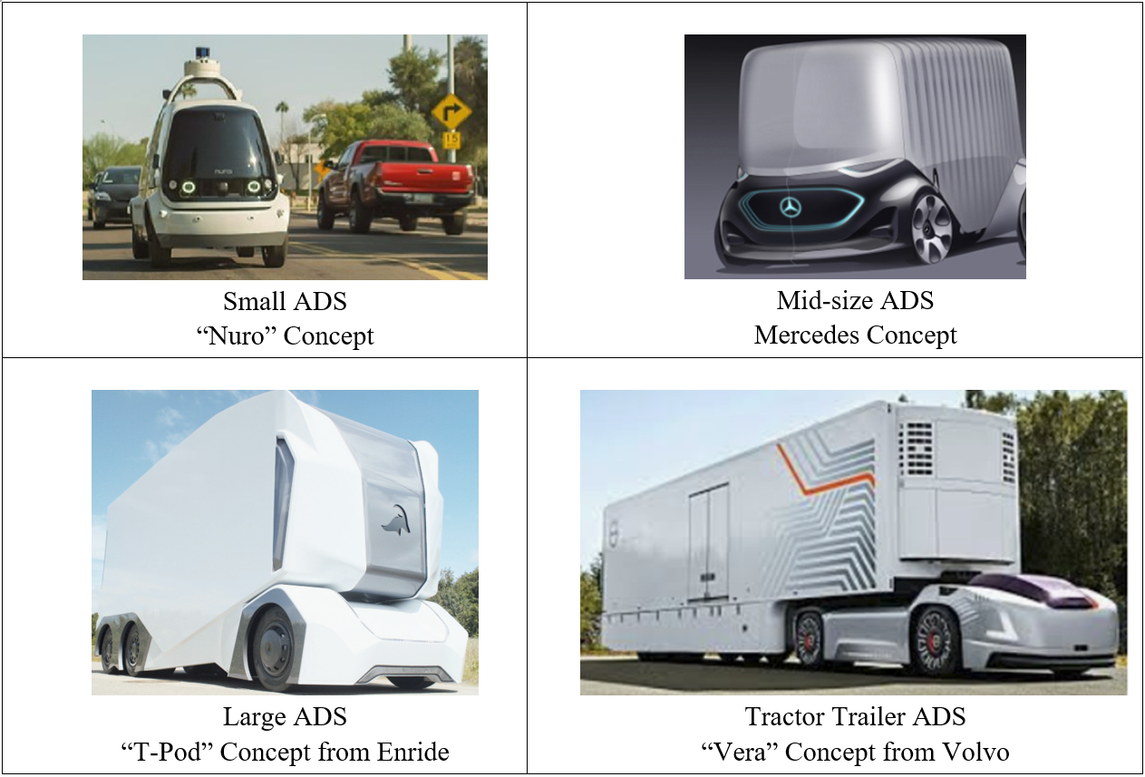
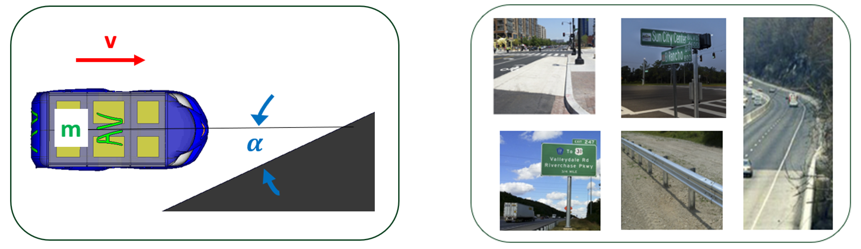
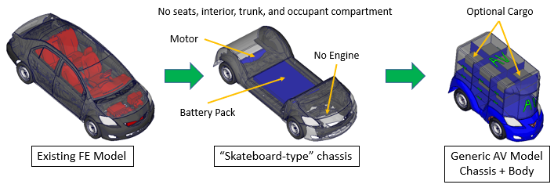
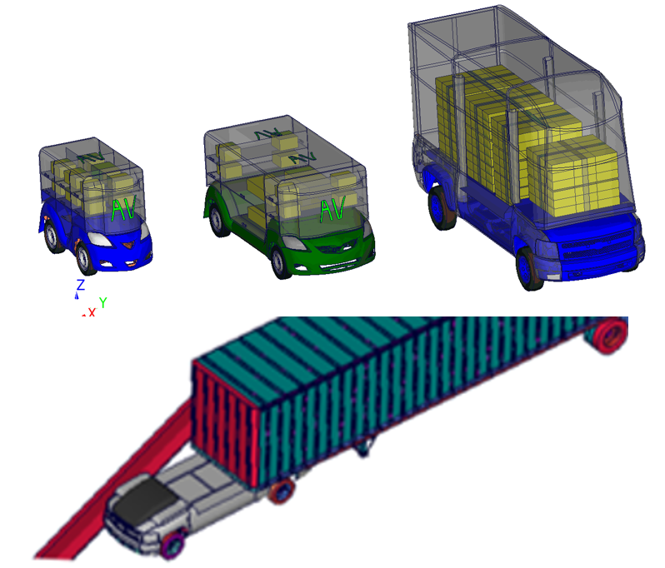
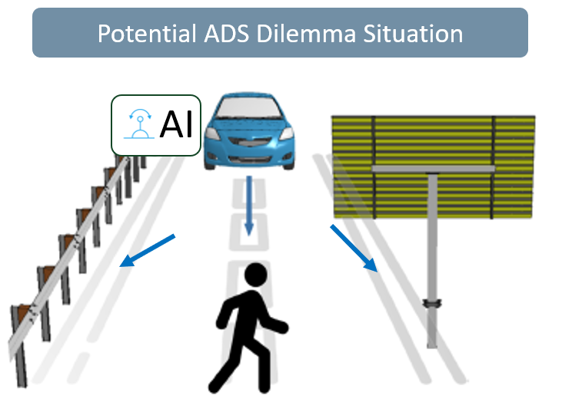
Crash Simulations between Non-Occupied Automated Driving Systems (ADS) and Roadside Hardware
Objective
ADS Concepts
Develop generic FE models of non-occupied ADS vehicles
Analyze how a wide range of parameters affect the outcomes of an impact with different roadside devices
Methods
Generic FE Models
ccsa.gmu.edu/models
Results
Outlook
Developed 4 generic FE models of non-occupied ADS
Analyzed effect of impact speed, angle, and cargo mass, when impacting roadside devices
Study indicates the feasibility of developing science-based databases that can support real-time decision making of ADS vehicles in inevitable impact situations using “Artificial Intelligence (AI)”

