Slide 1

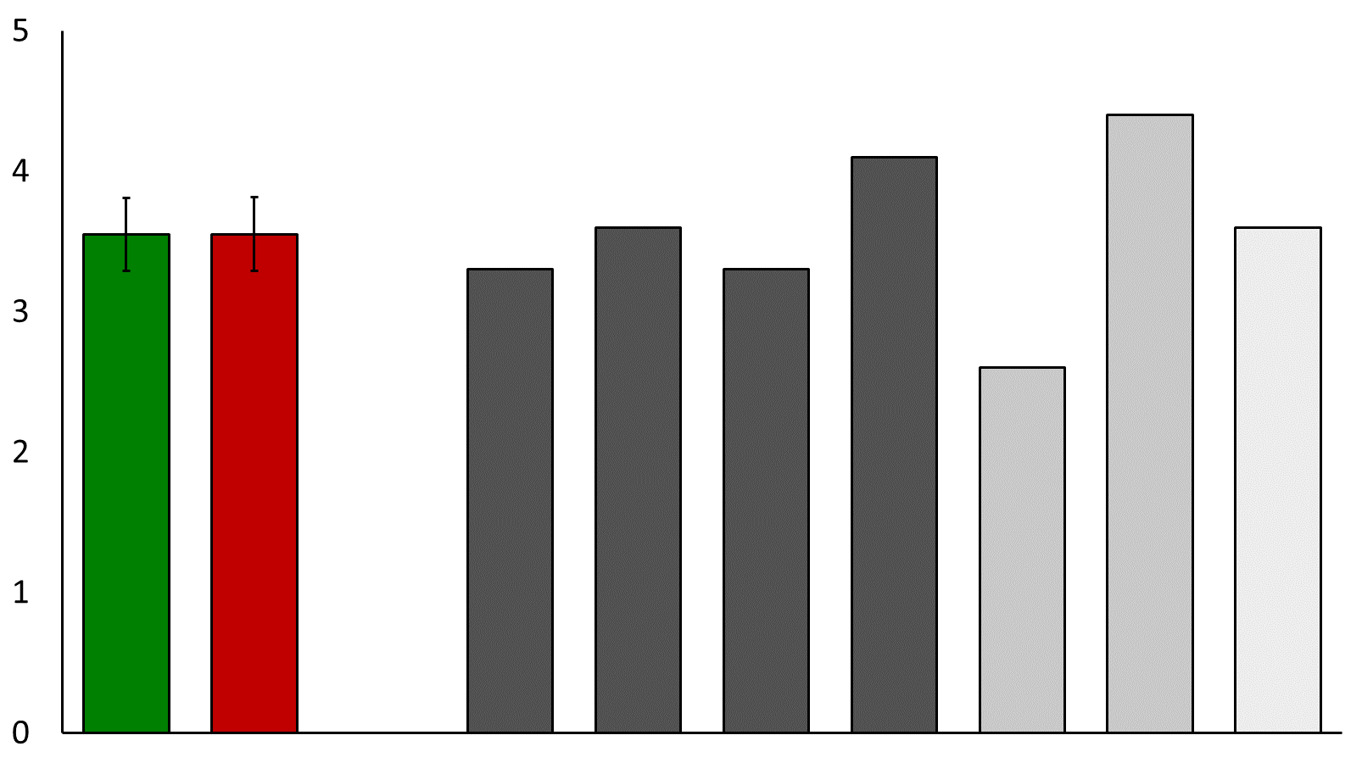
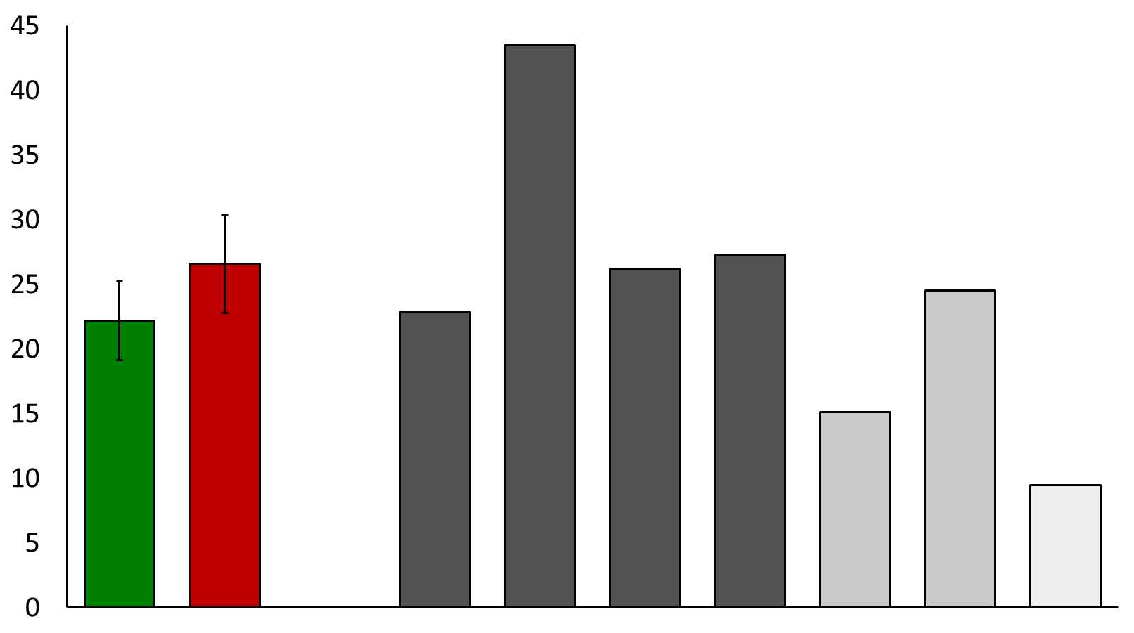
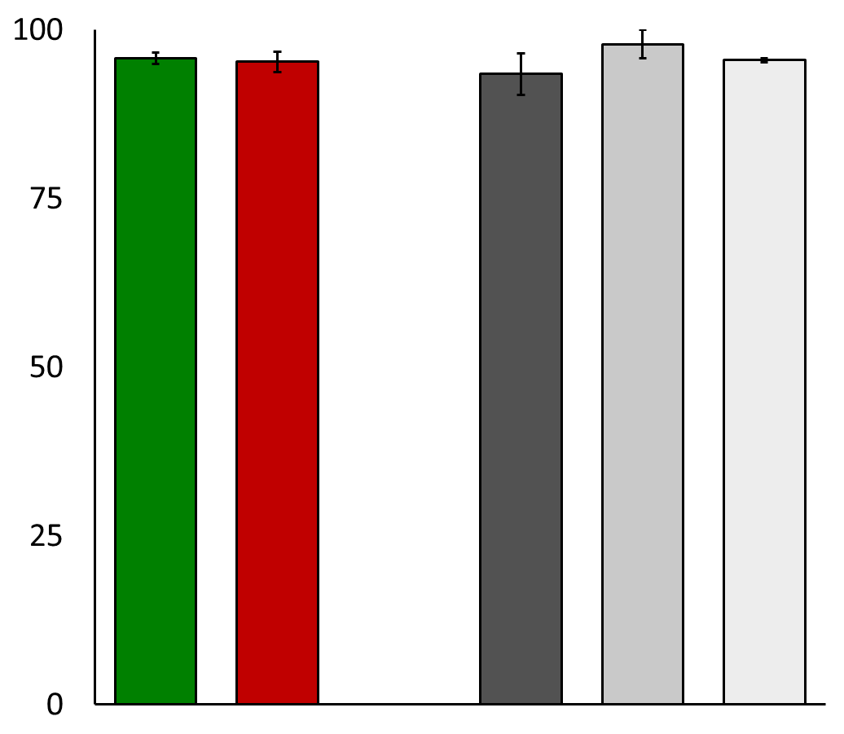
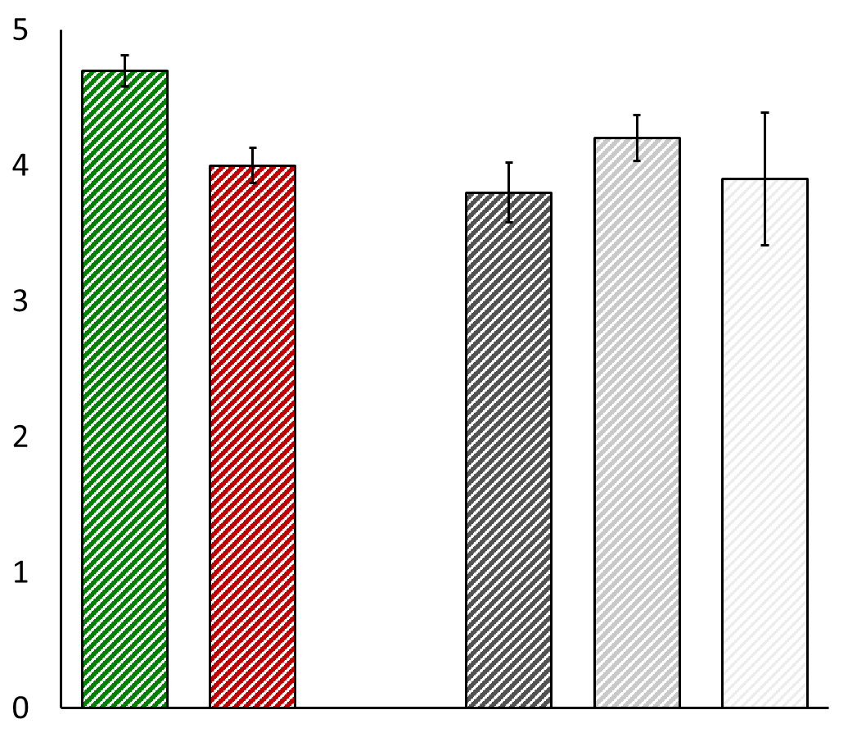
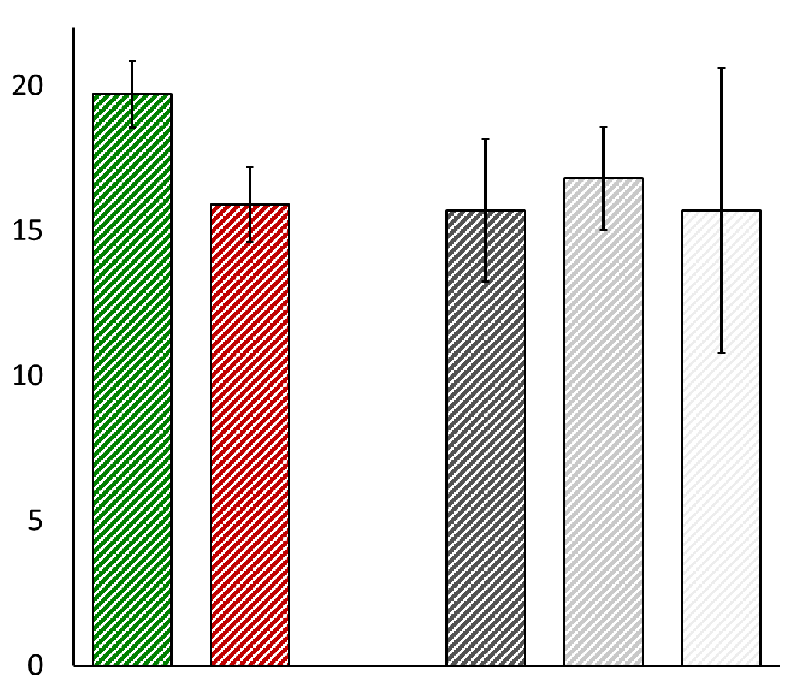
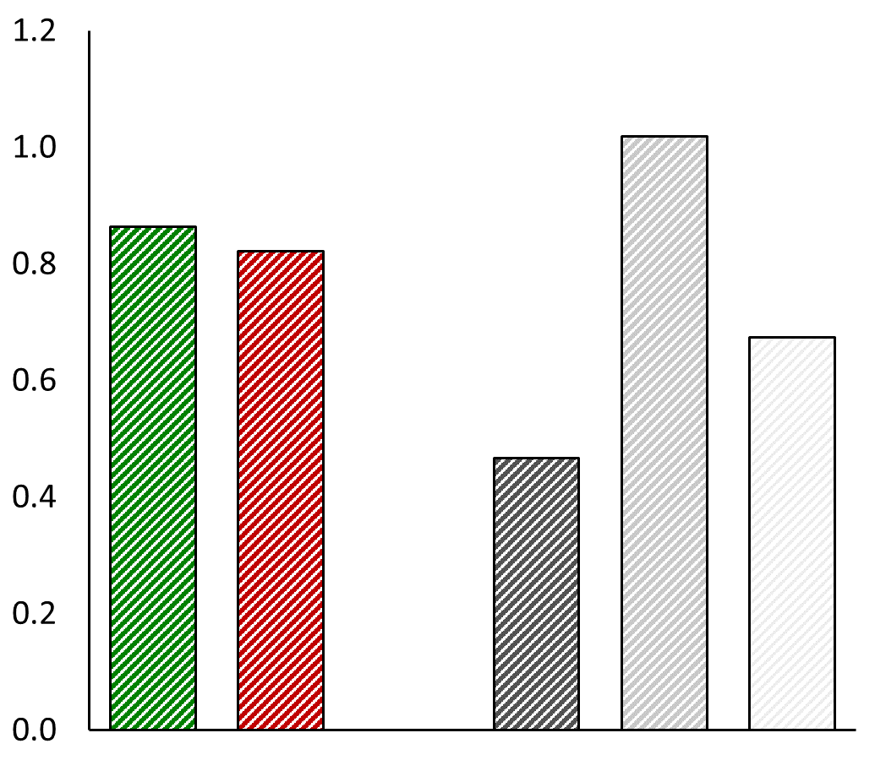
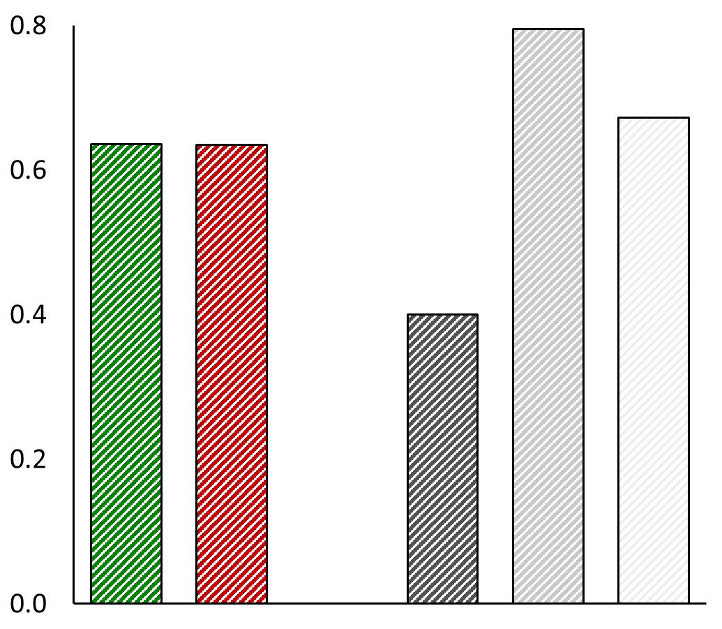
The Effects of Medical Conditions on Driving Performance
Christine E. Watson & Kathy J. Sifrit
Office of Behavioral Safety Research
Background
Some medical conditions affect the visual, cognitive, and psychomotor functions necessary for safe driving (Carr, Schwartzberg, Manning, & Sempek, 2010)
The use of prescription and over-the-counter medications to treat medical conditions is associated with increased crash risk in older adults (LeRoy & Morse, 2008)
There is a higher prevalence of medical conditions—and medications to treat them—in older adults
Are medical conditions in older adults associated with
changes in driving performance?
Alternatively, drivers with medical conditions
may self-regulate by limiting their exposure.
Results
Trips per day
Miles driven per day
COPD
PN
AMD
COPD
PN
AMD
Control group (n = 17)
Medical conditions (n = 8)
On-road performance score
Methods
Part 1: Literature Review/Expert Panel
Goal
Identify which medical conditions among older adults have the greatest potential to affect driving performance.
Results
4 conditions selected for further investigation based on:
Prevalence
Potential to affect driving
Lack of prior studies
Part 2: Naturalistic Driving Experiment
Participants
Primary sample
Older drivers (age > 60 years) with targeted medical conditions (PN, AMD, or COPD) (n = 8)
Age-matched, healthy control drivers (n = 19)
Augmented sample
Older drivers (age > 60 years) with peripheral neuropathy (PN) (n = 7)
Age-matched, healthy control drivers (n = 24)
Design
All participants completed a scored, on-road driving evaluation
Exposure data collected from drivers’ vehicles for 1 month (primary sample only)
n = 40
n = 15
COPD
PN
AMD
n = 4
n = 9
n = 2
Augmented sample
Part 3: SHRP2 Data Analysis
Participants
Strategic Highway Research Program (SHRP2) Naturalistic Driving Study
(Blatt et al., 2015)
Older drivers (age > 65 years) with targeted medical conditions (COPD, PN, or PD) (n = 74)
Age-matched, healthy control drivers (n = 129)
Design
Exposure and performance data collected from drivers’ vehicles
Medical Condition | Driving Errors (Literature Review) | Driving Errors (Expert Panel)
Diabetes | Loss of consciousness, disorientation Automatic driving during hypoglycemia | Sensory loss in feet (peripheral neuropathy, PN)
Age-related macular degeneration (AMD) | Delayed braking Driving too slowly Crossing edge lines/centerlines | Central field deficits Loss of contrast sensitivity
Parkinson’s disease (PD) | Delayed braking Driving too slowly Errors in basic driving maneuvers | Delayed responses to changed traffic situations
Chronic obstructive pulmonary disorder (COPD) | Not included | Lack of endurance, fatigue Temporary lapses in attention
p = .001
p = .046
Trips per day
Miles per day
COPD
PN
PD
COPD
PN
PD
n = 21
n = 42
n = 7
n = 21
n = 42
n = 7
Control group (n = 129)
Medical conditions (n = 74)
Crash or Near-Crash Events
At-Fault Events
Event rate (per 10,000 miles driven)
Event rate (per 10,000 miles driven)
COPD
PN
PD
COPD
PN
PD
n = 21
n = 42
n = 7
n = 21
n = 42
n = 7
Conclusions
Older drivers with diagnosed medical conditions did not perform differently than control drivers
Drivers with targeted medical conditions appeared to self-restrict their exposure (e.g., took fewer trips per day than control drivers)

