Slide 1
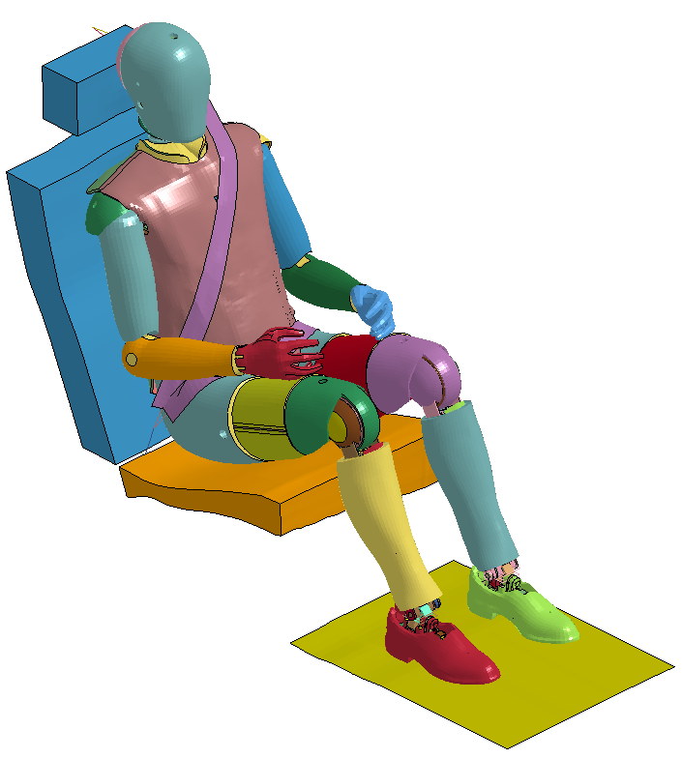
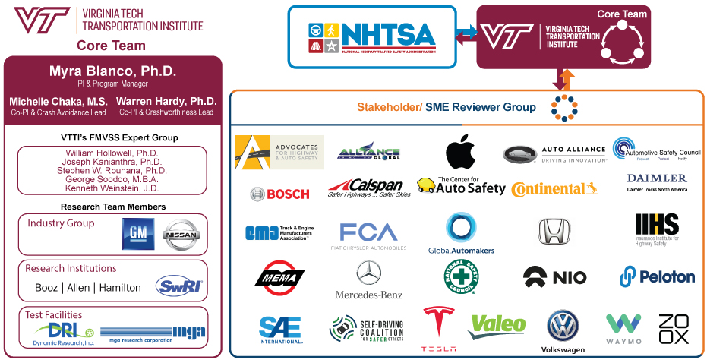
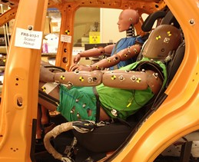
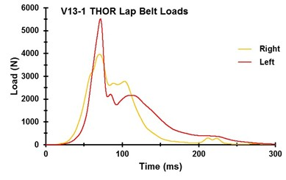
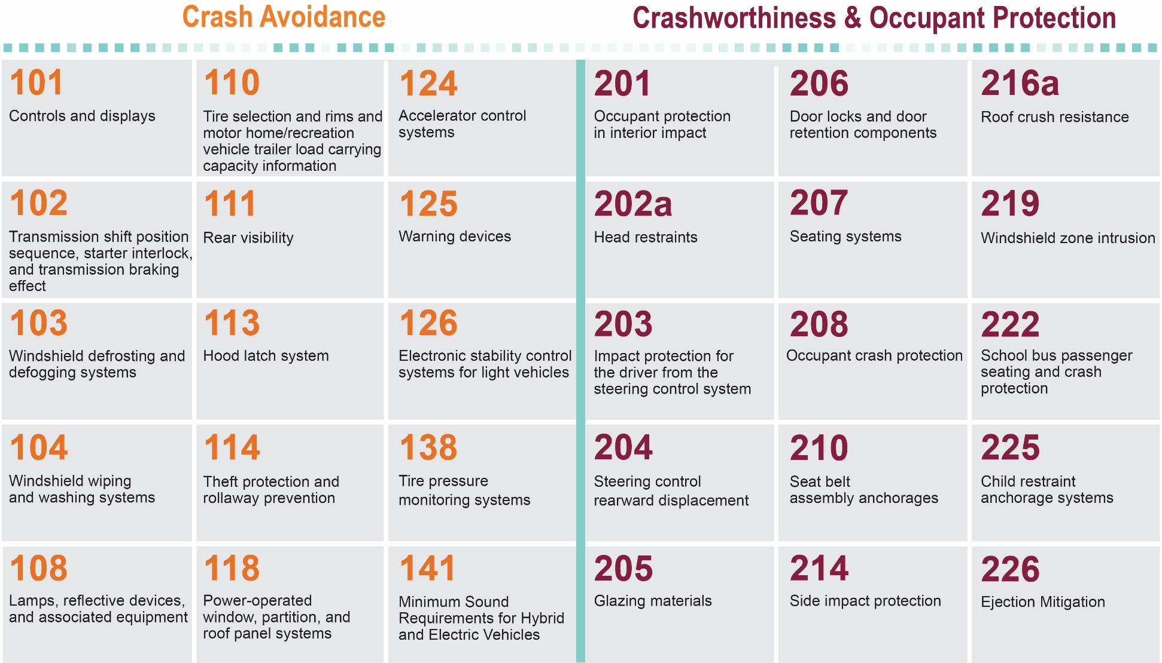
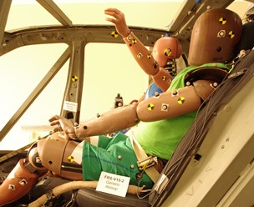
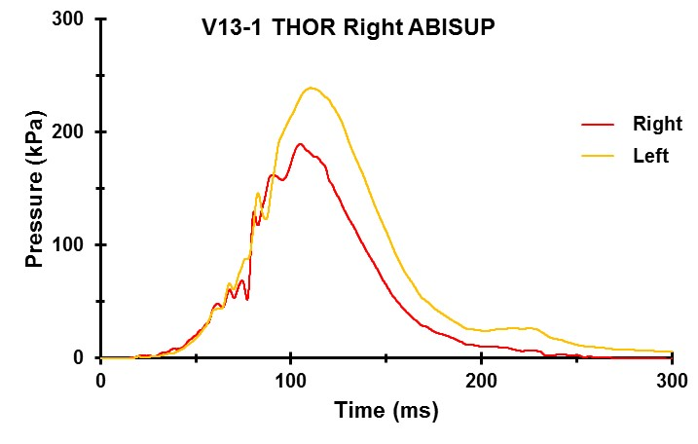
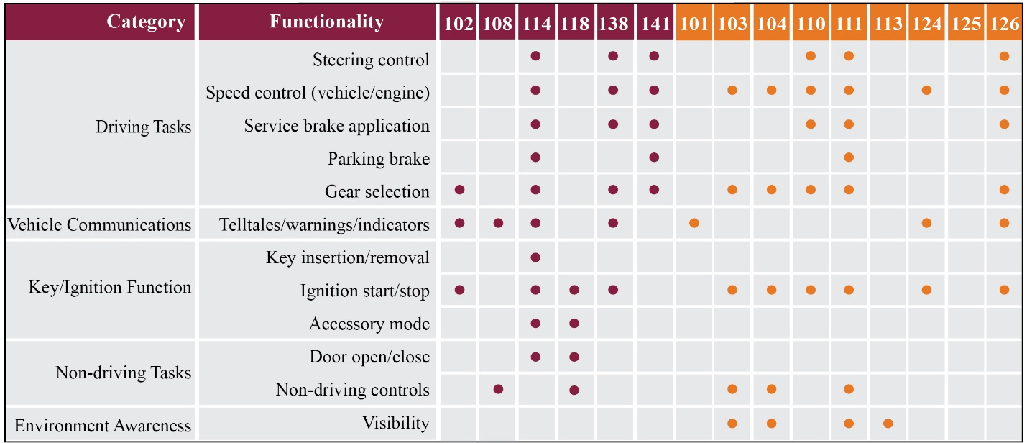
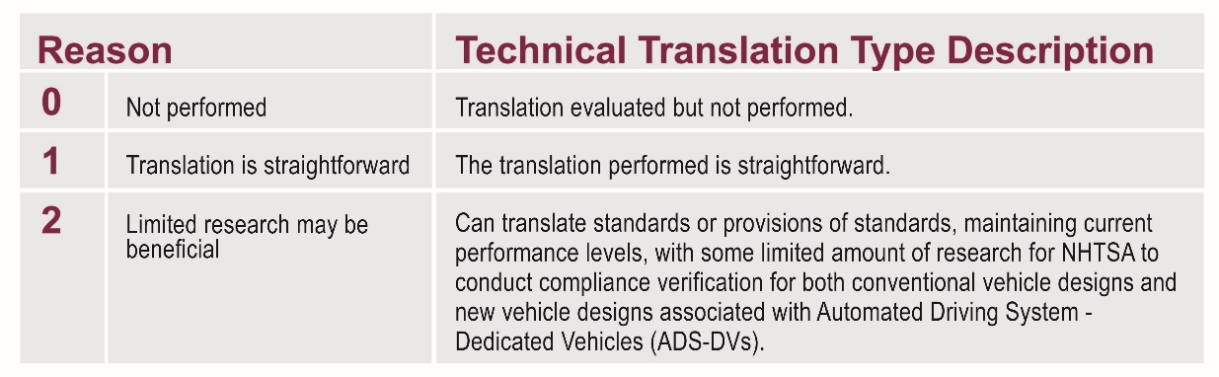
FMVSS Considerations for Vehicles with Automated Driving Systems
Project Objective
  Research and identify unnecessary/unintended barriers for self-certification and compliance verification of innovative vehicle designs with Automated Driving Systems (ADSs).
  Provide technical translation options of Federal Motor Vehicle Safety Standards (FMVSS) and related test procedures.
Focus
  ADS-equipped vehicles designed without manually operated driving controls (e.g., steering wheel, brake pedal)
Rear Seat Occupant Crash Protection
  Current emphasis of frontal crash tests is on the front seats.
  Expectation is that ADS-DV occupants may be more likely to self-select a rear seat.
  Initial focus of research effort was therefore to evaluate rear seat occupant crash protection for conventional seating.
  Evaluated a wide range of rear seat using finite element (FE) modeling and ATD sled tests
  Documented submarining and injury risks in head, neck, chest, femur and abdomen
  PMHS testing will be used to corroborate ATD results and to determine the efficacy of the ATDs for assessing rear seat safety
Project Team and Stakeholders
Phase 1 FMVSS of Focus
Test Procedures: Crash Avoidance
  Goal was to investigate the equipment, methods, and/or procedures to perform compliance testing on ADS-DVs
  Evaluate functionalities required to execute compliance test procedures using as many potential test methods as are technically feasible
Translation Approach
  Detailed evaluation of both regulatory text and the compliance test procedure to identify unnecessary barriers
  Code the translation type as 0, 1, or 2
  Suggest potential translations of standard text and test procedures
  Document FMVSS requirements where a technical translation was evaluated but not performed
  Document potential considerations for translation options
  Engage subject matter experts for review
Phase 2 Focus
  Technical translations for FMVSS not covered in Phase 1
  Refinement of crash avoidance test methods
  Technical translation considerations for unconventional seating evaluation in occupant protection standards
  Additional research studies that stemmed from Phase 1 findings
For more information, contact Ellen Lee: ellen.lee@dot.gov 202-366-1435

