Slide 1
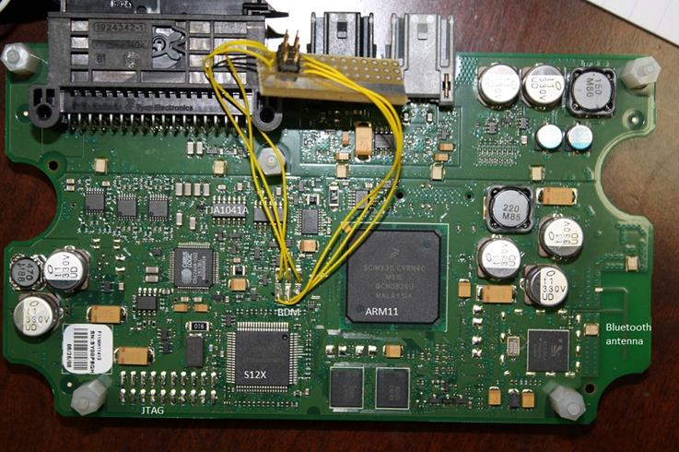
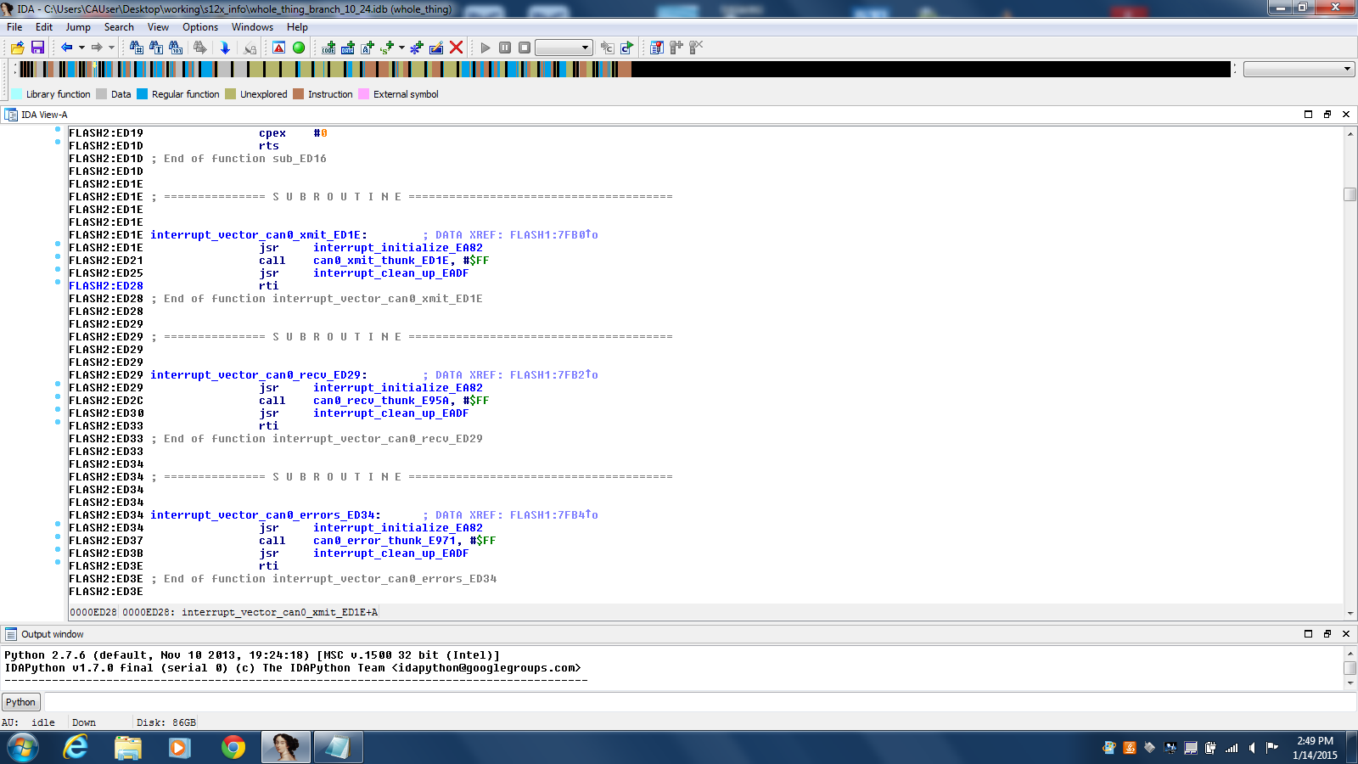
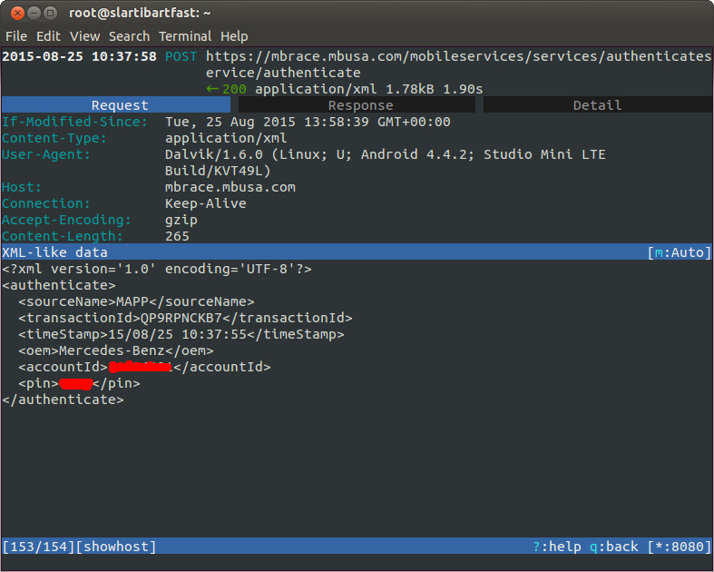

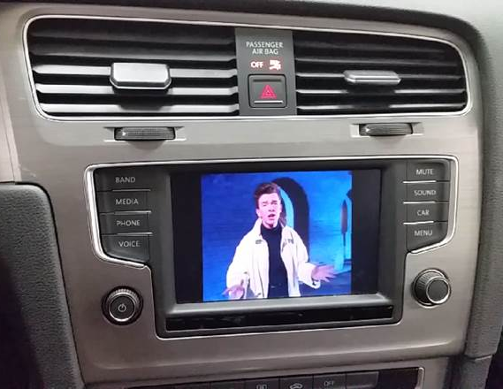
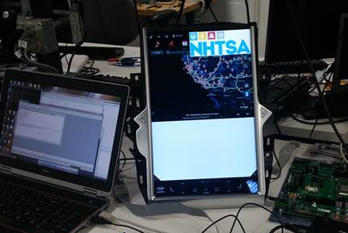


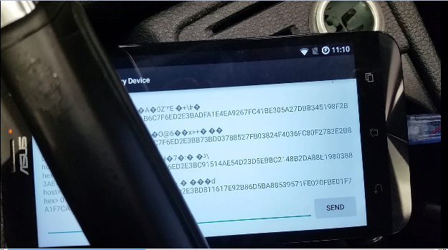
Applied Vehicle Cybersecurity Research
Background: The Vehicle Research and Test Center has expanded its laboratory capabilities to better support applied cybersecurity research.
Methods:
Direct Hardware Interface
Firmware Analysis
Spoofing – Man in the Middle
Attack w/ backoffice server
Wireless
Smartphone Projection Protocols
Vehicle Center Information Display / Infotainment / Telematics
Expected Outcomes: Using the knowledge, skills, and tools developed under this research, NHTSA is able to better identify cybersecurity risks, replicate publicized hacks, confirm if vulnerabilities have been patched, and provide expertise within and outside the agency.

