Slide 1

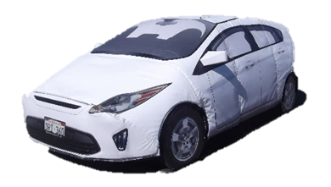
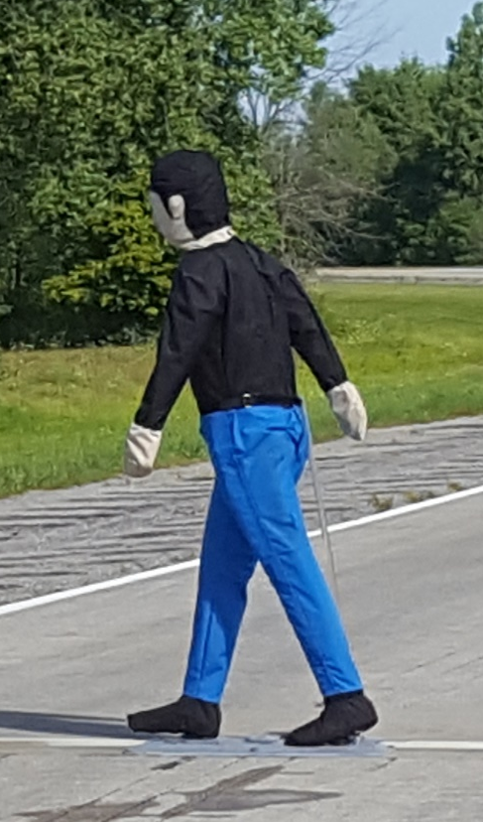
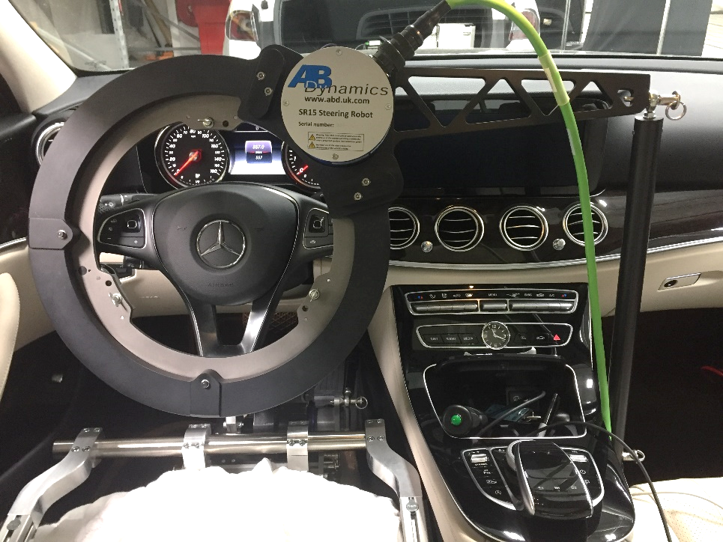
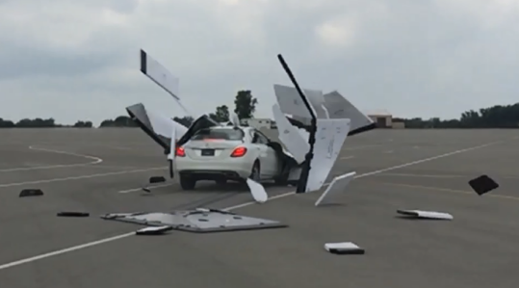

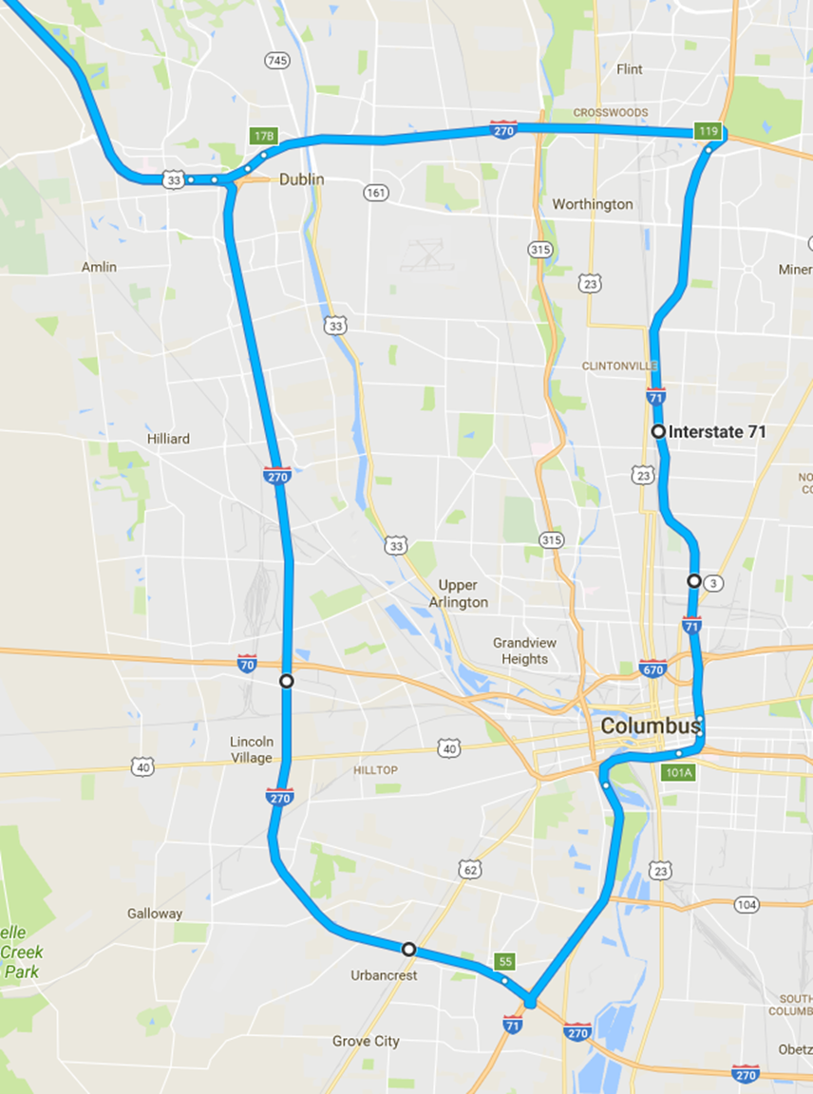
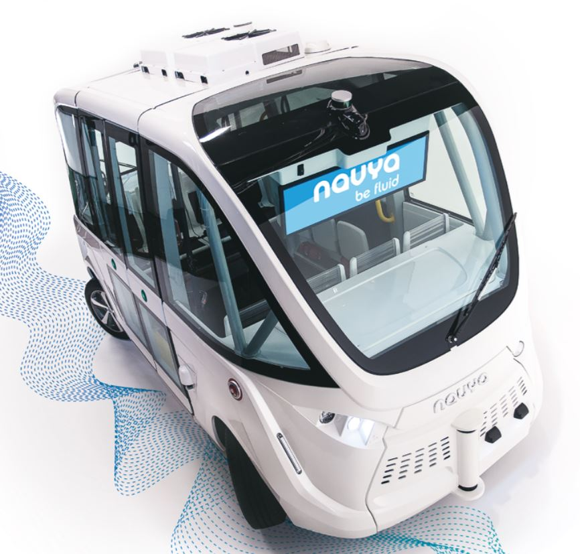
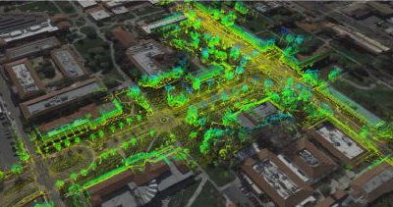
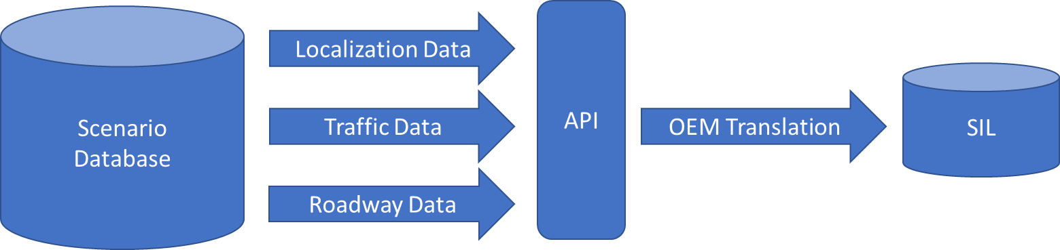
Driving Automation Research
Underway at VRTC
Test Track Assessment Methods
Objective Test Procedure Development
Use of advanced equipment and innovative test methods
Performance evaluations of the latest crash avoidance technologies
Pedestrian Automatic Emergency Braking (PAEB)
Blind Spot Intervention (BSI)
Opposing Traffic Safety Assist (OTSA)
Intersection Safety Assist (ISA)
Traffic Jam Assist (TJA)
Lower Level Driving Automation
Real-World Driving Experiences
An essential component for understanding system operation, functionality, limitations, and potential safety implications.
Instrumented vehicles operated on a series of diverse real road courses
Exposure to varying environmental conditions
Helps reveal potential difficult cases and system limitations
Helps guide the practical considerations needed to effectively and efficiently assess driving automation performance.
Test Track Assessment Methods
Operational characterization of two low-speed shuttles equipped with a Level 4 Automated Driving System (ADS)
Has required working through the logistics of defining an ODD and testing considerations unique to ADS-equipped vehicles
High Driving Automation
Simulation
A necessary component to efficiently understand and evaluate automated vehicle operation
Will work to build a simulation framework to provide generic yet detailed scenarios to an ADS software-in-the-loop simulation

