Slide 1
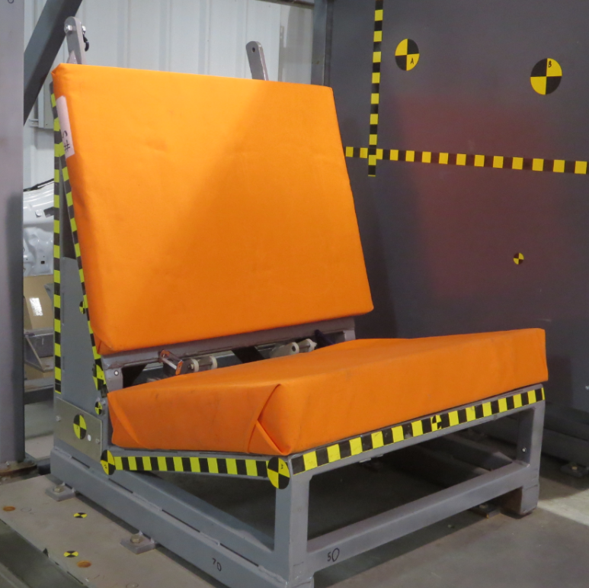
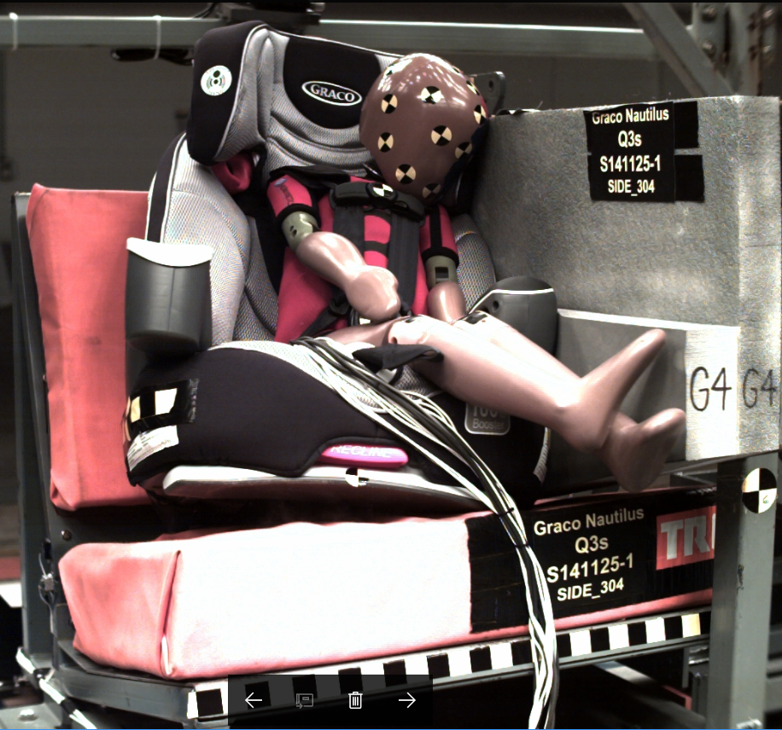
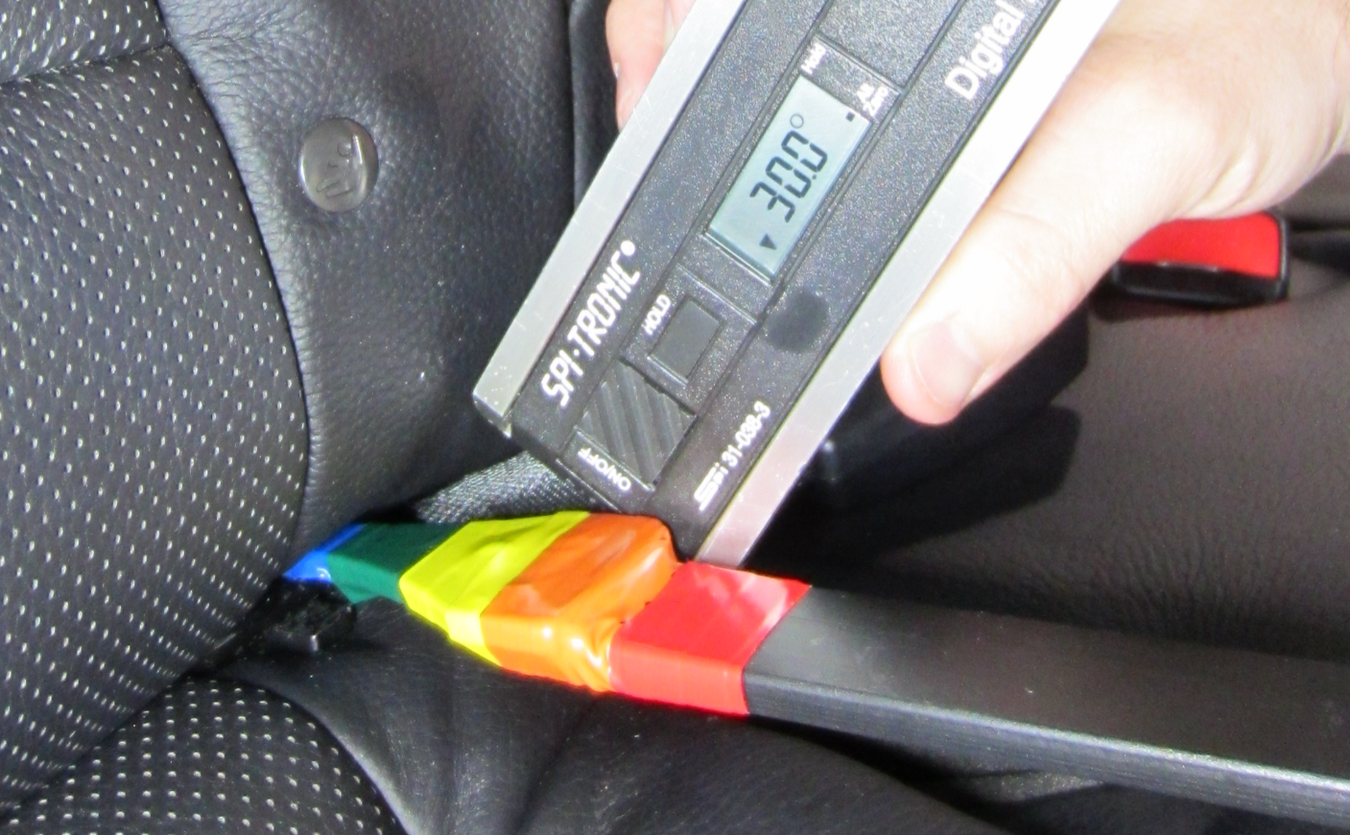
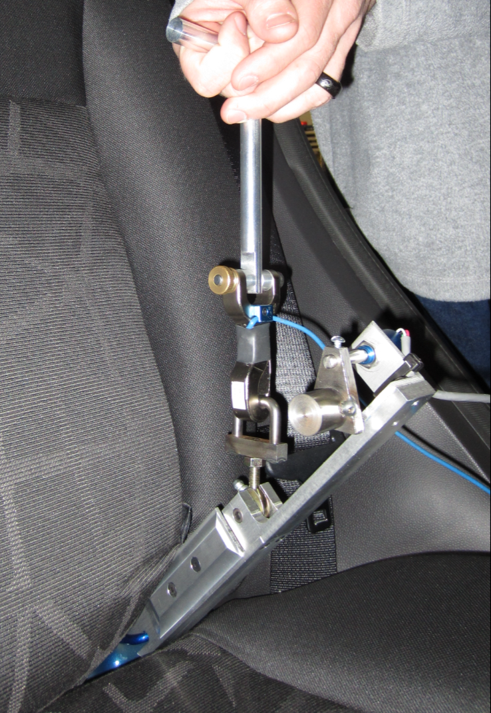
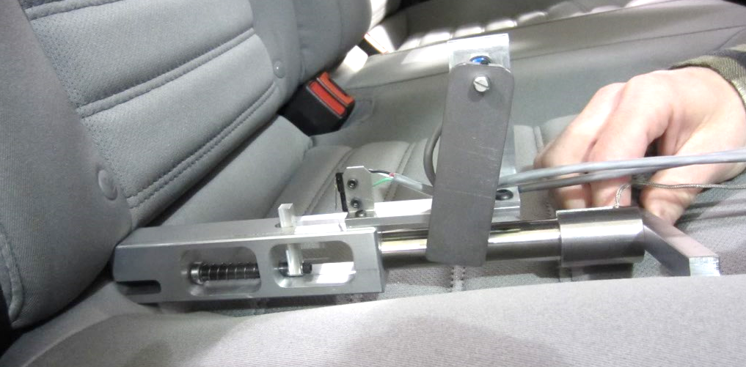
Child Restraint
Safety Research
BACKGROUND
Per MAP-21, conduct research to update the testing methods used to evaluate child restraint systems (CRS) performance and to improve LATCH ease of use.
OBJECTIVES OF RESEARCH
Update the frontal sled bench to be more representative of the modern fleet
Seat cushions
Anchorage locations
Anchorage Locations
Develop test procedures to assess CRS side impact performance using the Q3s (3YO side impact dummy)
Depth Tool
Clearance Angle Tool
Evaluate new tools to assess the ease of use of LATCH lower anchors in vehicles
Applied Force Tool

Slide 2
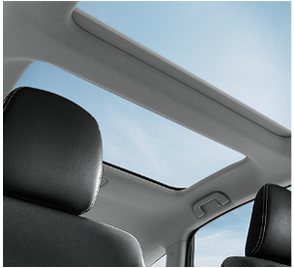
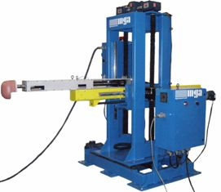
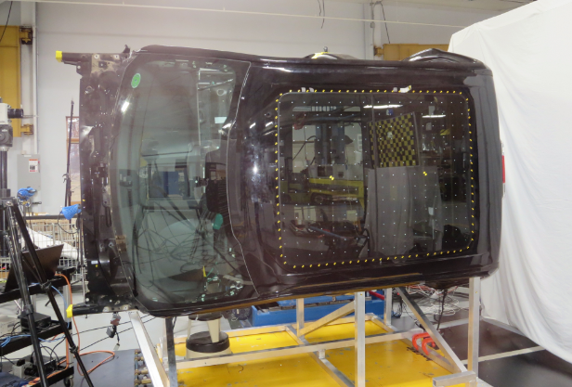
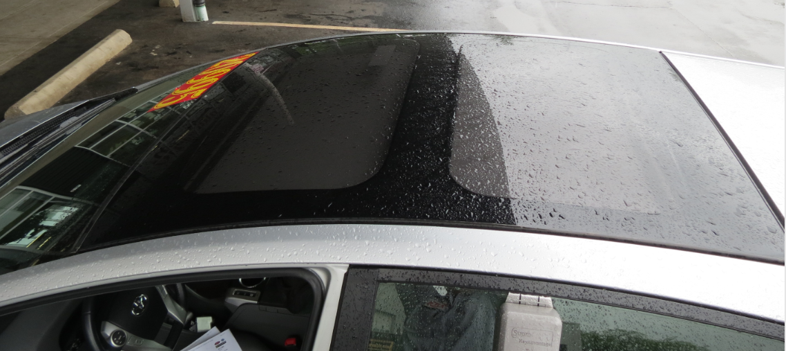
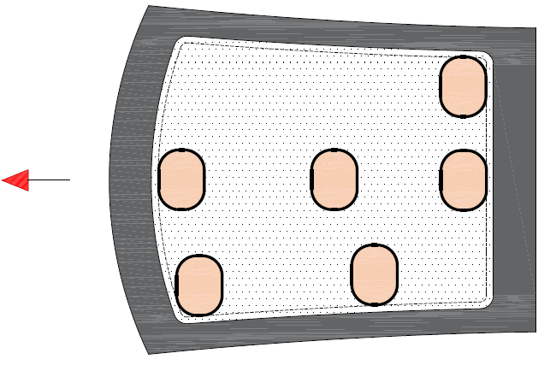
Roof Ejection Mitigation
BACKGROUND
Annual average (2002-2012) fatalities (~233) and serious injuries (~200) from ejections through sunroofs
OBJECTIVES OF RESEARCH
Assess the capability of production laminated glazing to mitigate ejection through roof glazing
Assess countermeasure effectiveness
Modified laminated panes – Inner slider, outer slider
ProTEC-II PET layered panes – Inner slider, outer slider
Polycarbonate panes - Fixed
Sunroof curtains (early prototype) – Open sunroof
Guided Impactor
Vehicle Mounted Sideways
Glass Pre-broken on Both Sides
RESULTS
Movable panels present more challenges for containing headform than fixed panels
Thicker plastic PVB interlayer (laminated) and PET film (Protec II) :
Did not tear
Reduced stretch (and ram excursions)
Transferred more forces to the edges
Greater challenge for movable panels
Polycarbonate: Very low excursion, no failures
Air Curtain (early prototype): Higher excursion
FUTURE WORK: Evaluate additional countermeasures
Spoiler sunroof
Air curtains
Impact Locations
Impact Speeds: 14, 16, 20 kph

Slide 3
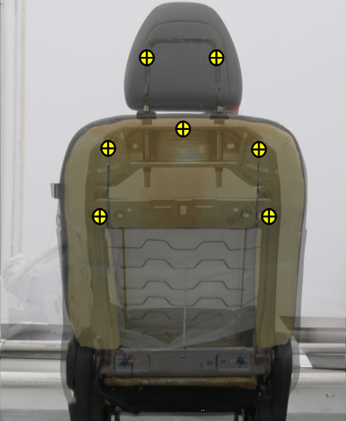
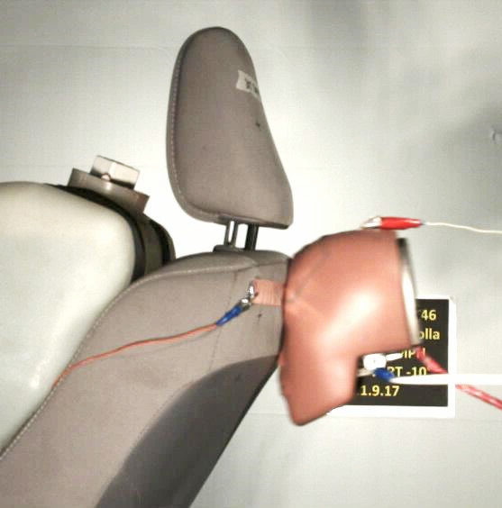
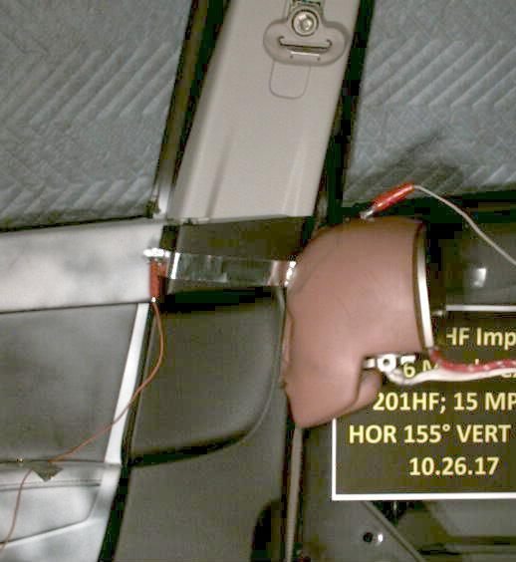
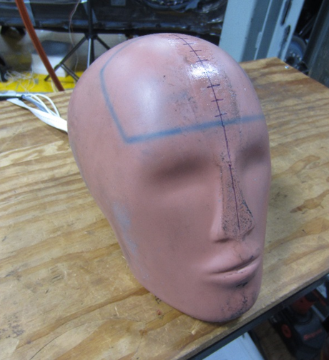
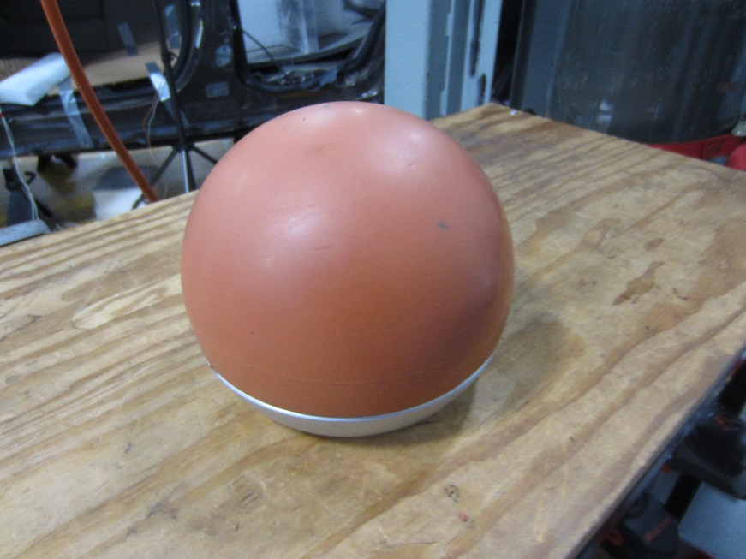
Lower Interior Rear Seat Occupant Protection
BACKGROUND
Contact to lower interior surfaces in the rear seat area account for about 850 serious to fatal head injuries each year
OBJECTIVES OF RESEARCH
Develop test procedures and assessment criterion to address injuries from impacts with the lower interior surfaces in rear seat area
Focus on head/face injuries due to contacts with seat backs/head restraints and lower B-pillars
Assess countermeasure effectiveness
Seat Back Testing
B-Pillar Testing
RESULTS
Completed fleet testing using two headforms on six vehicle platform seat backs and lower B-pillars
Elevated head injury results for five of six lower B-pillars and all seat back designs
Conducted initial countermeasure testing
Reduced head injury for most impact locations
NEXT STEPS
Headform selection
Additional fleet and countermeasure testing
Part 572, Subpart L Free-Motion Headform
Hemi-spherical Adult Free-Motion Headform

Slide 4
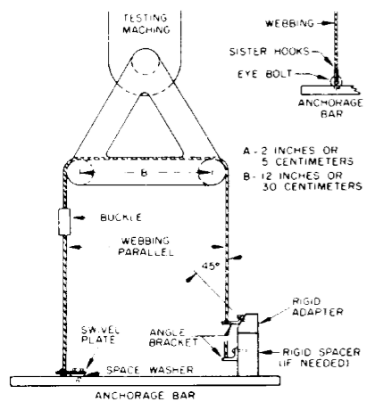
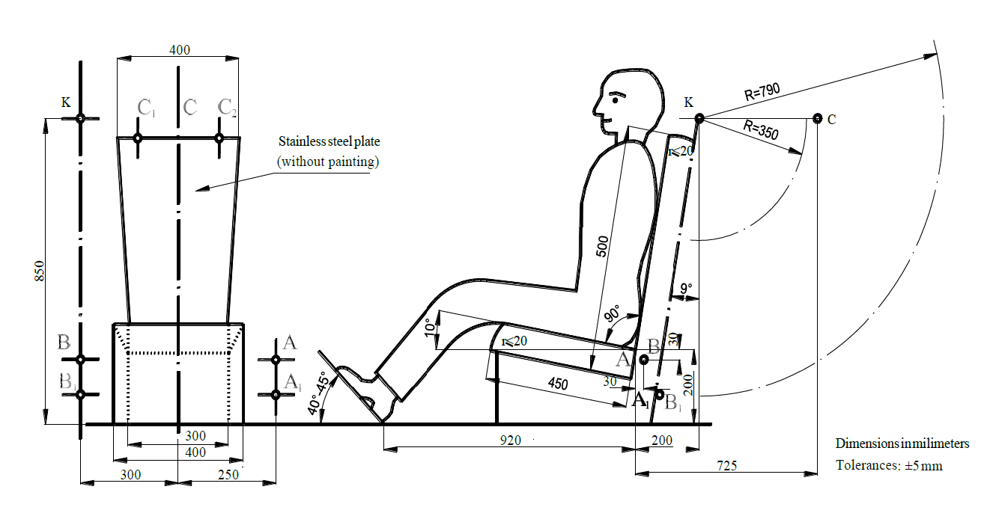
Comparison of Seat Belt Elongation Requirements
BACKGROUND
FMVSS No. 209 specifies performance requirements (minimum force and maximum elongation) for seat belt assemblies in a quasi-static tensile test
European regulation UN ECE R16 specifies performance requirements (chest and pelvis excursion) for seat belt assemblies in a dynamic sled test
OBJECTIVE OF RESEARCH
To understand the correlation between quasi-static requirements in US regulation and dynamic requirements in European regulation, as well as real-world injury possibilities
FMVSS No. 209 Tensile Test
UN ECE R16 Sled Test
TEST PLAN
Conduct FMVSS No. 209 tensile testing on ten seat belt assemblies
Complete UN ECE R16 sled testing on a subset of seat belt assemblies
Run sled tests in a realistic rear seat environment

