Slide 1
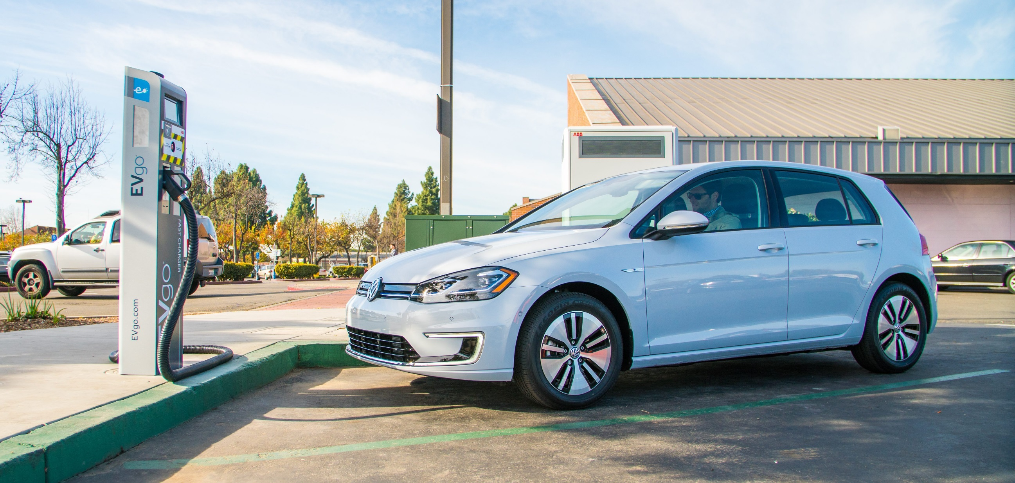
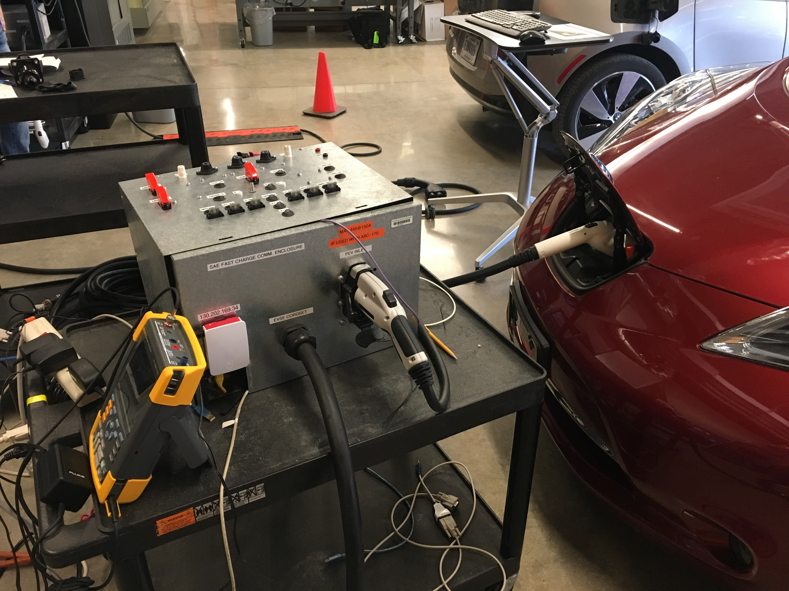
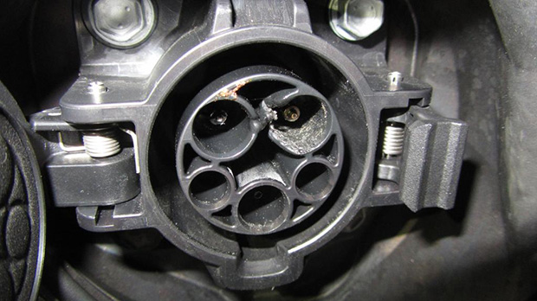
AC Charging Safety
OBJECTIVES OF RESEARCH
Functionality and safety checks are being controlled by the charger not the vehicle
  :Interoperability vs Safety (stop charge is ok…)
Develop redundant safety checks, vehicle protection against a bad charger
AC Charging Test Procedure Validation
Chassis Ground Offset Test
12 Volt System Overvoltage Test
12 Volt System Undervoltage Test
12 Volt System Disturbance Test
Charge Connector Control Signal Disturbance
Charge Connector Field Ground Disturbance
PEV Movement Test
  FUTURE WORK: Evaluate charging safety for
  Extreme DC Charging – 80% charge in 10 minutes
  Wireless charging

