Slide 1
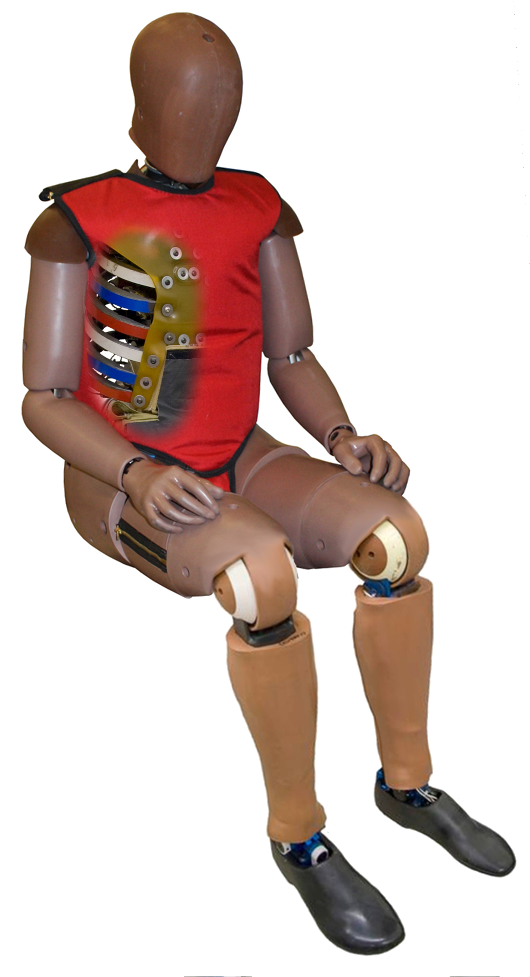
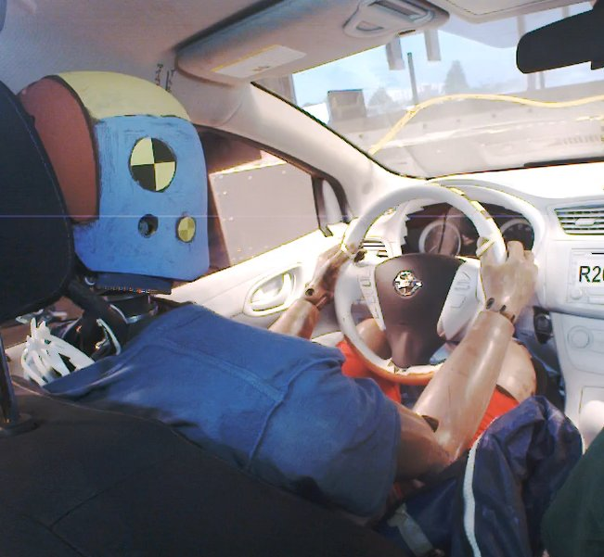
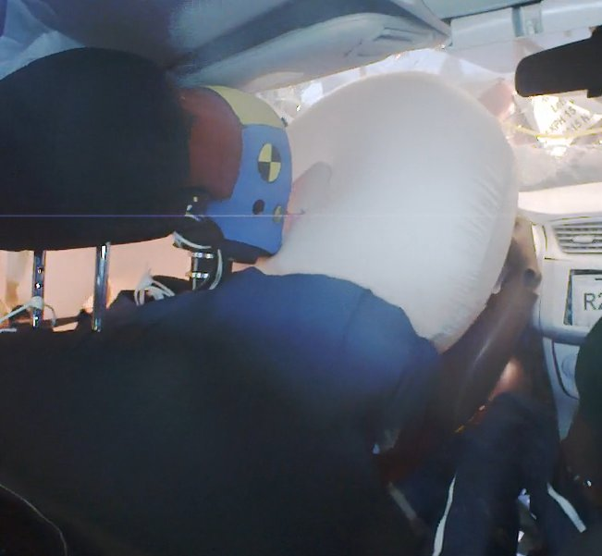
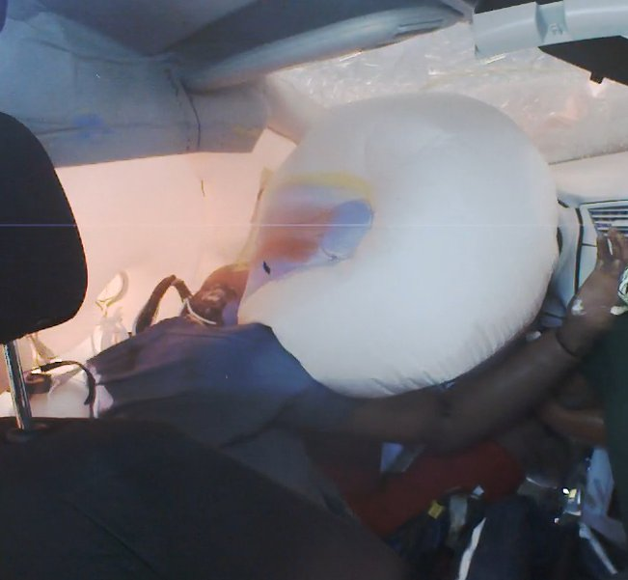
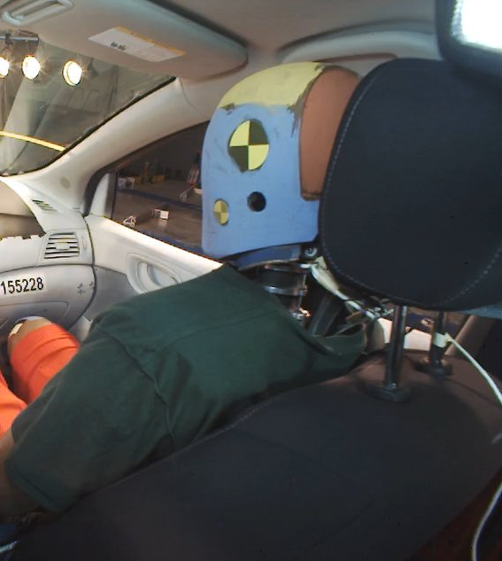
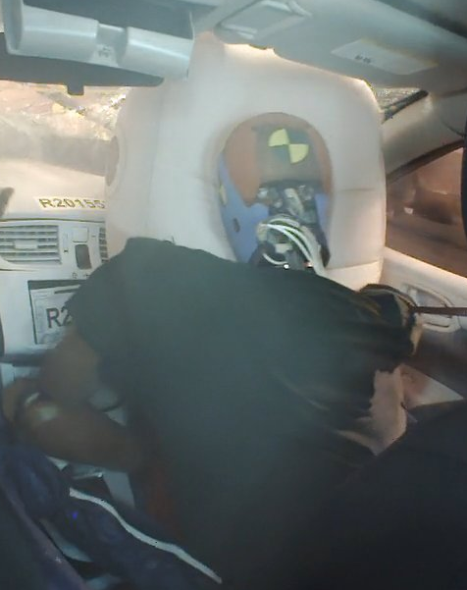
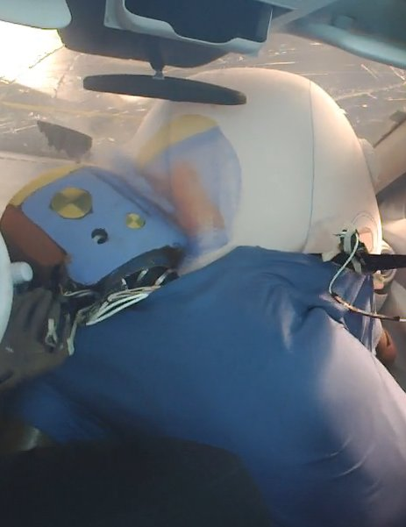
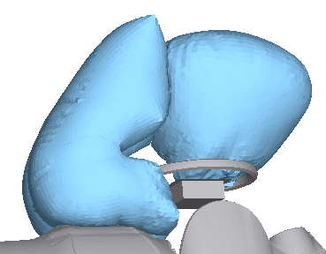
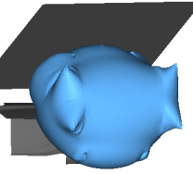
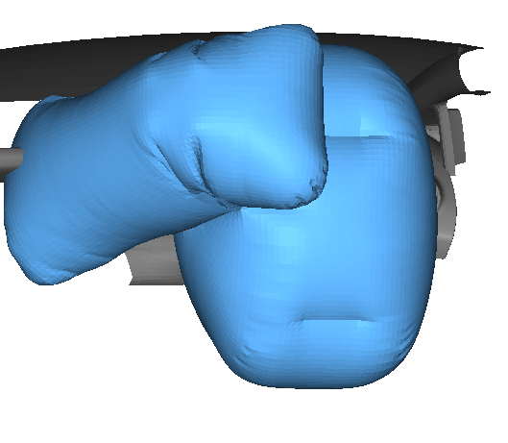
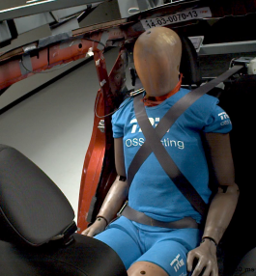
Oblique Offset Research Program
Fatalities still occurring despite airbags and safety belts
In Oblique and Corner Crashes Occupant Misses Airbag
Tall Narrow Object, 13%
50%
45%
Chest
Other, 7%
40%
Vulnerable Occupants, 12%
Severe, 40%
35%
Head
30%
**
25%
Percentage of AIS 3+ Injuries
20%
**
15%
**
10%
**
**
Underride, 14%
5%
0%
IP
SW
Corner Oblique, 3%
Airbag
Belt
Door
Roof Rail Side
A-pillar
B-pillar
Oblique, 11%
Corner, 10%
Need Test Procedure to Address Injuries and Non-frontal Kinematics
Human-like response
  Neck that bends, twists, and stretches for realistic head motion
  Flexible spine to allow proper upper body motion
Advanced instrumentation
  Ribcage motion at four locations and three dimensions
OMDB
THOR-50M
Non-frontal Kinematics and Contacts Produced by Test Procedure
Driver Kinematics
Passenger Kinematics
Head passes between frontal and side airbag
Contact IP
Countermeasures to Address Non-frontal Kinematics

