Slide 1
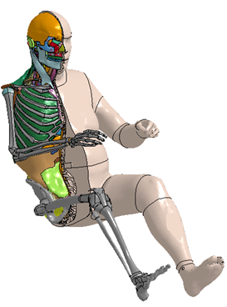
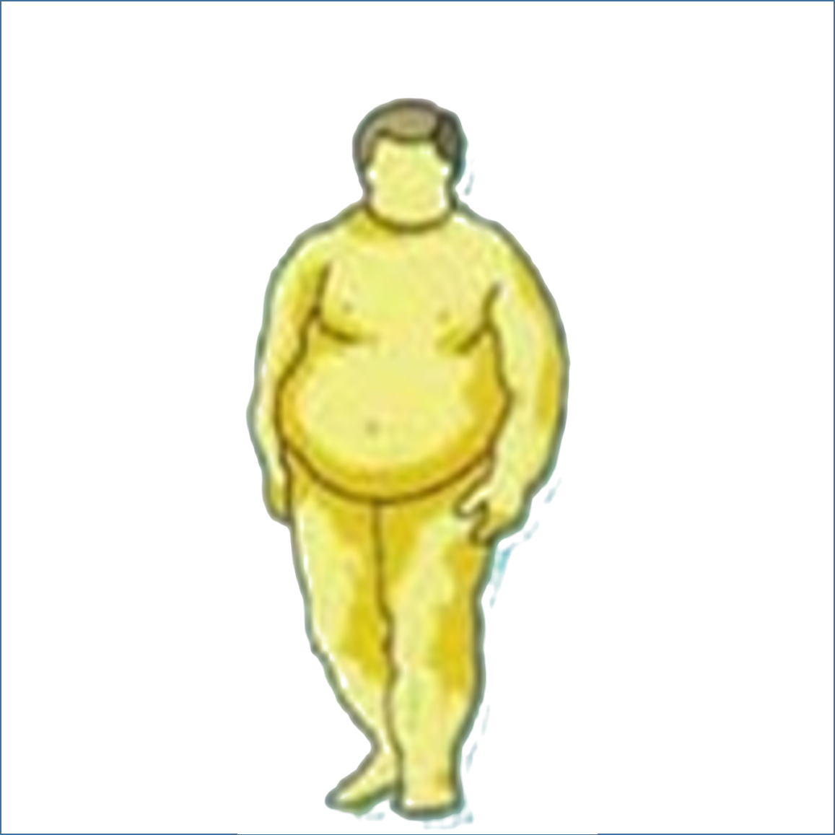
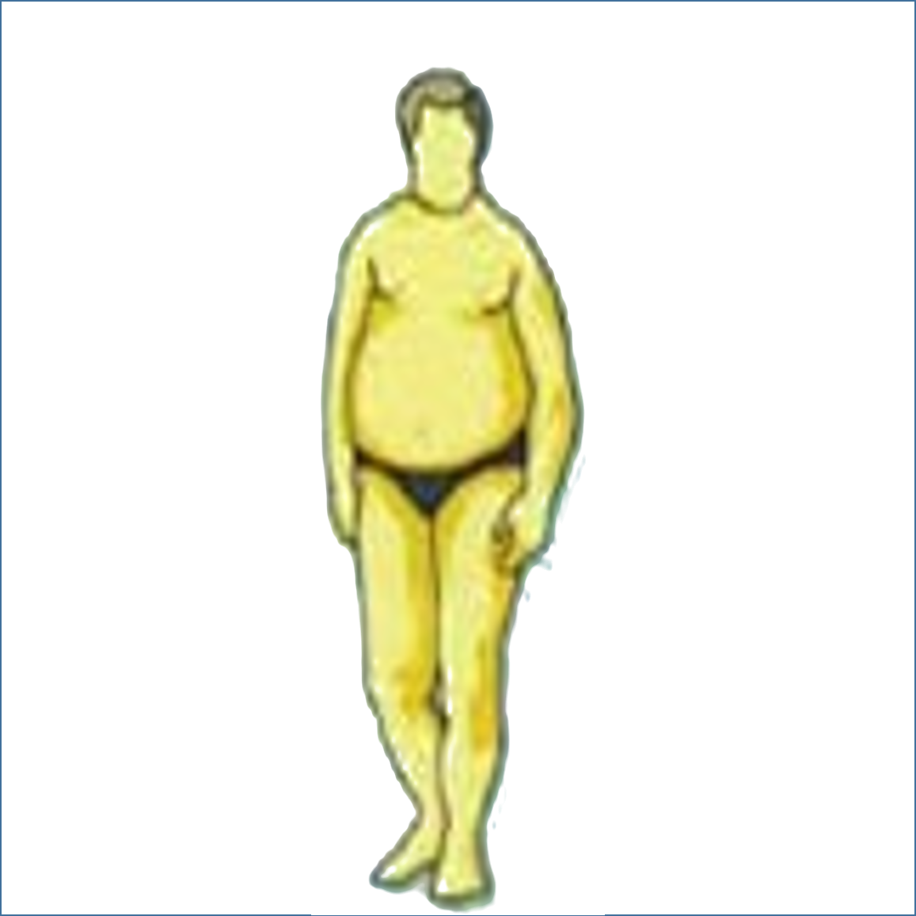
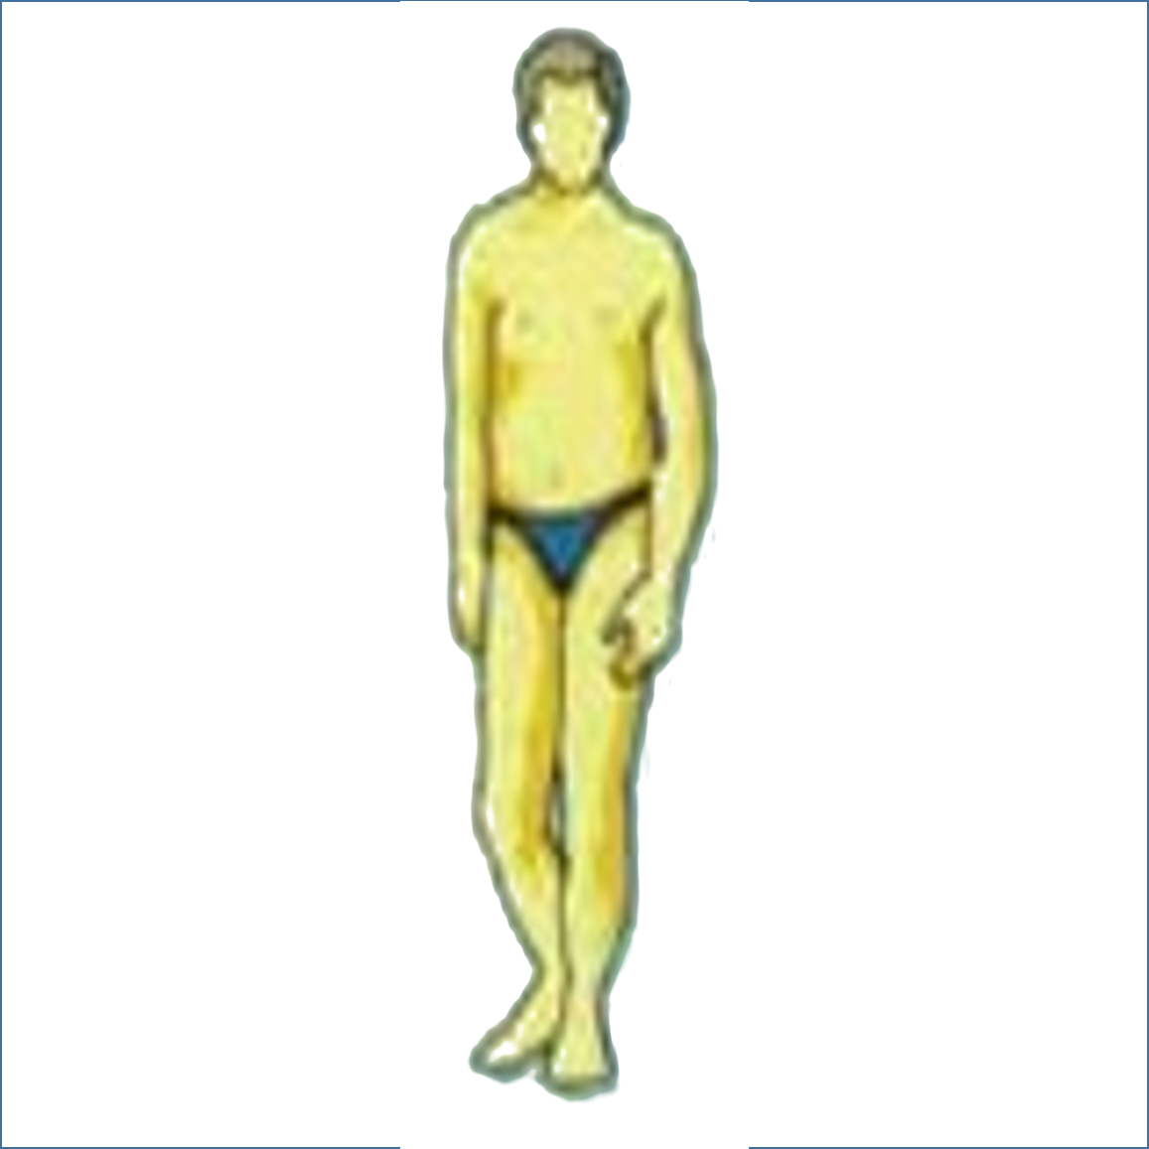
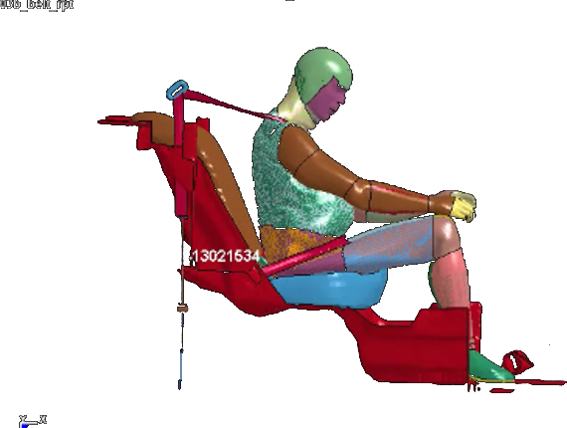
Restraint Design for Obese Occupants
Objective
Evaluate occupant restraint design changes that can provide improved safety performance for a wide range of occupant BMIs’
Evaluate restraint design changes impact on normal BWI occupants
More likely to die or injure in car crash
Human Body Model

