Slide 1
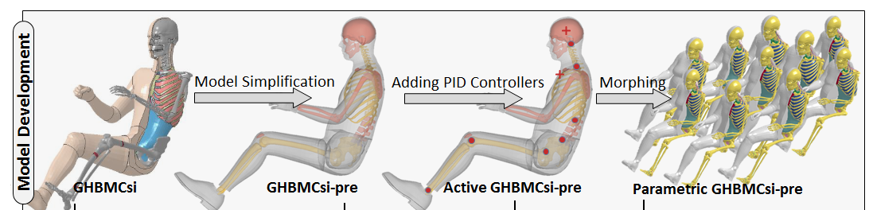
Integrated Safety
Objective
  To gather data on naturalistic responses of vehicle passengers to vehicle maneuvers, including hard braking and rapid steering.
  To develop an efficient, parametric, and active human model to accurately predict occupant pre-crash kinematics in response to different types of vehicle pre-crash maneuvers.
  To develop a tool to position the detailed human body model in a detailed vehicle crash model
Hard Braking
Turn and Brake

