Slide 1
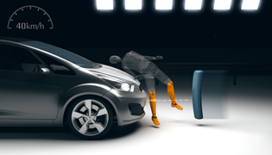
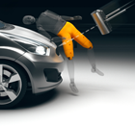
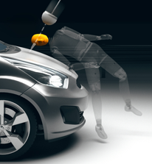
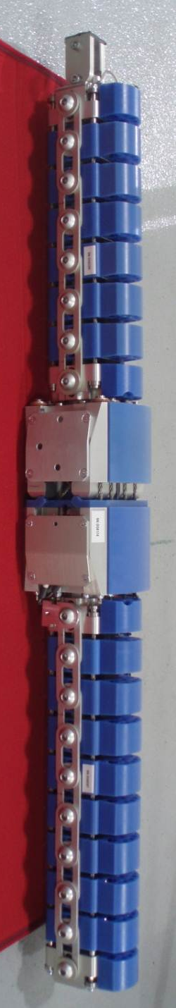

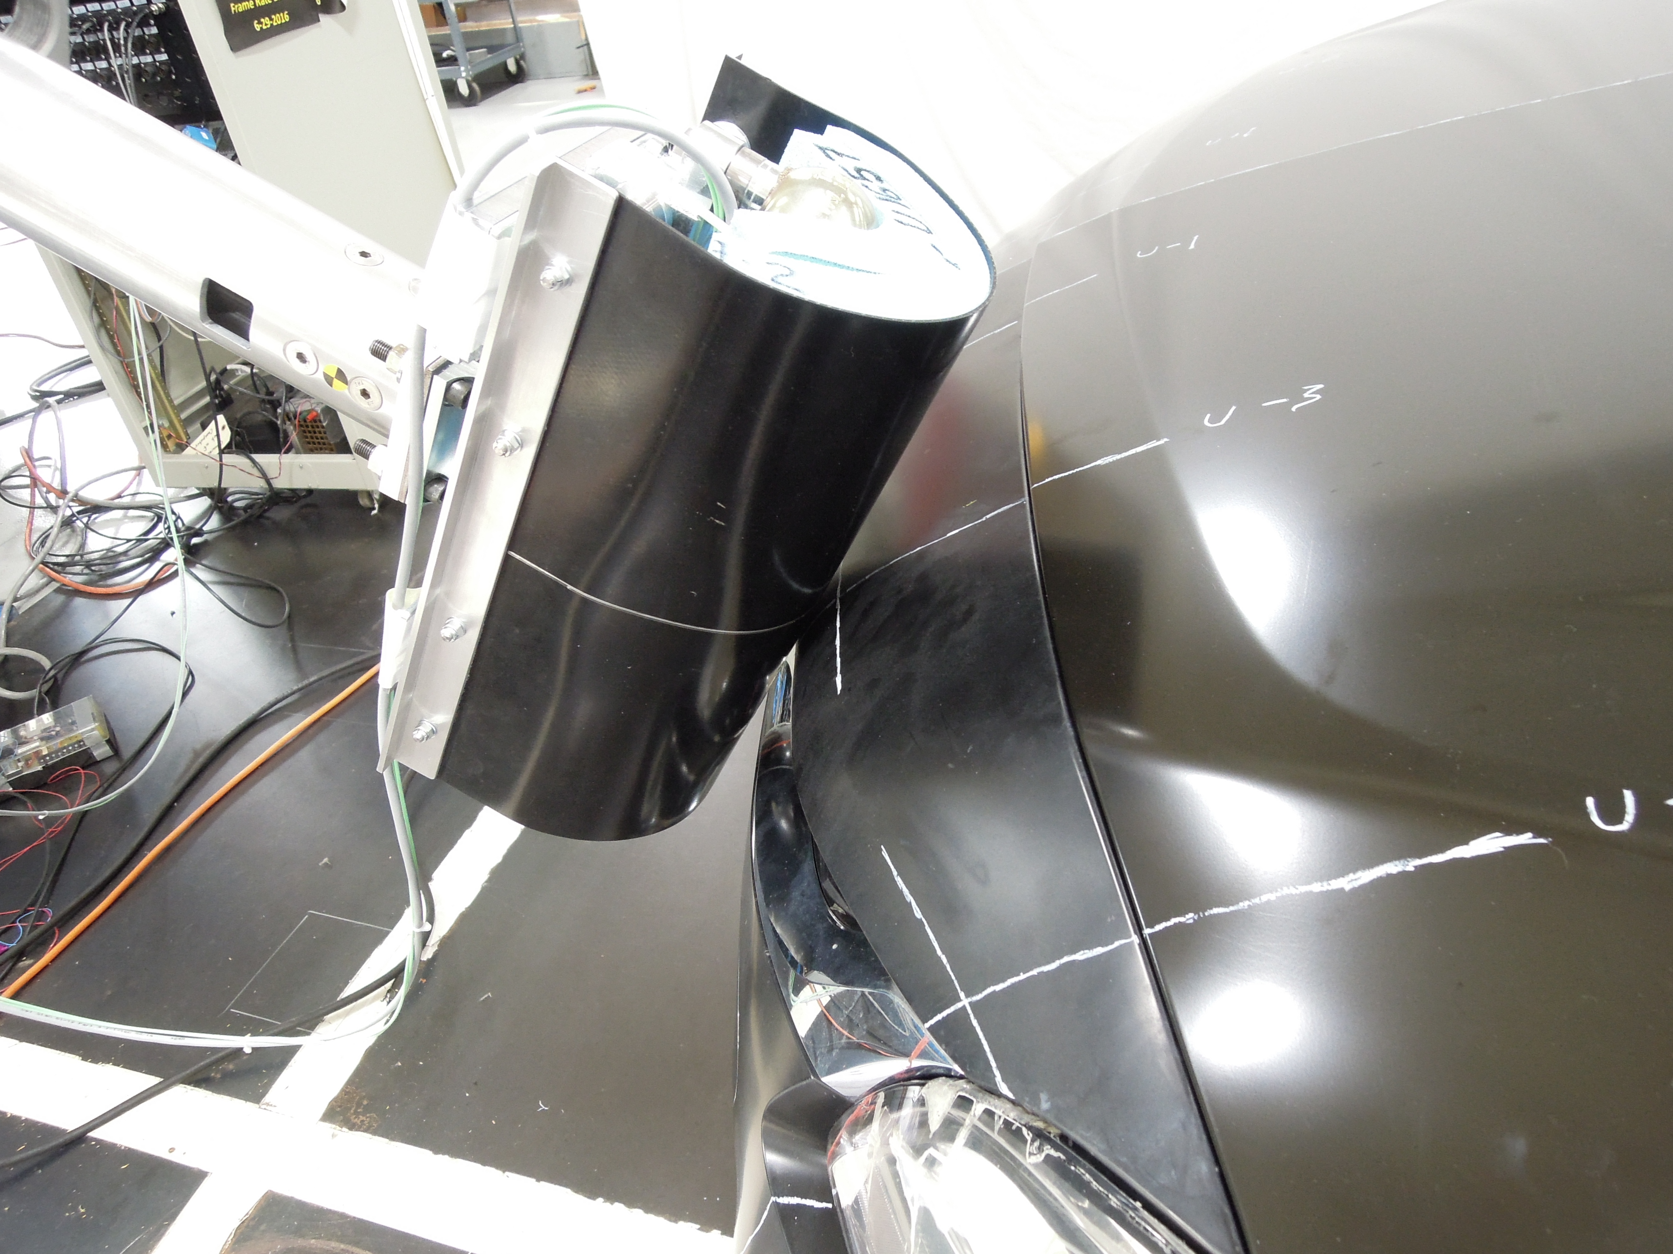
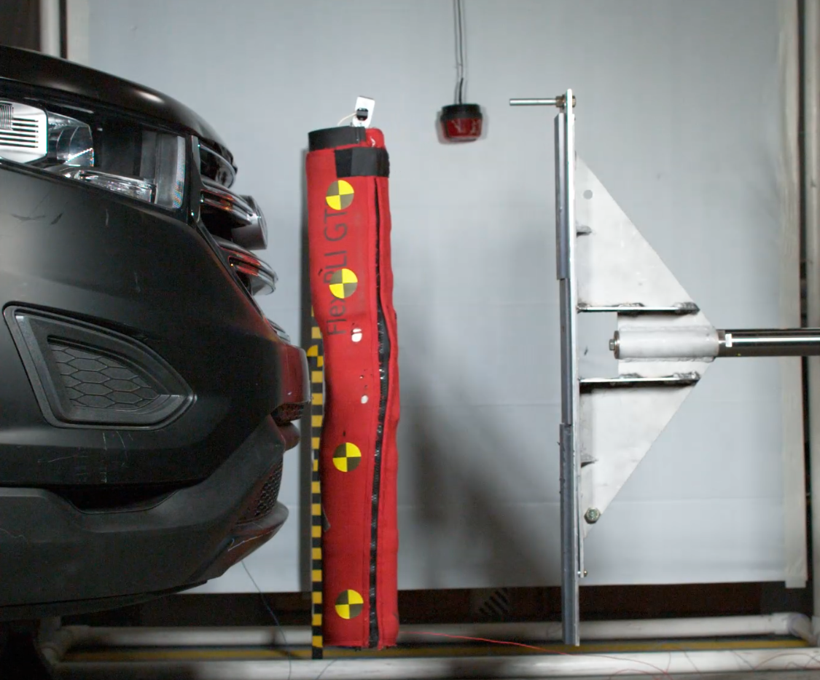
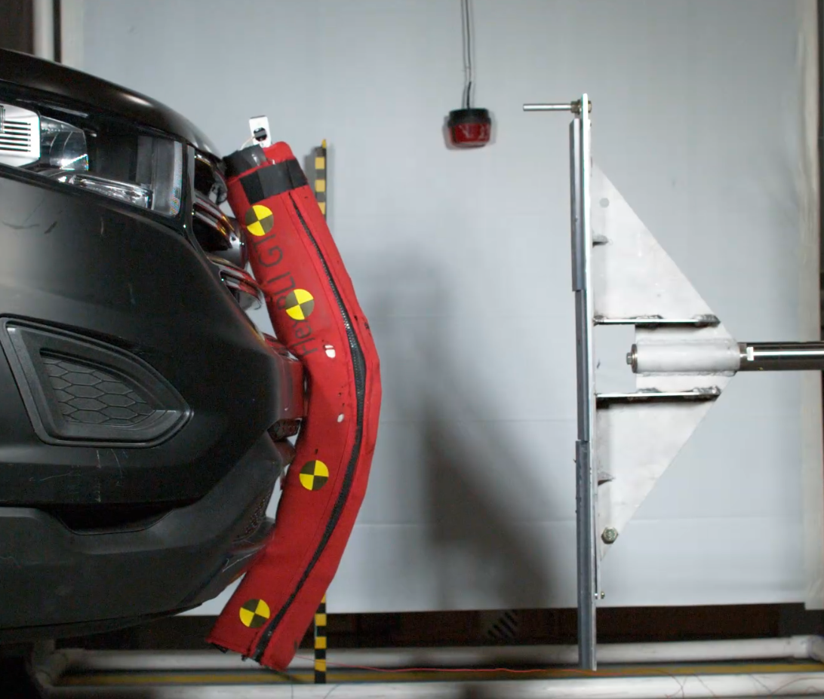
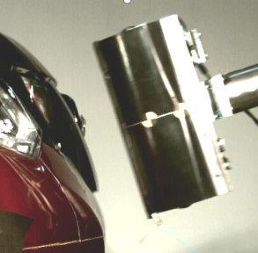
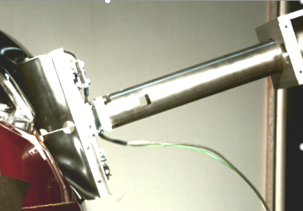
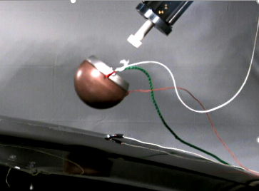
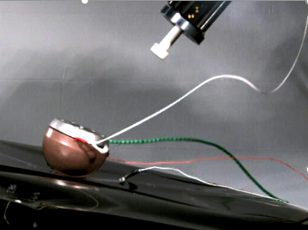
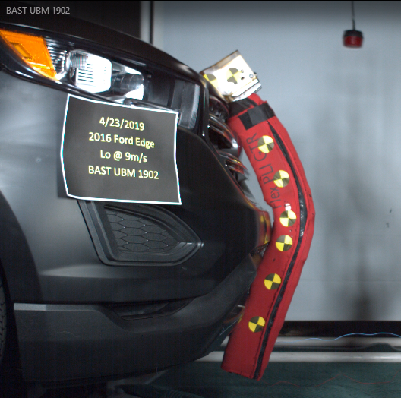
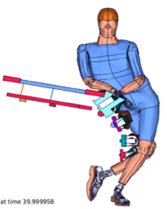
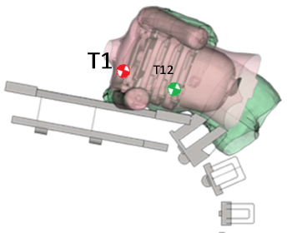
Pedestrian Biomechanics & Crashworthiness
1970s-80s: Seminal research to understand how pedestrian kinematics are affected by vehicle geometry and how head injury risk is affected by underhood clearance
1990s: International collaboration to examine the relationship between vehicle contact sources and injuries to various body regions; develop harmonized test procedures to measure head/leg injury risk
2015 – Present: Research and testing to evaluate, finalize, and document tools and test procedures for US vehicles
2000s: Vehicle testing and research to evaluate US fleet performance using newly developed test procedures/tools
2010-2015: Testing to assess industry-proposed amendments to test procedures
LOWER LEG/KNEE
is most common pedestrian injury
Tool: FlexPLI
PELVIS/UPPER LEG is a common injury with larger vehicles especially
Tool: EEVC/TRL upper legform
HEAD is most common serious/fatal injury
Tools: Adult and child-sized headforms
FlexPLI is a durable & repeatable tool
Found that front end designs can be both pedestrian-friendly and limit cosmetic damage in low speed bumper impacts
Determined that global platform vehicles tend to do better than US-only vehicles
Legform is a durable & repeatable tool
Smaller vehicles performed better than larger vehicles, reflecting real world trend
Even though lab-specific measurements & environmental conditions were found to influence test results, VRTC results matched EuroNCAP scores
Headforms are durable & repeatable tools
Observed HIC improvements in newer vs. older MY vehicles; trying to link to real world data (see below)
Safety benefit provided by active hoods varies by vehicle in laboratory; unclear from real world data
Very good lab-to-lab consistency in global platform vehicles tested at VRTC and EuroNCAP
CURRENT RESEARCH
Advanced Legforms with Upper Body Mass
More accurate femur injury measurement
Replace FlexPLI/upper legform tests with just one test to assess overall leg protection
Analyze Pedestrian Injury Trends
Knee cruciate/collateral ligament injury patterns: is there a need for a cruciate injury metric in the FlexPLI or does a collateral injury metric alone adequately protect the cruciate ligaments?
Prevalence of pedestrian countermeasures in U.S. vehicles: are newer model year vehicles less likely to produce serious/fatal injuries than older model year vehicles?
Assessment of Pedestrian Thorax Injury
Are vehicle countermeasures that protect the head/leg also reducing thoracic injury risk?
Experimental approach to evaluate thorax risk
Integrated Assessment of CA/CW Technologies in a Vehicle
How do crash avoidance technologies (pre-crash warning systems) and crashworthiness countermeasures work together in a given vehicle to reduce injury severity?
Assess CW countermeasure performance at various levels of CA effectiveness to get an overall pedestrian performance picture
For more information see Docket ID NHTSA-2019-0112 NHTSA Crashworthiness Research – Pedestrian Protection Documentation

