Slide 1
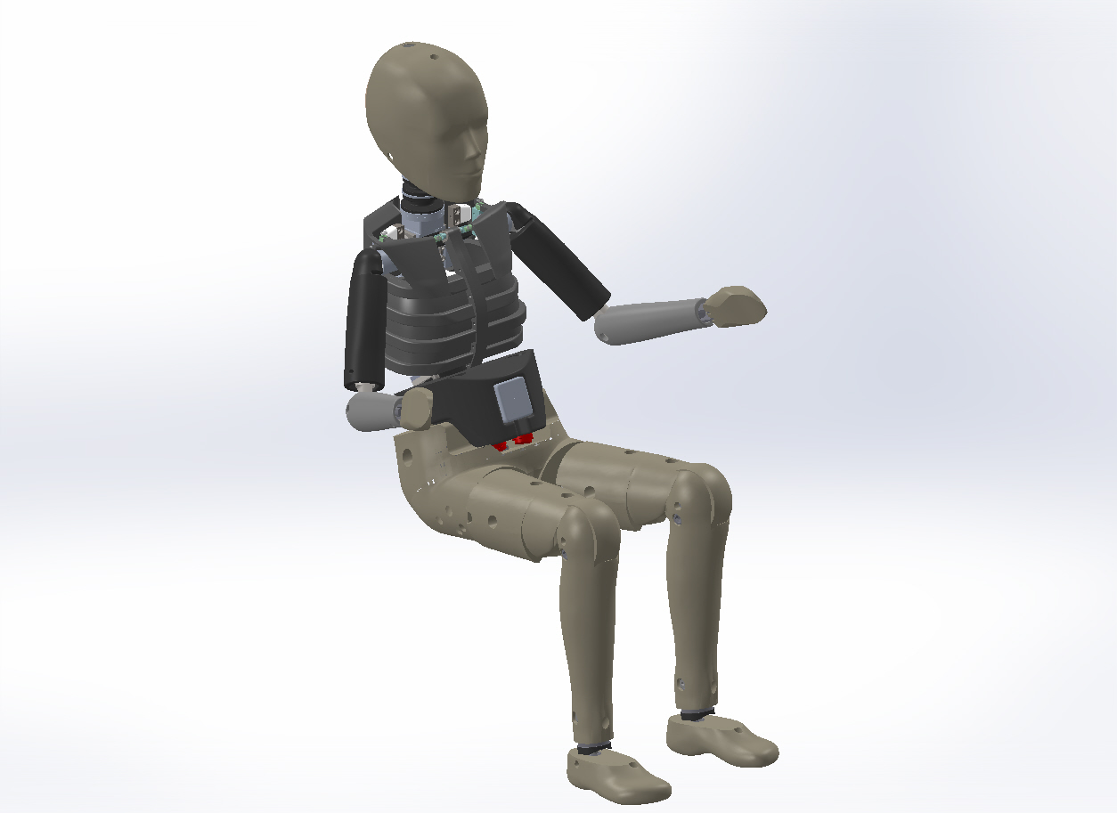
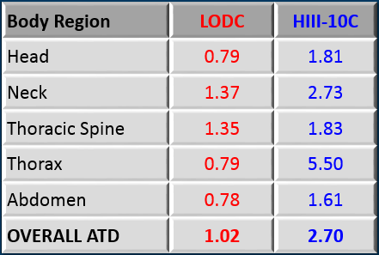
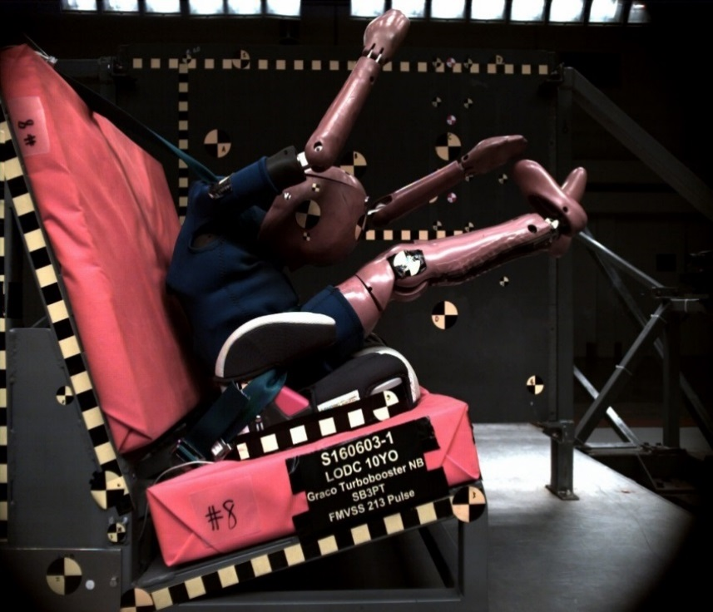
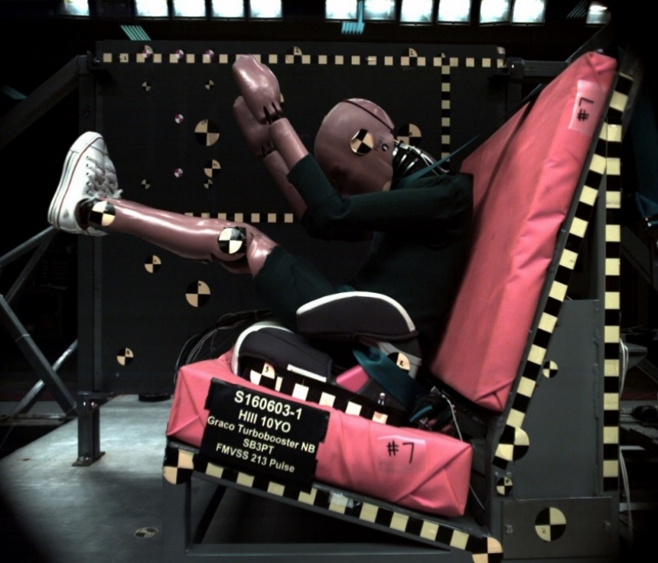
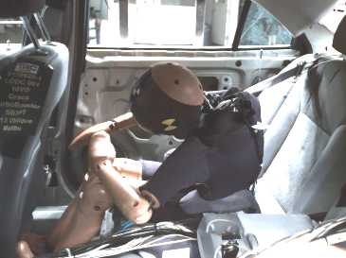
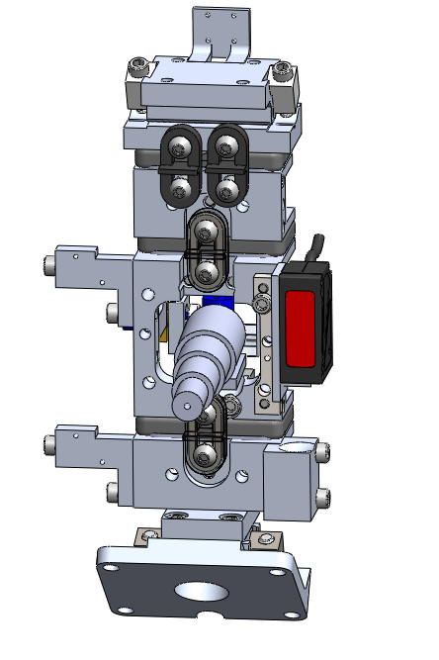
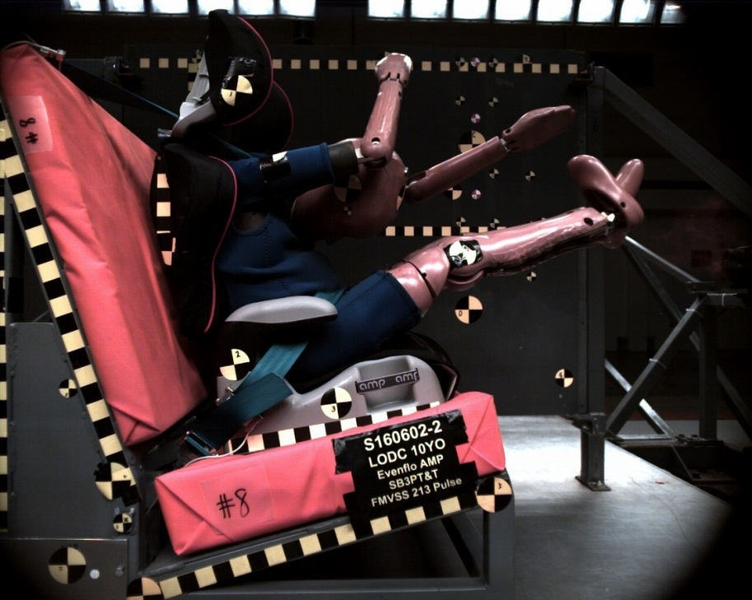
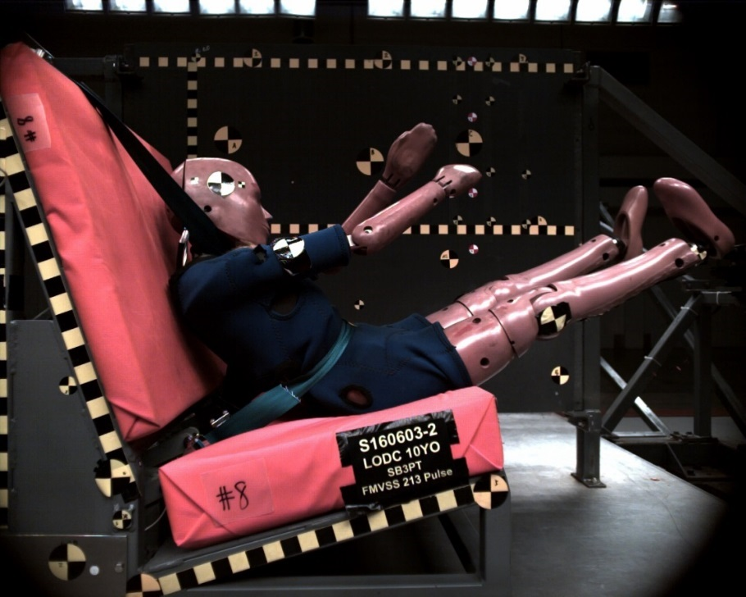
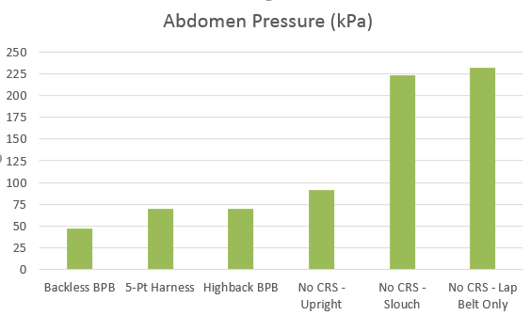
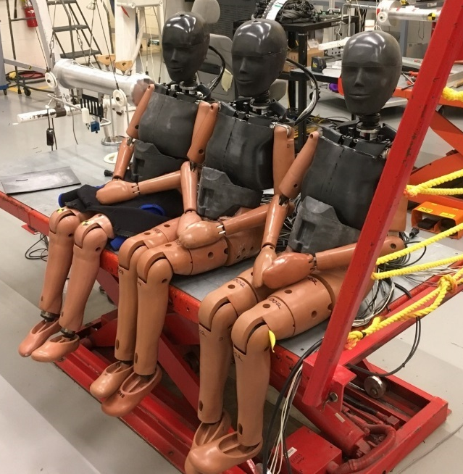
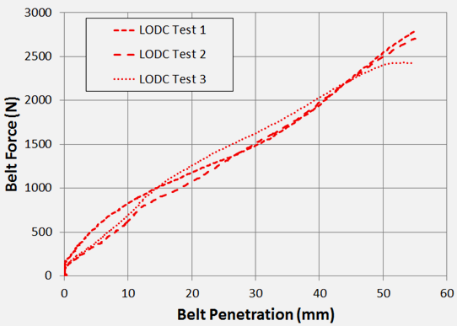
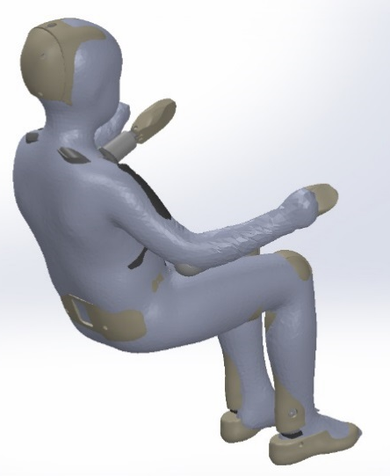
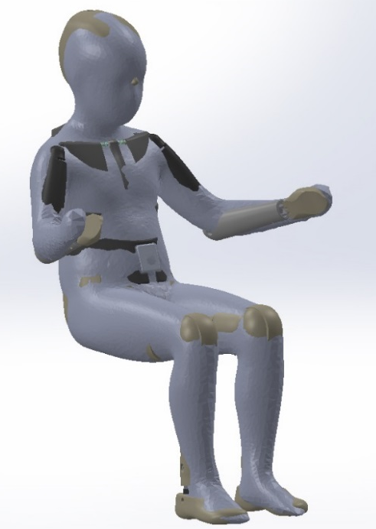
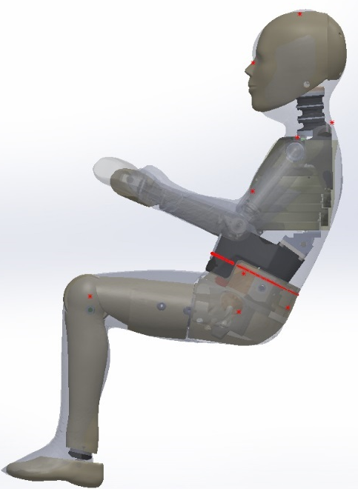
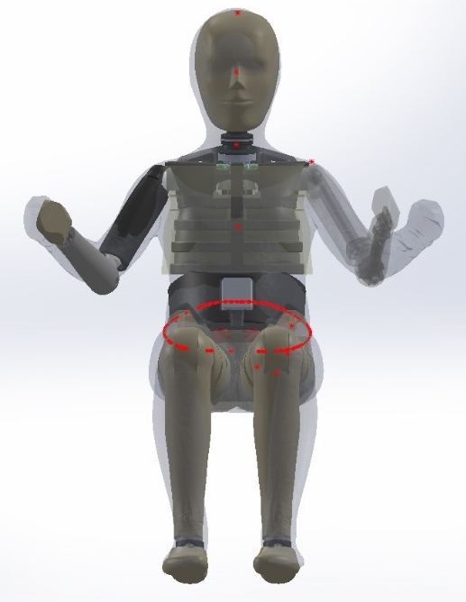
Large Omnidirectional Child (LODC) ATD
The Large Omnidirectional Child (LODC) anthropomorphic test device (ATD) is the first ever child ATD designed and built fully in-house by NHTSA. It has features such as a flexible thoracic spine, human-like ribcage, and instrumented abdomen that make it behave more like a large child occupant than other 10 year old sized child ATDs currently used to evaluate both booster seat and vehicle rear seat restraint systems. Because of this improved biofidelity, the risk of injuries that are typical for improperly restrained children can be more comprehensively assessed by the sensors contained within the LODC. NHTSA is evaluating the LODC in a wide array of test conditions to assure its performance. A finite element model of LODC is also under construction.
Head injuries from contact with the vehicle interior are the most common serious injuries for child occupants. The Hybrid III 10 year old ATD often exhibits hard chin-chest contacts due to a rigid spine. The LODC has a flexible spine as well as pediatric head and neck properties resulting in more realistic head & upper body kinematics:
Overall, the LODC has much improved biofidelity over the Hybrid III 10 year old (lower number means better biofidelity):
LODC
HIII-10C
Abdomen injuries due to lap belt penetration, a situation known as “submarining”, are common for children transitioning from a child restraint system (CRS) or belt-positioning booster (BPB) seat into a vehicle restraint. The Hybrid III 10 year old abdomen is less biofidelic and doesn’t contain any instrumentation to measure injury risk. The LODC abdomen is tuned to match pediatric response and also equipped with pressure sensors that measure the risk of injury:
The LODC shoulder, spine, and ribcage are assembled according to human anatomy, resulting in realistic shoulder belt engagement and load distribution within the upper thorax, in both frontal and oblique crash scenarios. We are evaluating alternative chest deflection measurement systems to more accurately monitor thoracic injury risk:
No submarining (CRS maintains lap belt on pelvis
Submarining (lap belt enters abdomen)
The LODC is soft and flexible enough to be biofidelic while still exhibiting excellent repeatability and durability:
LODC Abdomen Pressure (kPa)
LODC anthropometry is based directly on seated child occupant data:
Submarining was observed (high risk of abdominal injury)
No submarining was observed
For more information see Docket ID NHTSA-2019-0110 NHTSA Crashworthiness Research – LODC Documentation

