Slide 1
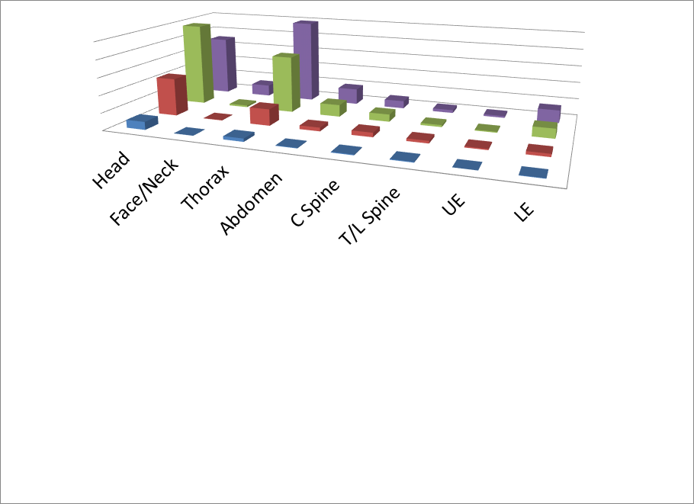
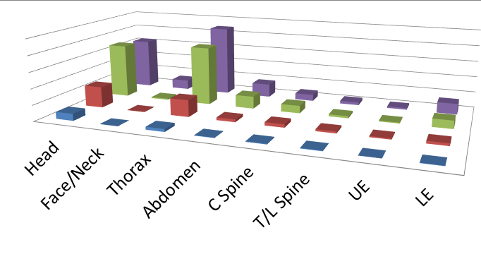


Future of Crash Safety (FoCS) Crash Data Projection Model
Background
Retrospective crash data can be used to identify important safety issues. However, defining future research priorities using retrospective data from the past is complicated by the rapid pace of advancement in vehicle crashworthiness, occupant protection, and crash avoidance technology. The purpose of this research effort is to develop a method to make detailed projections of the nature of future crashes in the US.
Methods
The projected future crash datasets were modeled by making adjustments to each individual weighted case in a retrospective dataset (2004-2015 NASS CDS, NASS GES, and FARS). Adjustments to case weight and outcome were based on:
Inconsistencies and sources of potential error in the source retrospective datasets
Predicted shifts in transportation trends, occupant behavior, population characteristics, and the economy
Estimates of future penetration and effects of safety countermeasures and policy changes
Retrospective Crash Data
Crash Avoidance | FMVSS 126 ESC, 138 TPMS NCAP 2004 Upgrade to Rollover Resistance AEB, FCW, BSD, LDW, LKA Level 3 and 4/5 Automated Driving Systems
Crash Severity Mitigation | AEB with CIB FMVSS 138 TPMS
Crashworthiness & Occupant Protection | FMVSS 202, 208, 214, 216, 226, 301 NCAP 2011 Update (Front & Side Protection)
Infrastructure & Policy changes | Rumble Strips, Red Light Cameras, Cable Median Barriers, Max Speed Limit Increases
2004 - 2015
Adjustments to Source Datasets
Under-reporting low-severity crashes Exclusion of non-towed cases Over-reporting of restraint use Exclusion of CDS cases missing data No injury data in vehicles >9 y.o. (CDS 2009+) AIS Version Change to AIS2005 (CDS 2010+)
Trends
Vehicle type Belt use Child restraint use Population growth Licensure rates Unemployment
Safety Countermeasures
Projected Future Crashes
Projections can be analyzed by almost any of the case/injury characteristics and harm measures available from NASS CDS data
Revised versions of model can be used to explore effect of hypothetical countermeasures or alternative variable predictions
2020
2025
Preliminary Crash Projections 2020-2030
2030
    In 2020-2030, crashes projected to be more frequent but serious injuries less frequent than in 2004-2015. Example results:
    Intersection crashes (Crossing Paths & Left Turn Across Path/LTOP): Frequent, harmful, & projected to continue increasing
    Frontal, Side, & Oblique Crashes: Expected to continue to be associated with majority of injury/harm in the future
    More older occupants with serious injuries expected in future, but fewer seriously injured younger occupants
By Pre-crash Scenario
By Impact Direction
By Occupant Age
Notes:
Changed first sentence of background; made the three necessities for each countermeasure red font so that everything associated with countermeasures is in red;
AM: I have to admit I kind of preferred it in black … makes it stand out more as “methods” description and not get lost in the cloud of countermeasures. But I defer to the poster presenter who is going to have to explain it 100 times ☺.
Combined ‘FMVSS Updates’ & ‘NCAP Upgrades’ into ‘FMVSS & NCAP Updates’, similar to the research slide. Then moved some countermeasures around to fit on the poster.
I’m thinking it would be more clear to encompass all blue trends in one giant blue box (including the bigger font word “Trends”); also put each individual trend in a small blue box to clearly separate them from one another. Same concept for countermeasures in red.
AM: I spent crazy amount of time making the individual boxes and just couldn’t get them to look right. (The boxes amplify any imprecision and if they weren’t all aligned in straight lines they looked really messy.) So this version has wider spacing among all the listed trends and CMs, as well as the giant cloud box but no little boxes. If you still think they need the individual boxes (I’ve been staring at it too long to have any opinion), let me know and I’ll enlist the help of somebody more graphically inclined to do it properly! Let me know also if you think my giant boxes need professional help!
AM: All my text changes are highlighted. The “crash, vehicle…” was just to make the lists consistent with each other. In final bullet, revised without the word hypothetical (partly in response to Nat’s comments on slides but also I just like it better).
AM: Looking for alternative to the “is difficult due to” phrasing. Difficult doesn’t seem like a reason not to do something and it also sounds awkward to my ear. I’m trying to think of something that gets at fact that retrospective data is just not very effective for this job. I keep coming back to things like “complicated by” (Allison’s current vote, I think), “stymied by”, “rendered ineffective by”. I have temporarily changed the text ere to the “made less effective by” phrasing that is consistent with Nat’s slide.
AM: I threw in a VRTC/TRC by-line just to see where it would fit if we were to addd it. Delete at will.

