Slide 1
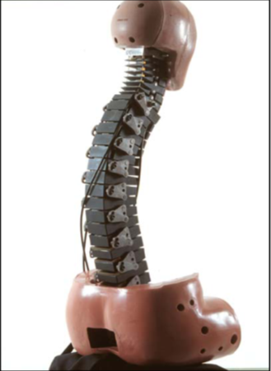
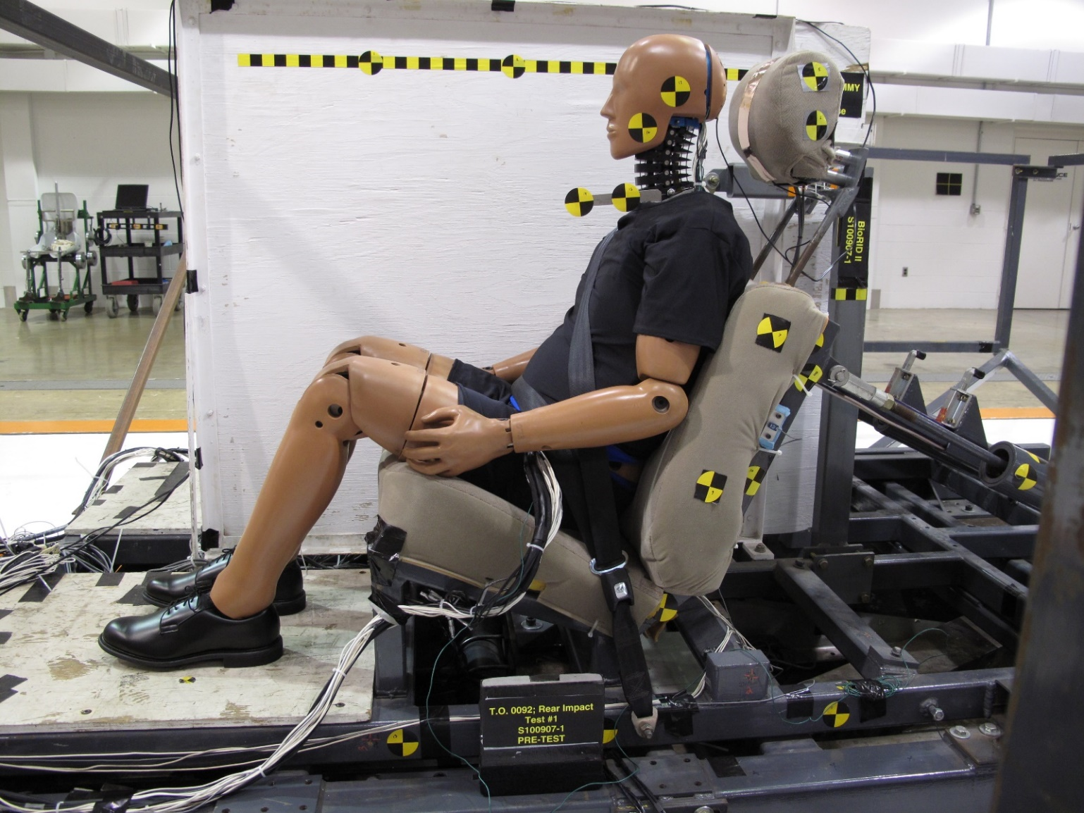
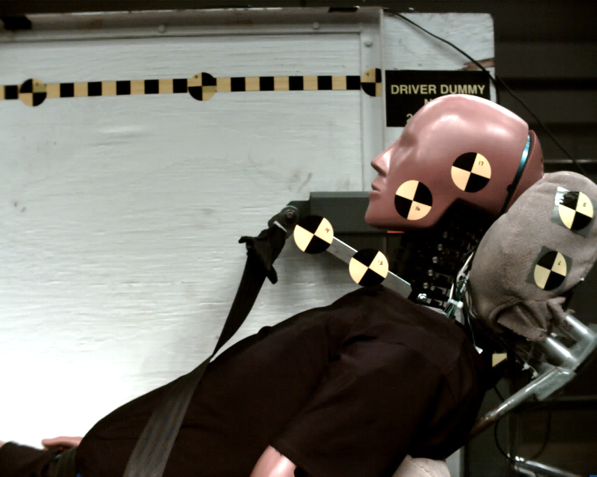
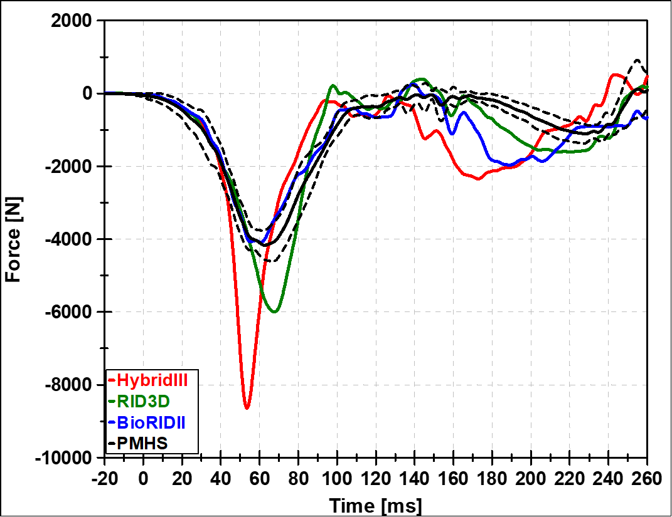
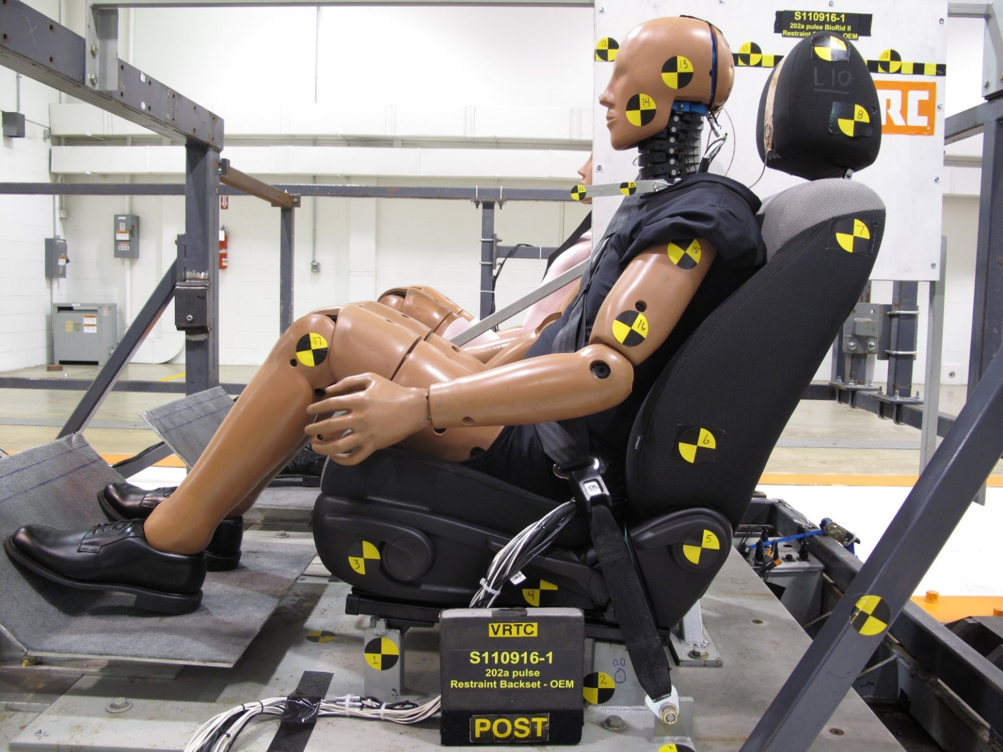
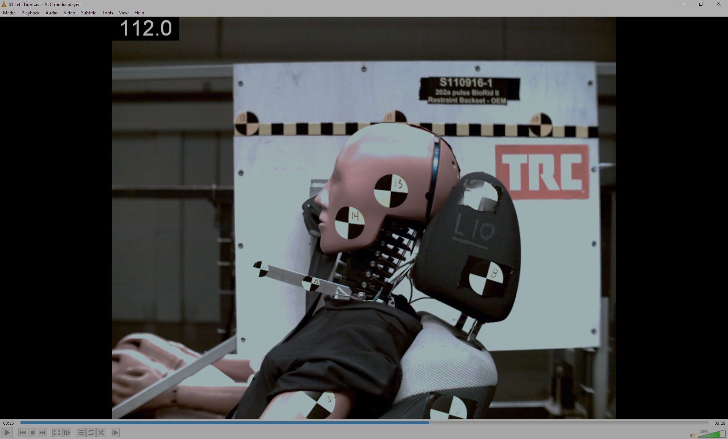
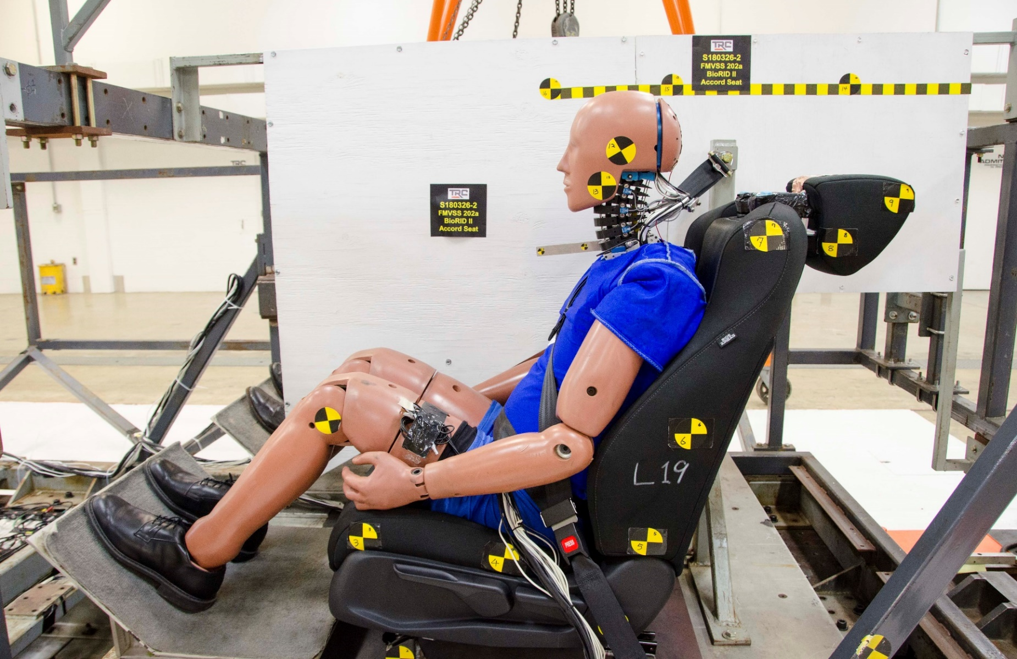
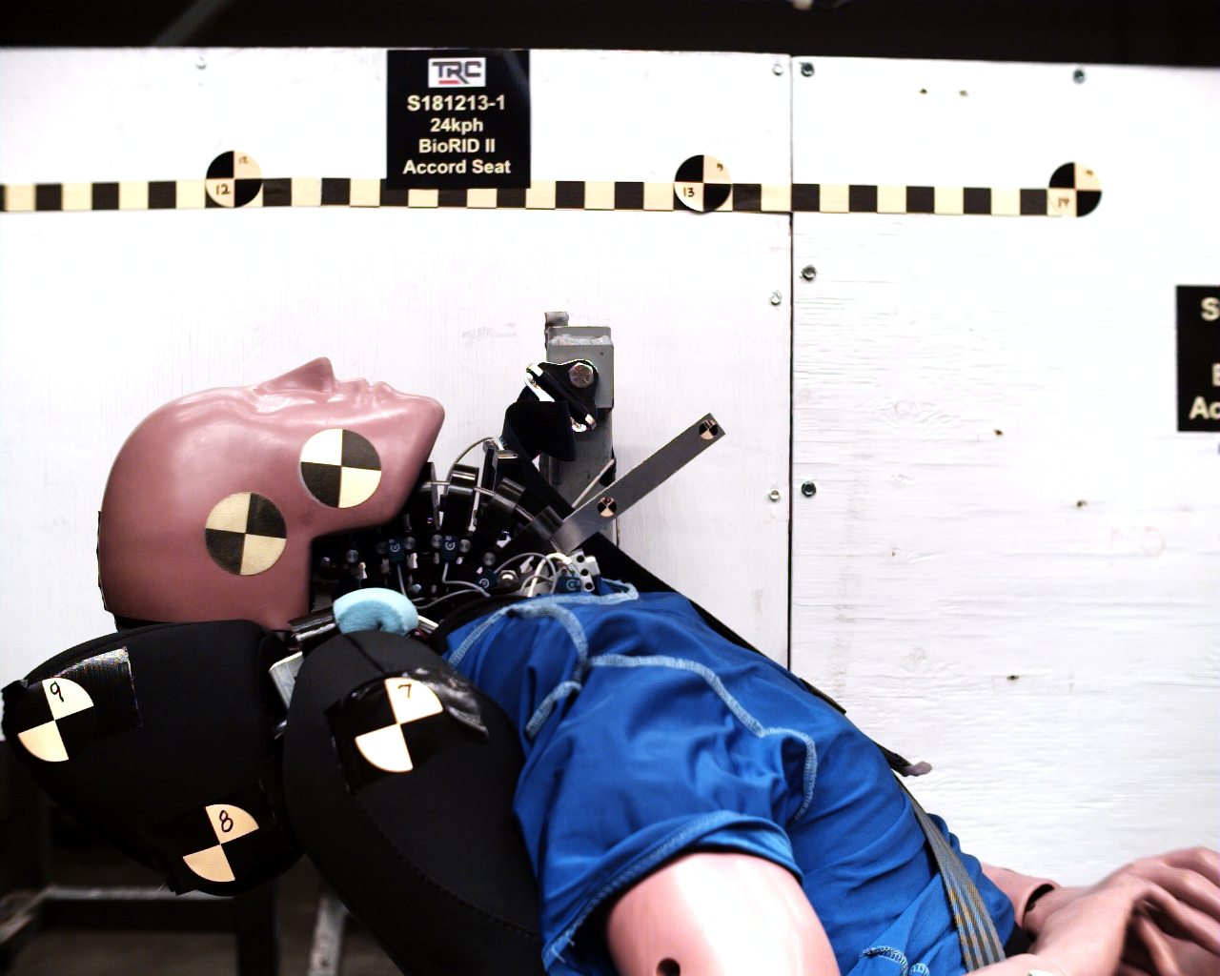
BioRID II ATD
The BioRID anthropomorphic test device (ATD) is a 50th percentile male ATD designed for low speed whiplash testing that uniquely integrates a fully articulated spine into its design. The fully articulated spine incorporates elastomeric elements between the vertebrae that simulates muscles and discs. This specialized spine design allows the ATD to respond very similarly to a human during rear impacts, and provides an accurate assessment of injury risk. Evaluation of the BioRID has included rear impact sled testing that utilized a custom-built experimental seat, production seats from various manufacturers, and production seats with modified head restraints.
Modern head restraints are designed to reduce whiplash injuries based on response data collected from the HIII 50th ATD, but this ATD wasn’t specifically designed to respond like a human during low-severity rear impacts.
The BioRID’s lifelike spine design allows the neck to move similarly to a human’s while simultaneously promoting realistic interaction between the seat back and the ATD (see biorank scores in the bottom right figure). These design considerations improve the potential for the detection of whiplash injury when evaluating head restraint design.
BioRID Features
7 cervical (C1-C7) vertebrae
12 thoracic vertebrae (T1-T12)
5 lumbar vertebrae (L1-L5)
Instrumentation that can measure intervertebral rotations, spine and neck forces, and accelerations at key locations in the ATD.
Elastomer blocks glued to top of each vertebrae to simulate
compression/resistance of muscles and discs
Cables in neck to adjust neck tension
Lifelike thoracic flesh with fluid filled abdomen
Seatback Loading Results
BioRID Evaluation in a Custom-built Experimental Seat
Peak Rotation During Evaluation
ATD Type | Score (lower is better)
Hybrid III | 3.35
RID3D | 1.82
BioRID | 0.74
BioRID Evaluation in a Production Seat
Peak Rotation During Evaluation
PMHS
BioRID
RID3D
HybridIII
BioRID Evaluation in a Production Seat With Modified Head Restraint
Peak Rotation During Evaluation
For more information see Docket ID NHTSA-2019-0111 NHTSA Crashworthiness Research – BioRID II Documentation

