Slide 1
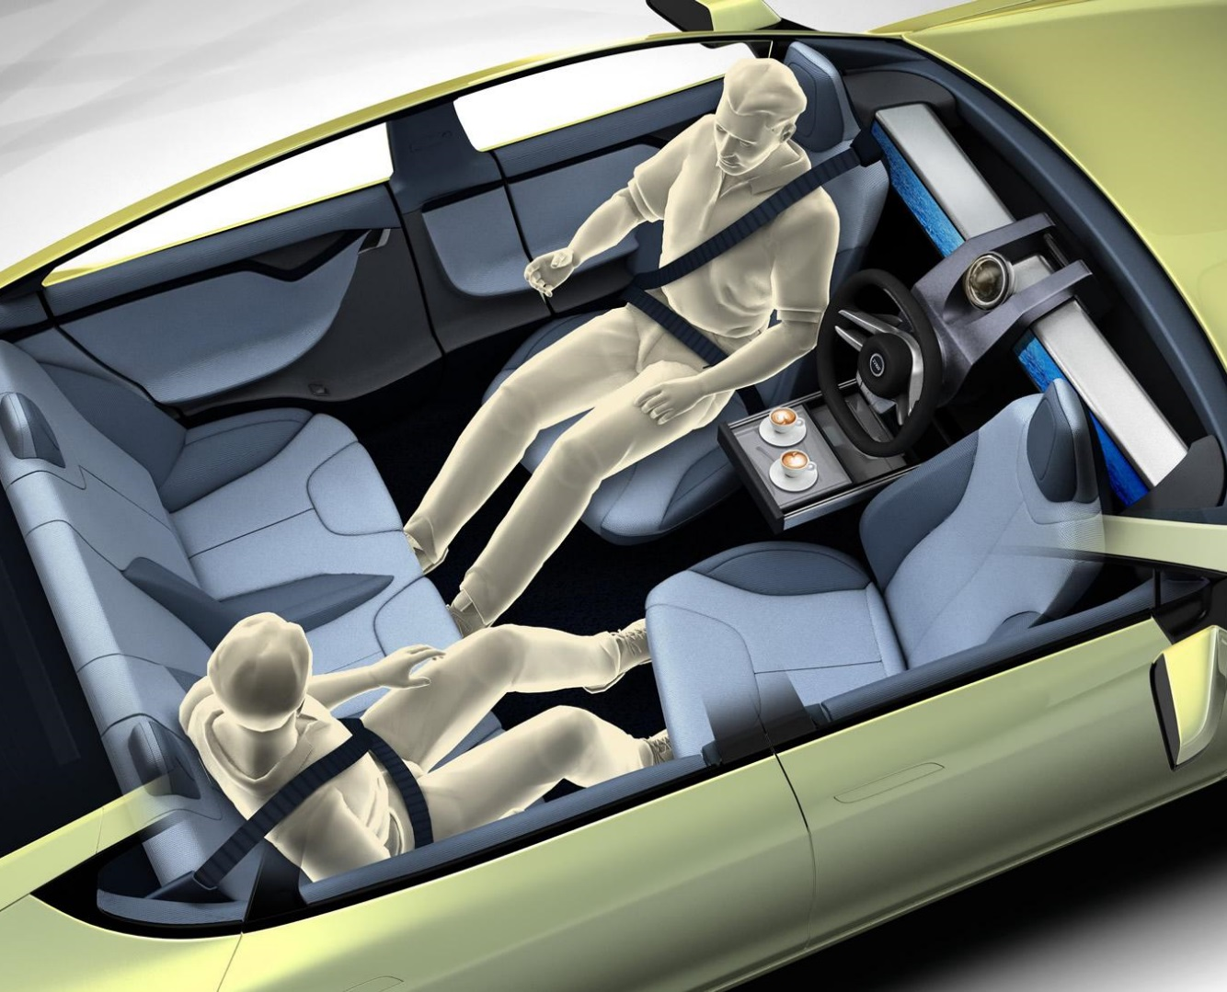
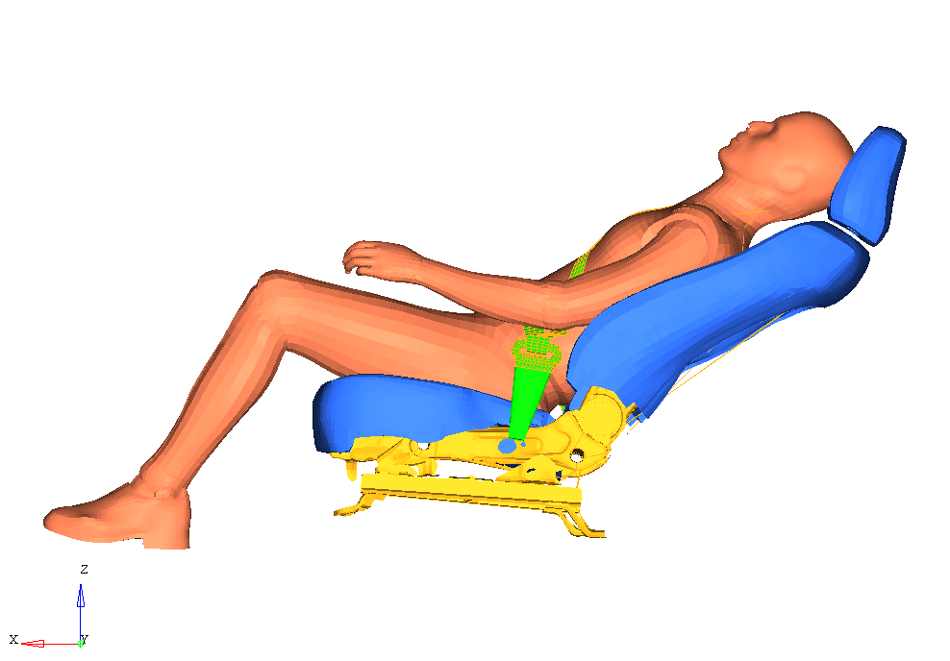
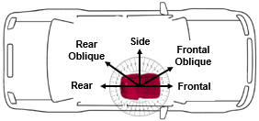
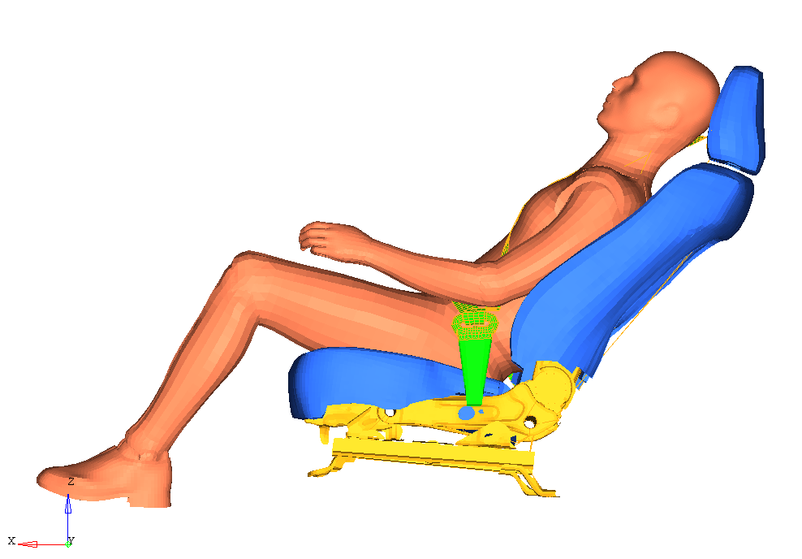
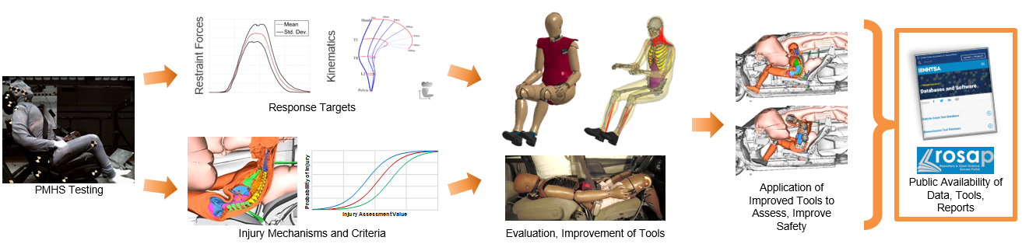
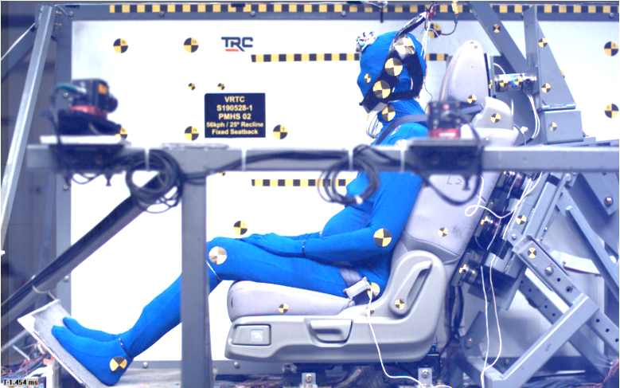
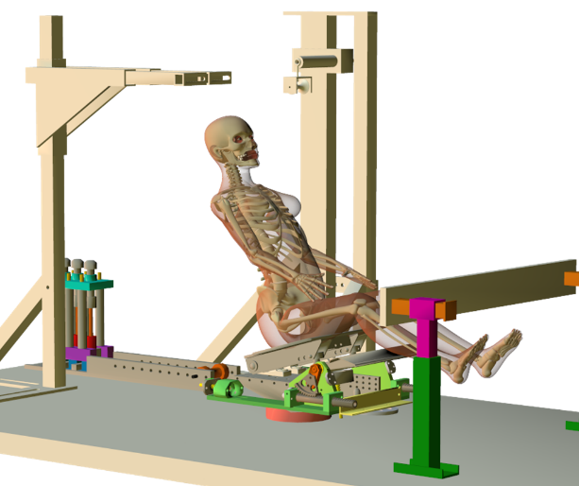
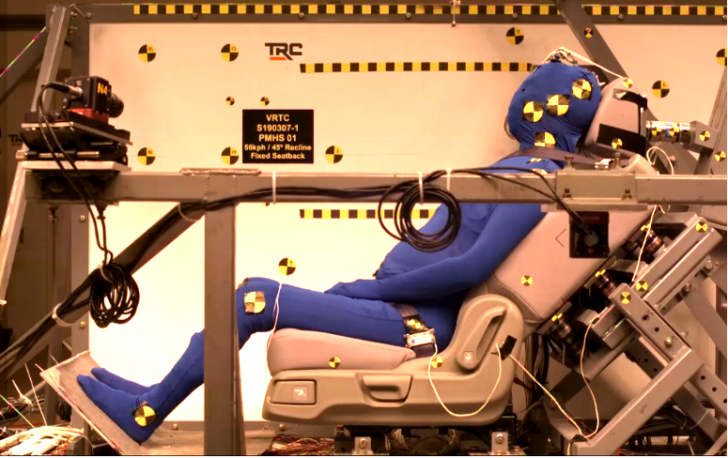
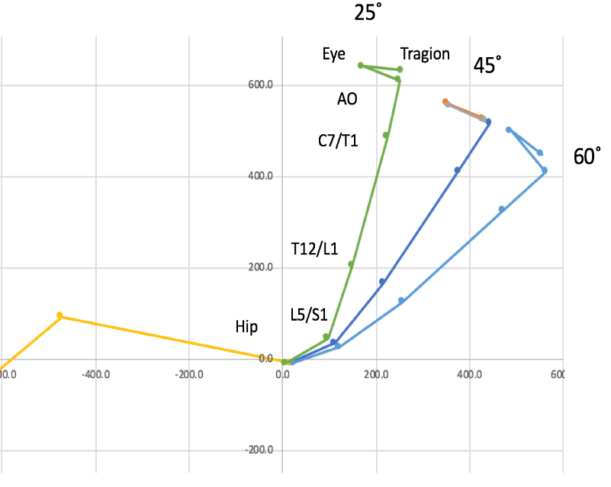
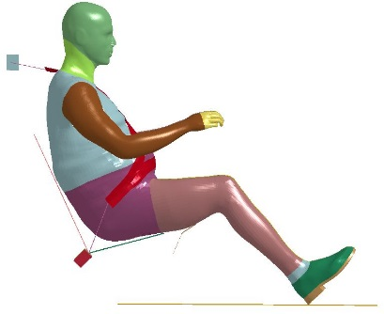
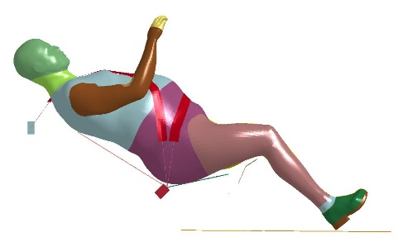
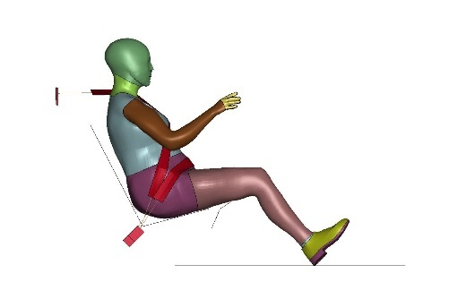
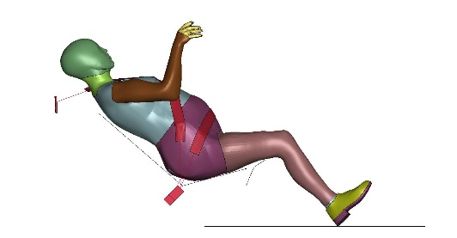
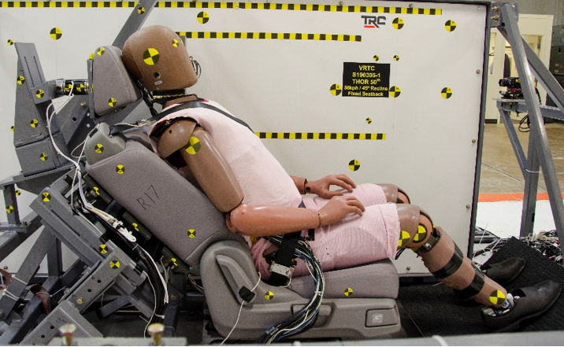
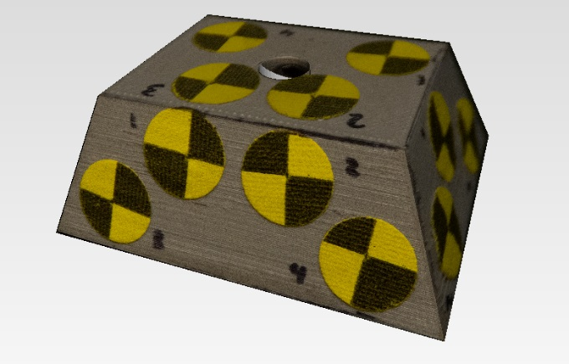
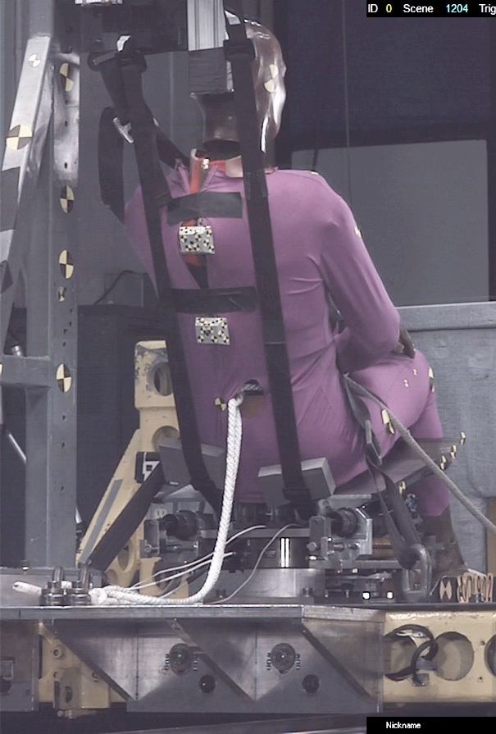
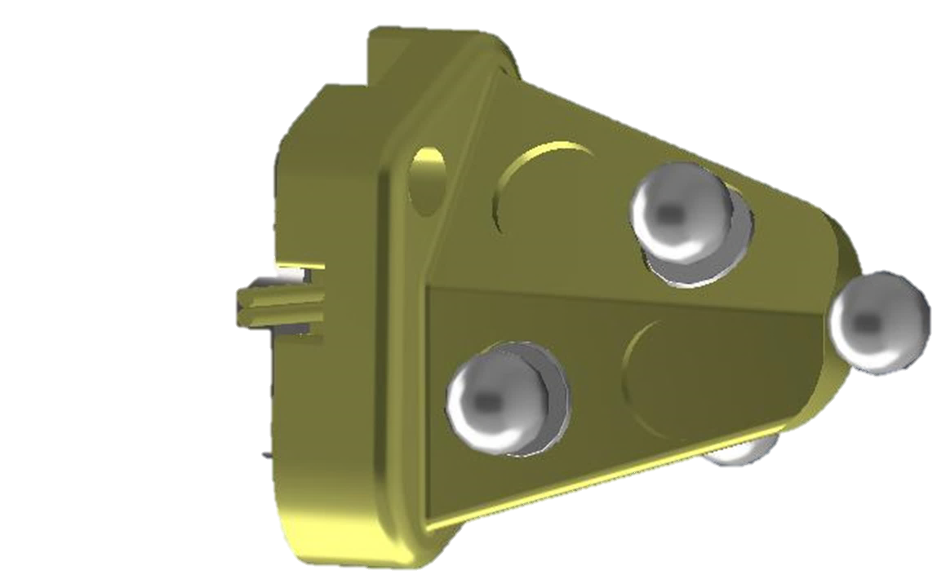
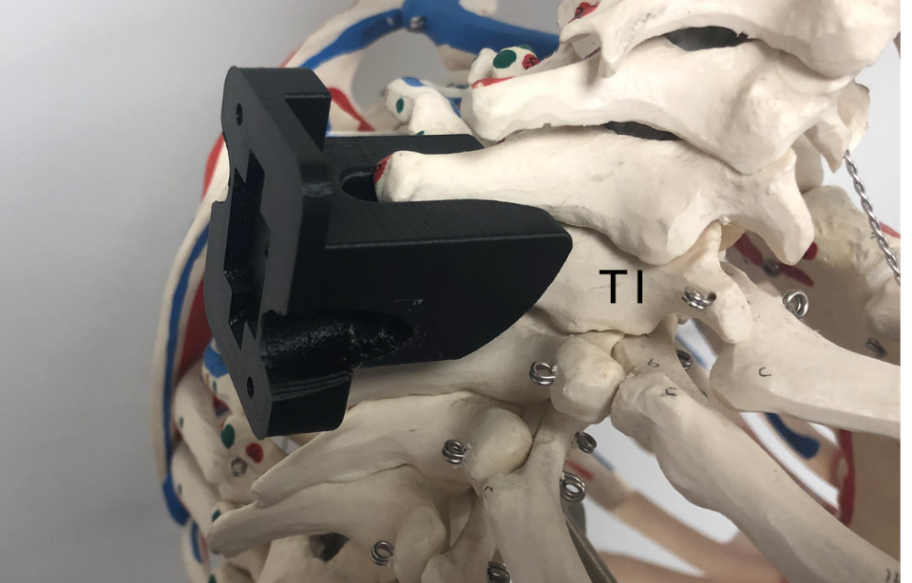
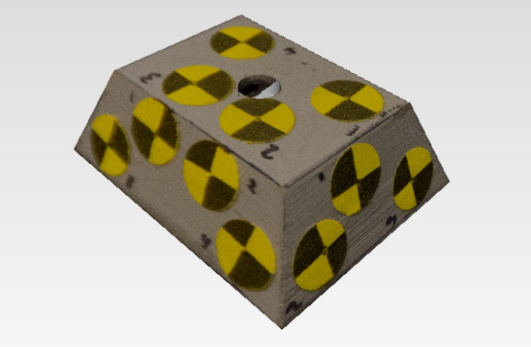
Crashworthiness of Vehicles with Automated Driving Systems
Crashworthiness tool development/evaluation for non-traditional seating configurations
NHTSA is investigating existing computational models and crash test dummies in the most likely scenarios: reclined seating for both forward and rear-facing occupants for different impact severities
Biofidelity of tools to be modified as needed to provide optimal injury risk assessment given new post-mortem human surrogate (PMHS)-based biomechanical data
NHTSA sponsoring three research projects to generate new biomechanical data:
(1) rear-facing, (2) forward-facing, and (3) forward-facing for occupants vulnerable to submarining/abdominal injury.
NHTSA’s Research Approach
Rear Facing Reclined
Forward Facing Reclined
Phase I: 50th Percentile Male
Forward Facing Reclined
Phase II: Vulnerable Occupant
Test Configuration
Fixed seatback for repeatability
2018 Honda Odyssey 2nd Row
Instrumented to measure seat forces
Adjustable recline angle & PDOF
Allows for production seats & restraints
Test Matrix
15 PMHS tests
Delta V: 24 km/h or 56 km/h
Seatback Angle: 25° or 45°
Key Outputs
Data from PMHS tests
Data from ATD tests
Biofidelity corridors
Injury assessment
Matched-pair ATD tests
THOR-50M
Hybrid III 50th
BioRID
LODC
PMHS, 25° Seatback
Inclusion Criteria
Age ≥ 18 years
170 ≤ Height ≤ 181 cm
18.5 ≤ BMI ≤ 30 kg/m²
Test Configuration
Adjustable, open seatback
Adjustable, padded knee bolster
Spring-controlled seat
Test Matrix
24 PMHS tests
Delta V: 32 km/h or 56 km/h
Seatback Angle: 25° or 45°
Restraints: force-limited belt with knee bolster out of contact
Key Outputs
Data from PMHS tests
Data from ATD tests
Biofidelity corridors
Injury assessment
Inclusion Criteria
Obese
Male or female
BMI ≥ 30 kg/m²
Small Female
143 ≤ Height ≤ 157 cm
38 ≤ Weight ≤ 62 kg
Test Configuration
Adjustable, open seatback
Adjustable, padded knee bolster
Spring-controlled seat
Test Matrix
24 PMHS tests
12 obese, 12 small female
Delta V: 15 km/h and 56 km/h
Seatback Angle: 25° or 45°
Restraints: force-limited belt with knee bolster out of contact
Key Outputs
Data from PMHS tests
Data from ATD tests
Biofidelity corridors
Injury assessment
PMHS, 45° Seatback
25°
60°
Obese
THOR-50M, 45° Seatback
Small
Female
TEMA Markers
VICON
Markers

