Slide 1
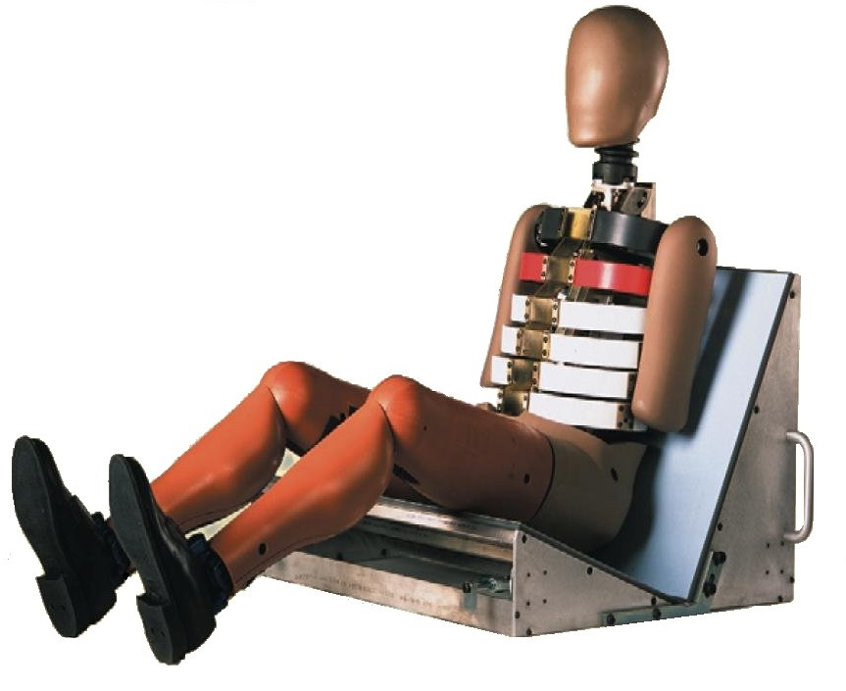
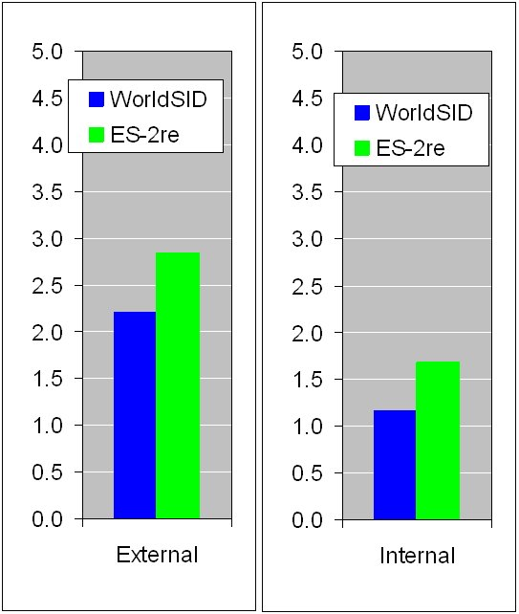
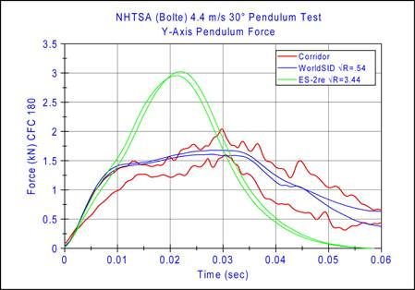
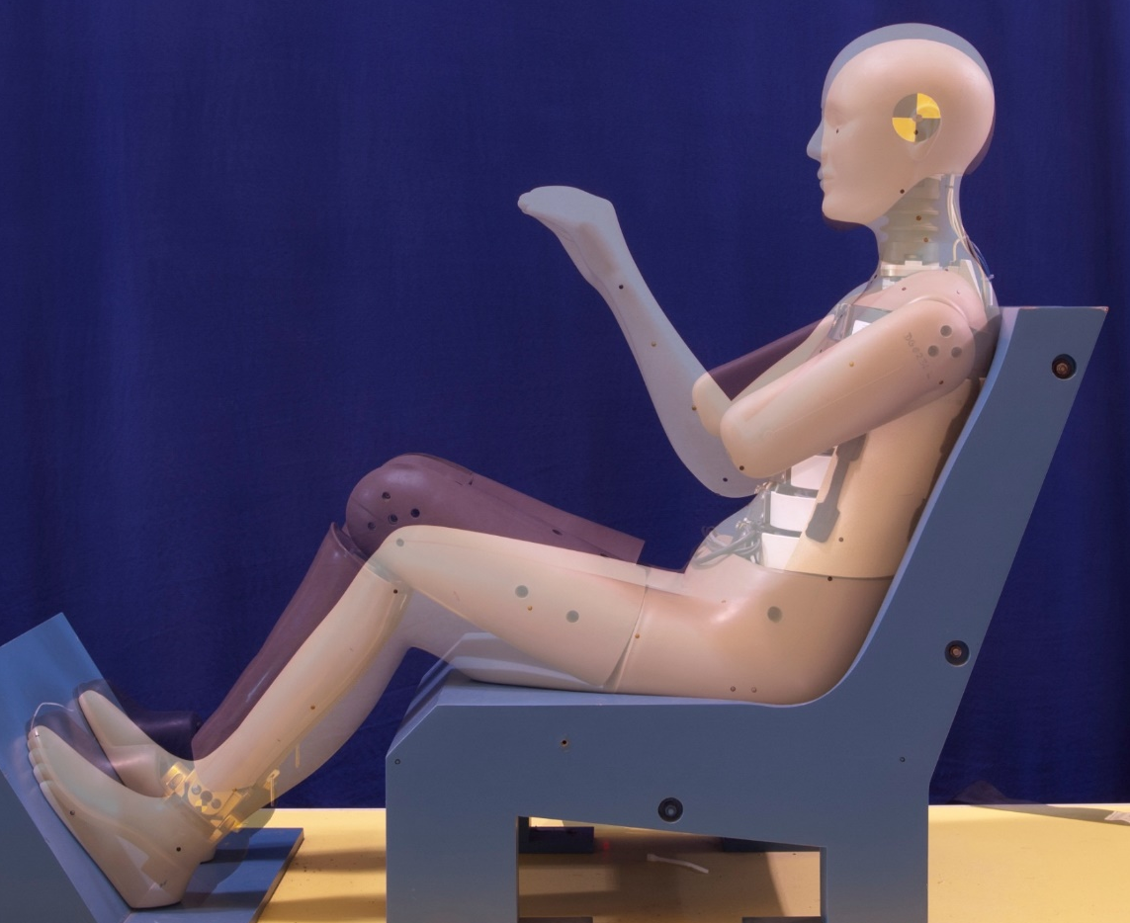
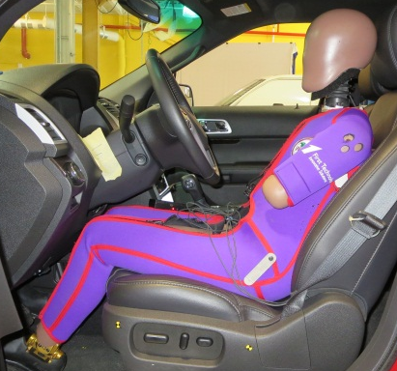
WorldSID ATD Family
The WorldSID 50th percentile male (WSID-50M) anthropomorphic test device (ATD) is designed for improved assessment of injury risk to car occupants in side impact collisions. Initially developed in a collaboration of worldwide industry and government organizations, it was designed to take advantage of an improved understanding of human responses in side impact. The WSID-50M represents an adult male of average height and weight and its features include six independent ribs tuned for humanlike response, a multipoint measurement system (RibEye) capable of quantifying lateral and oblique rib displacements, and an on-board data acquisition system. A small female ATD (WSID-05F) is also available representing the 5th percentile female height and weight, though its development trails that of the WSID-50M.
WSID-50M has improved oblique shoulder biofidelity compared to the ES-2re, a feature that is critical to accurate dummy kinematics for side impact loading.
Overall, the WorldSID-50M has much improved biofidelity over the ES-2re (lower number means better biofidelity).
WSID-50M
Anthropometry based on UMTRI AMVO dataset.
WSID-05F
Tests conducted with multiple WSID-50M dummies at several test sites indicated excellent repeatability and reproducibility (R&R) for the majority of qualification test responses.
RibEye system provides improved measurement of peak rib displacement, especially for oblique loading. This leads to better injury assessment capability.
RibEye Sensors
RibEye LEDs
For more information see Docket ID NHTSA-2019-0108 NHTSA Crashworthiness Research – WorldSID-50M Documentation
and Docket ID NHTSA-2019-0109 NHTSA Crashworthiness Research – WorldSID-05F Documentation

