Slide 1


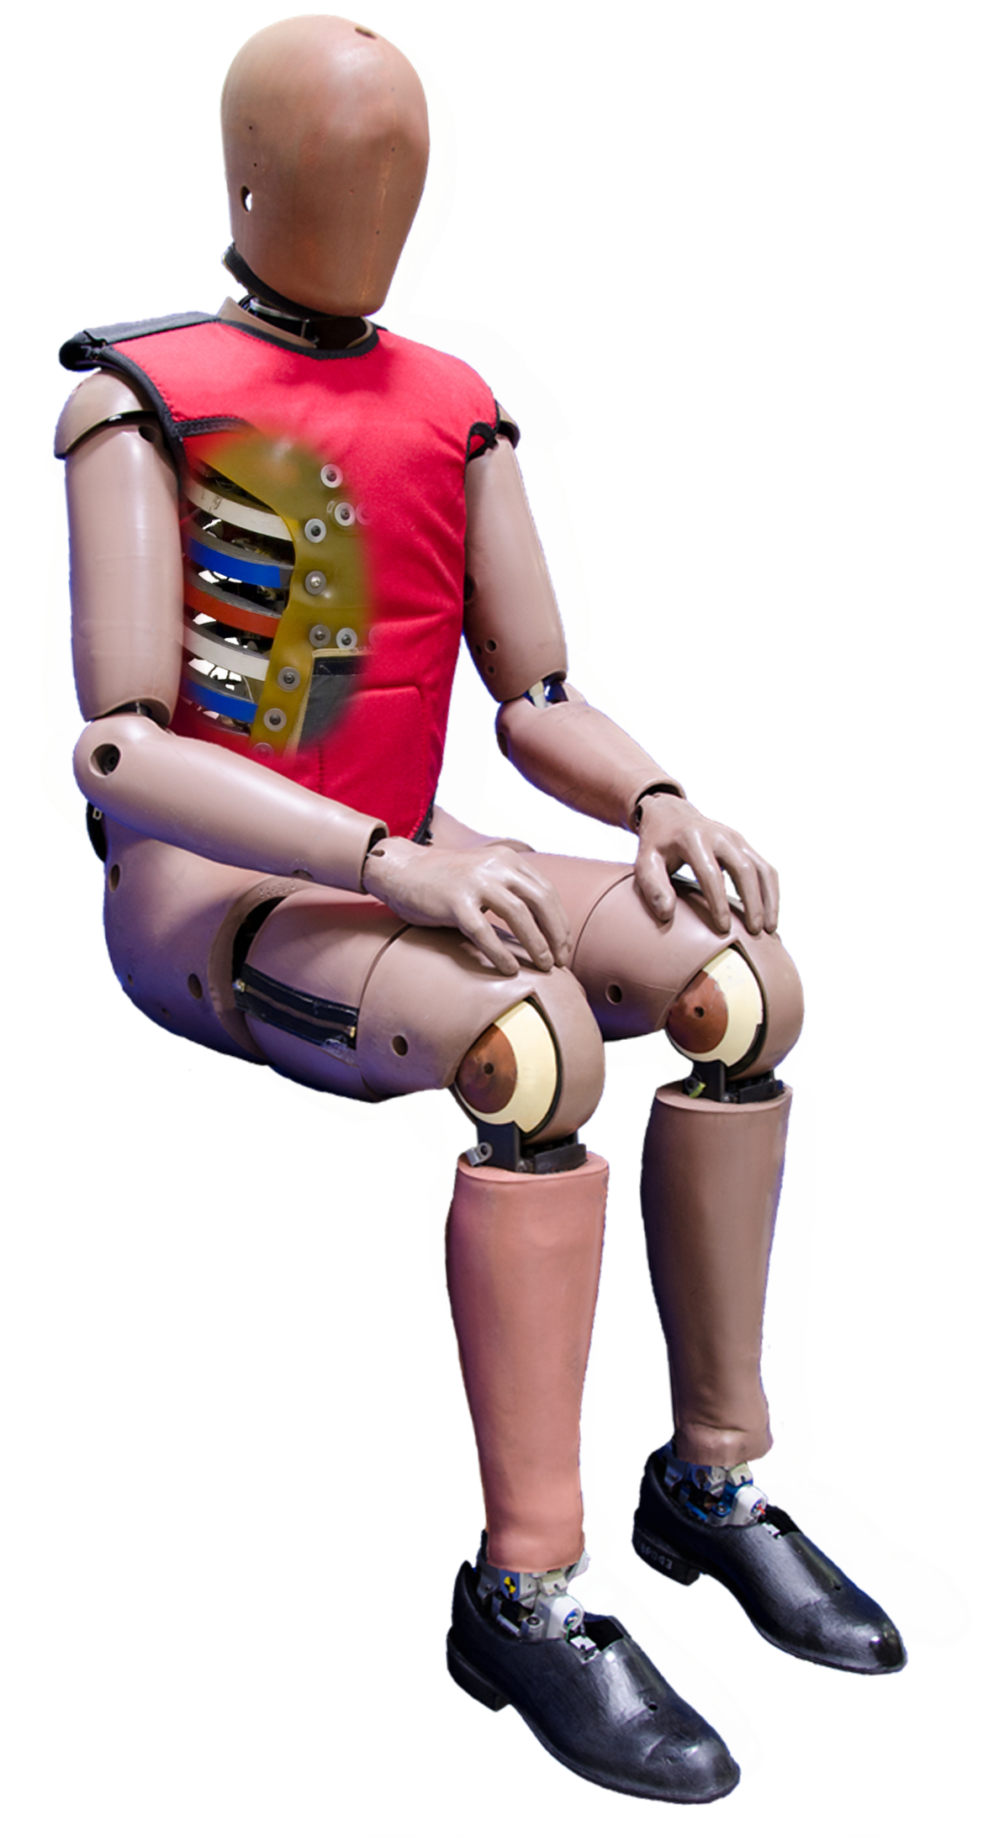

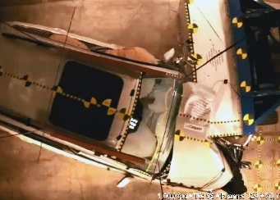
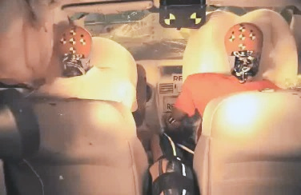
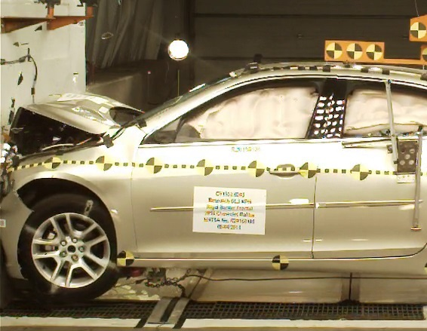
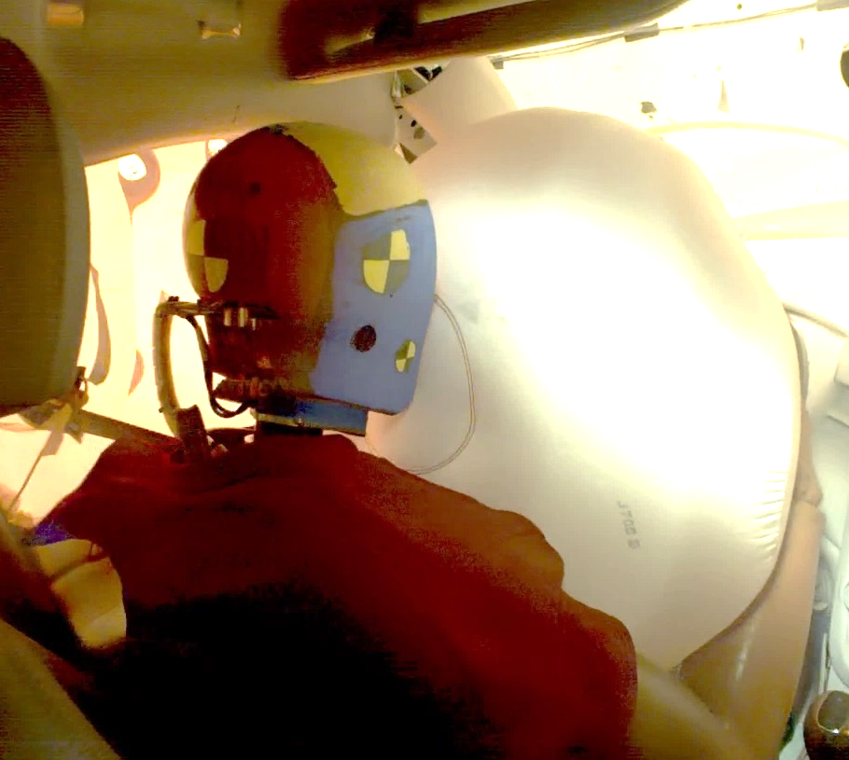
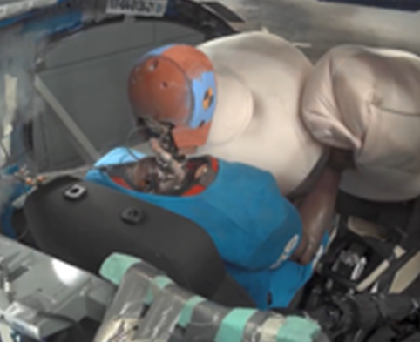
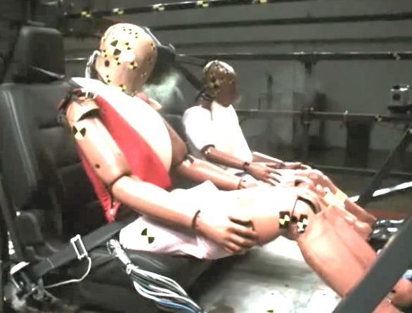
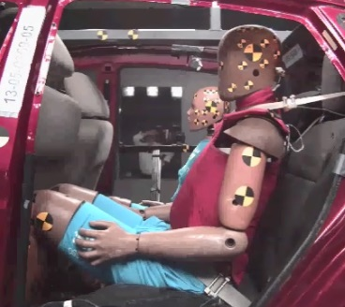
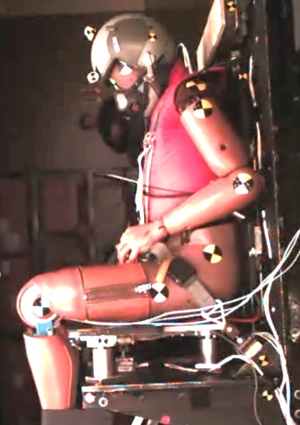
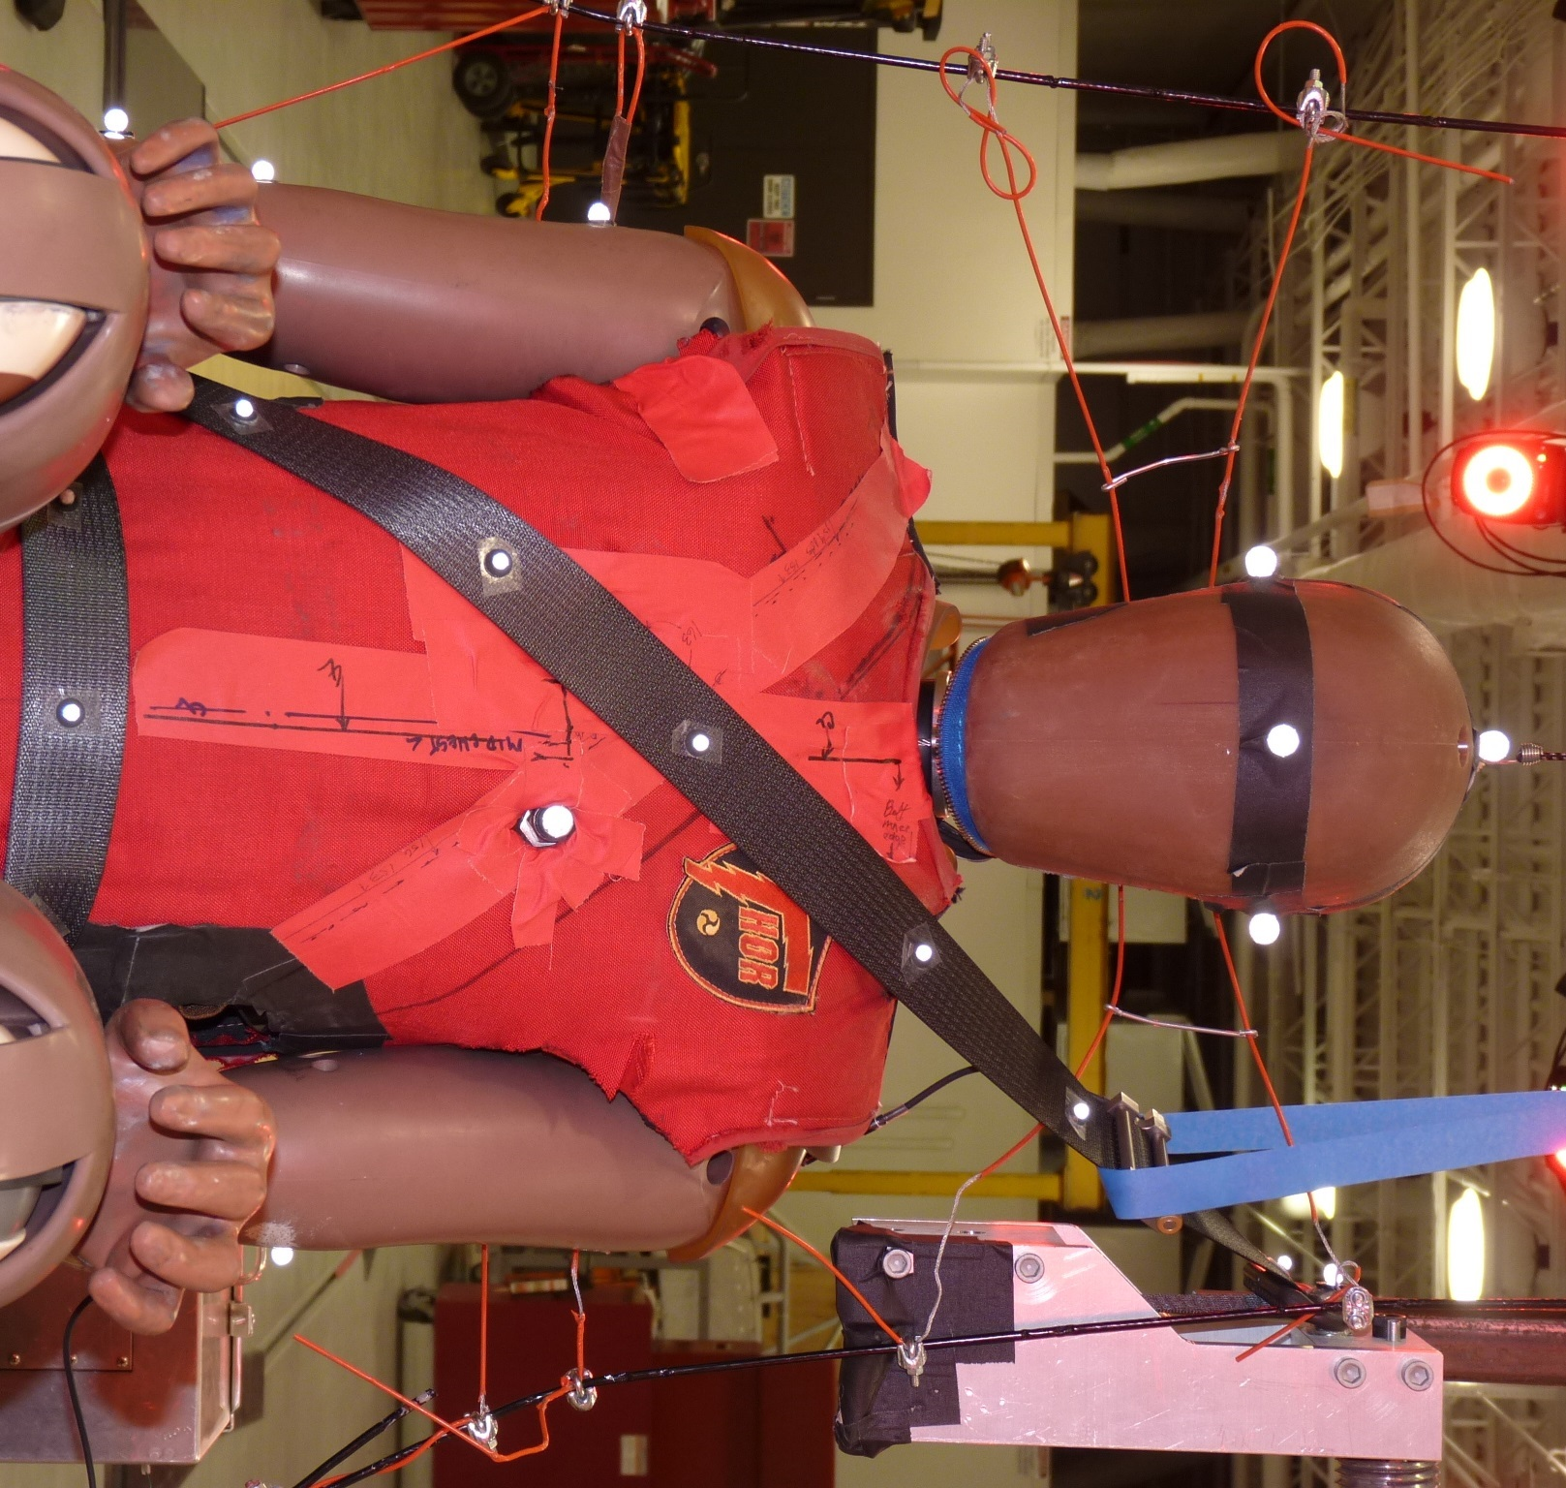
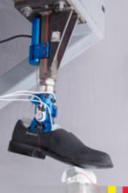
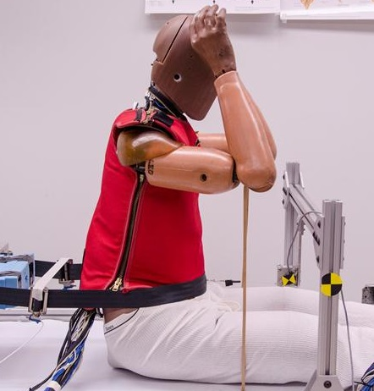
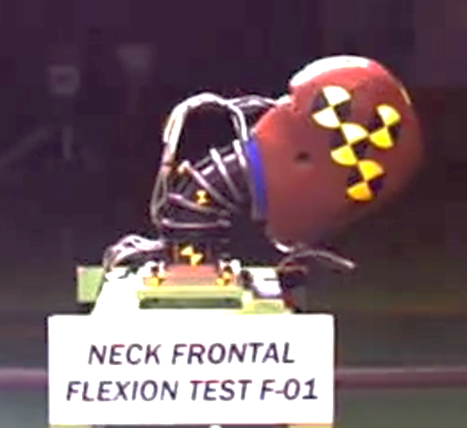
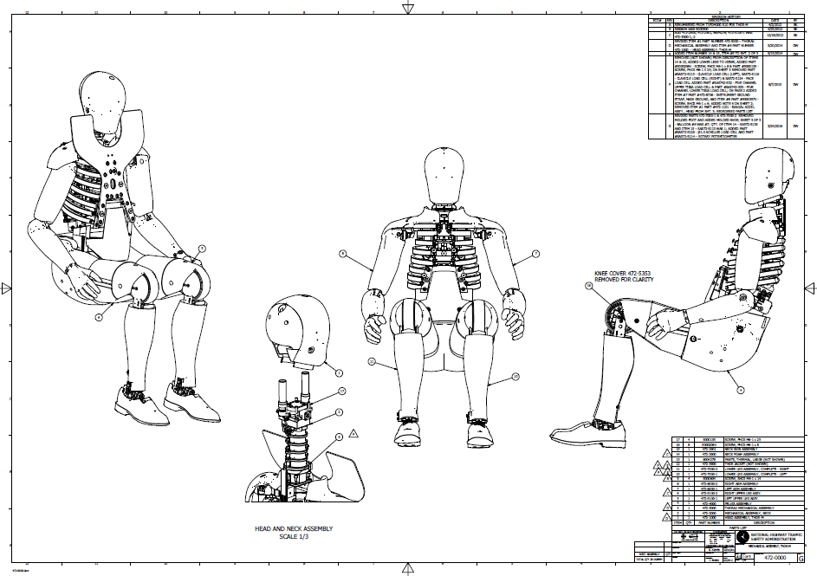
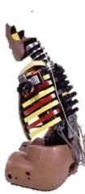
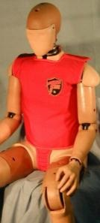
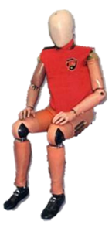
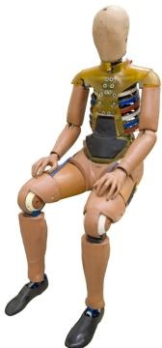
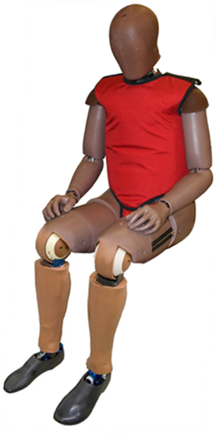
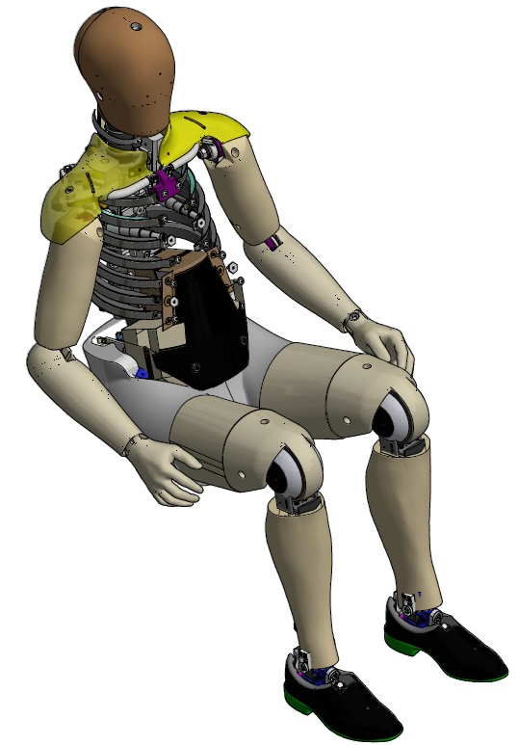
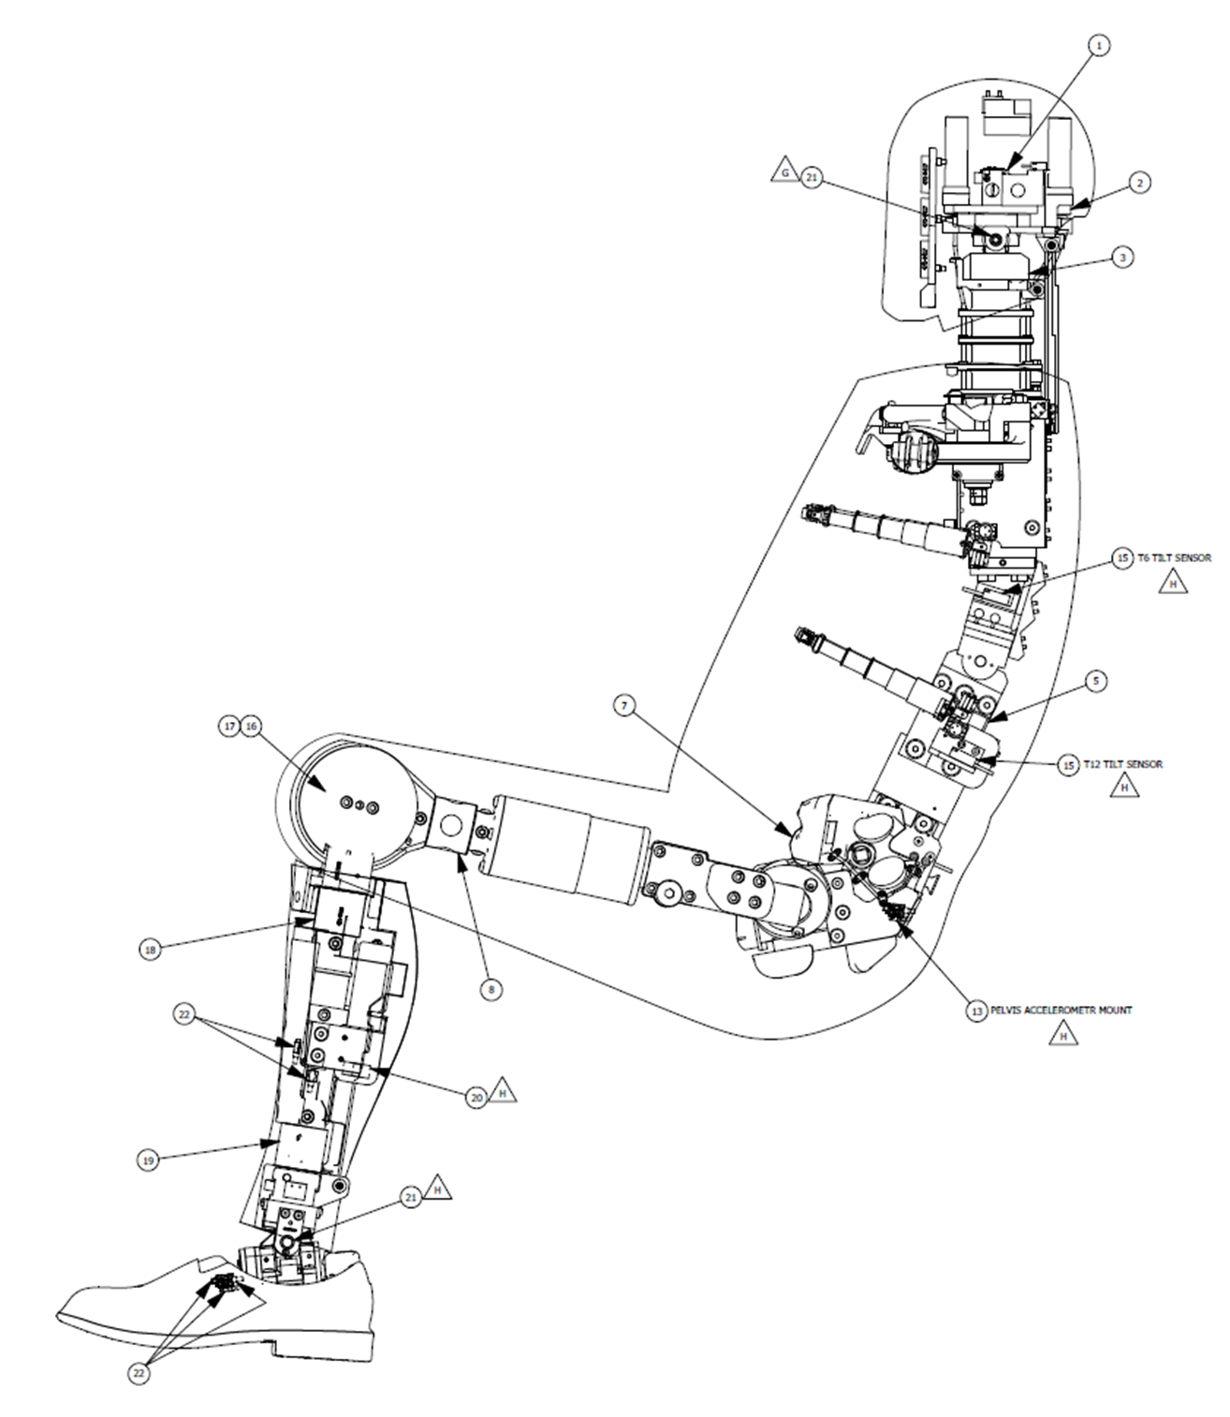
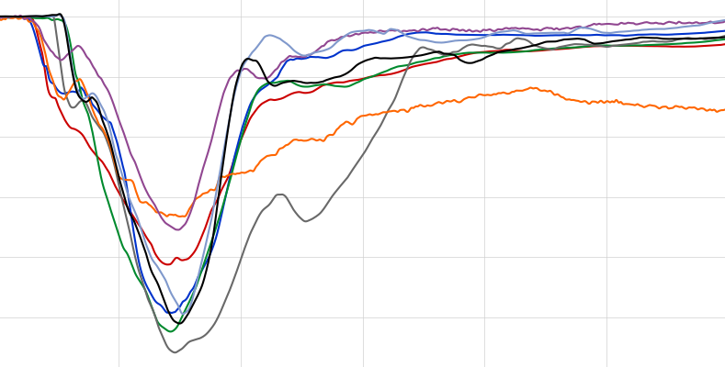
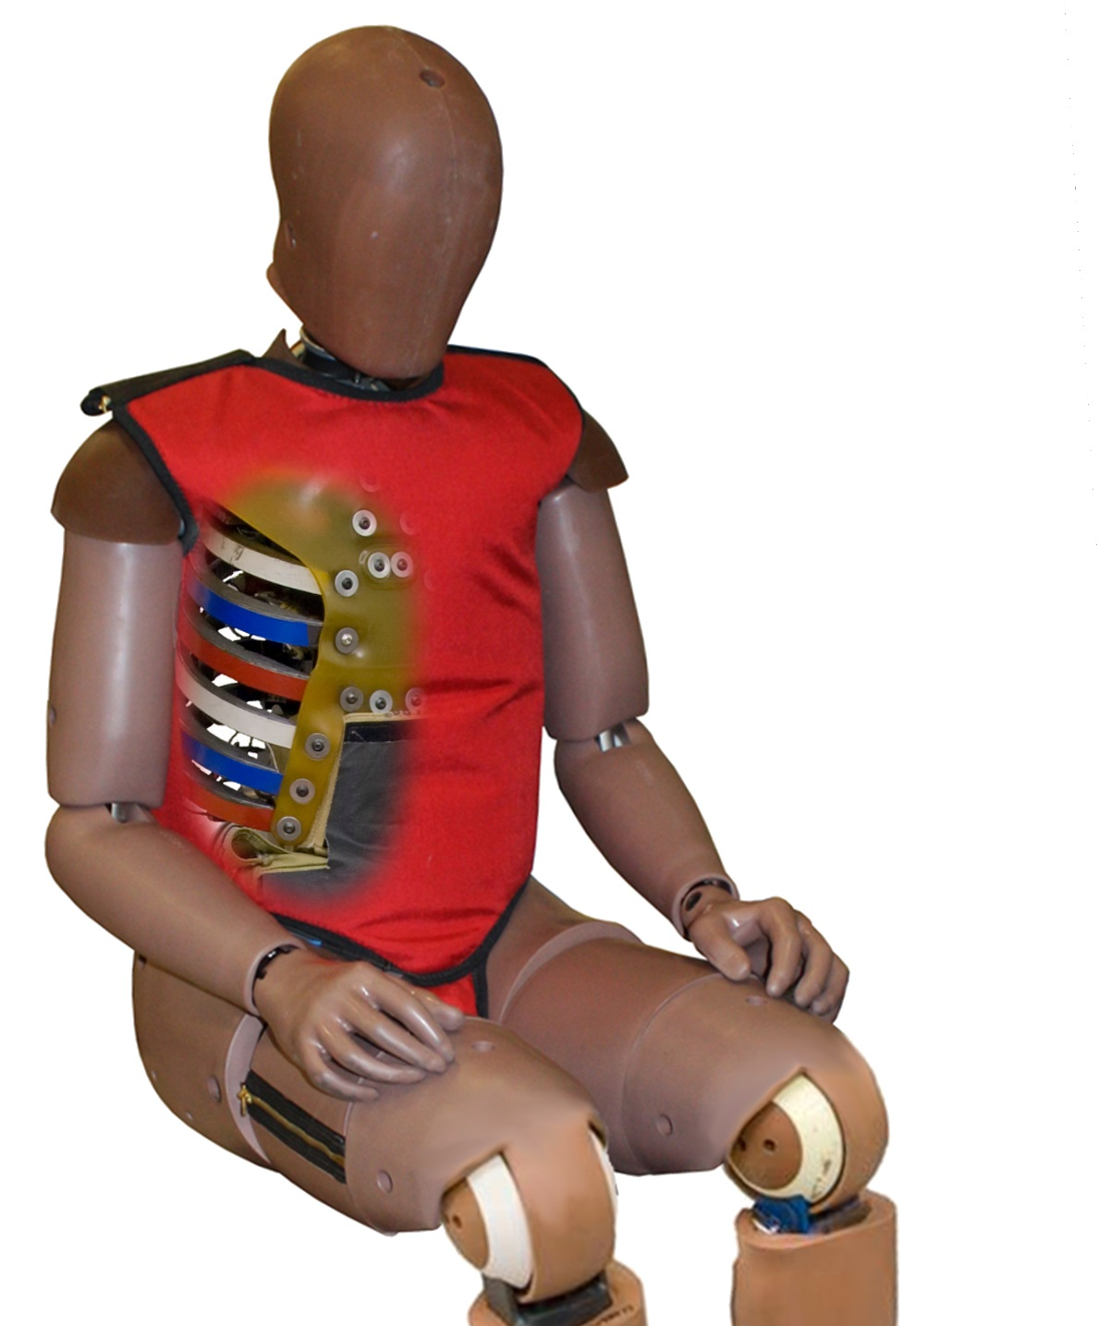
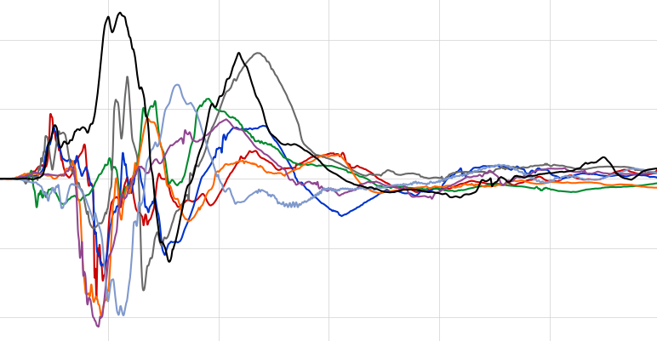
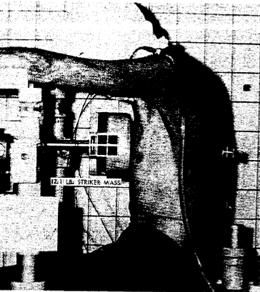
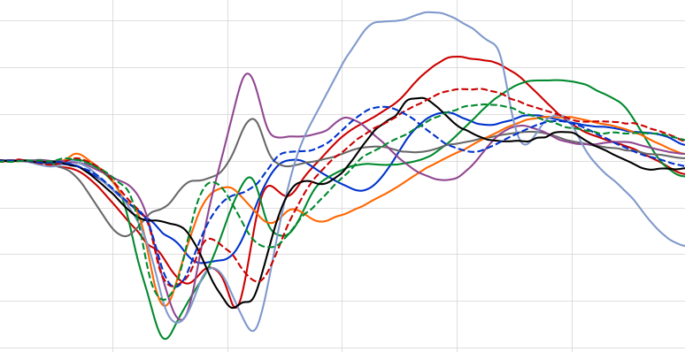
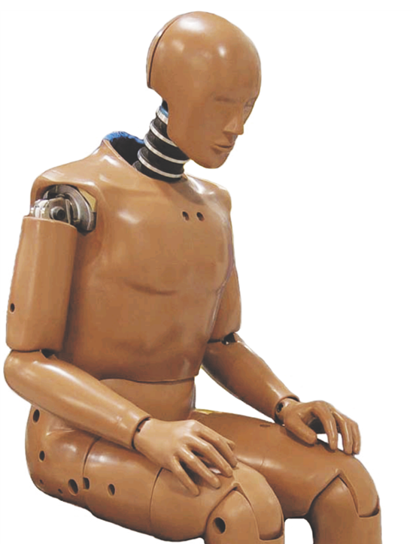
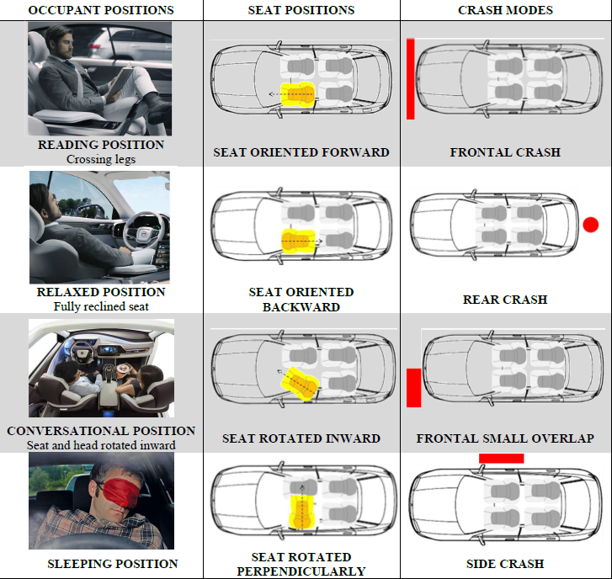

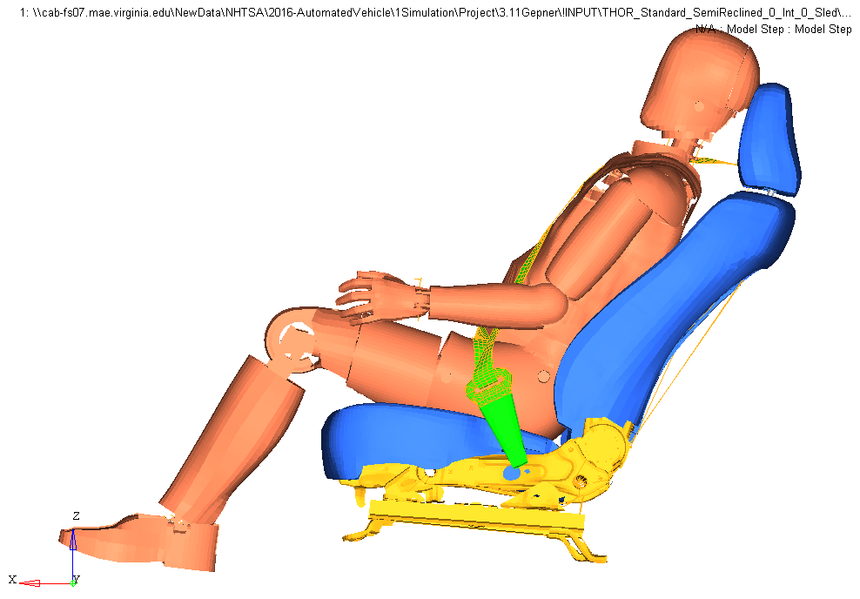
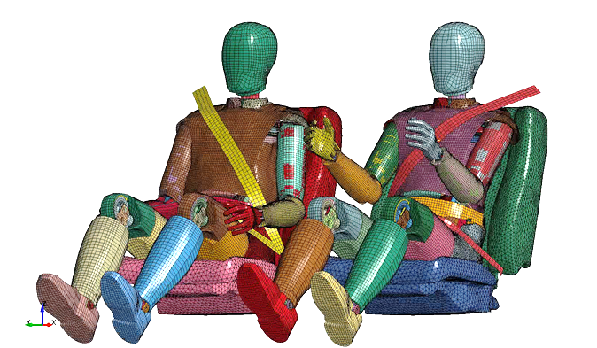

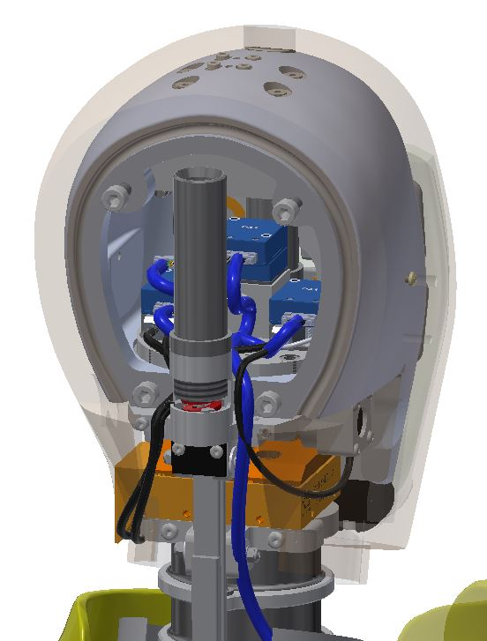
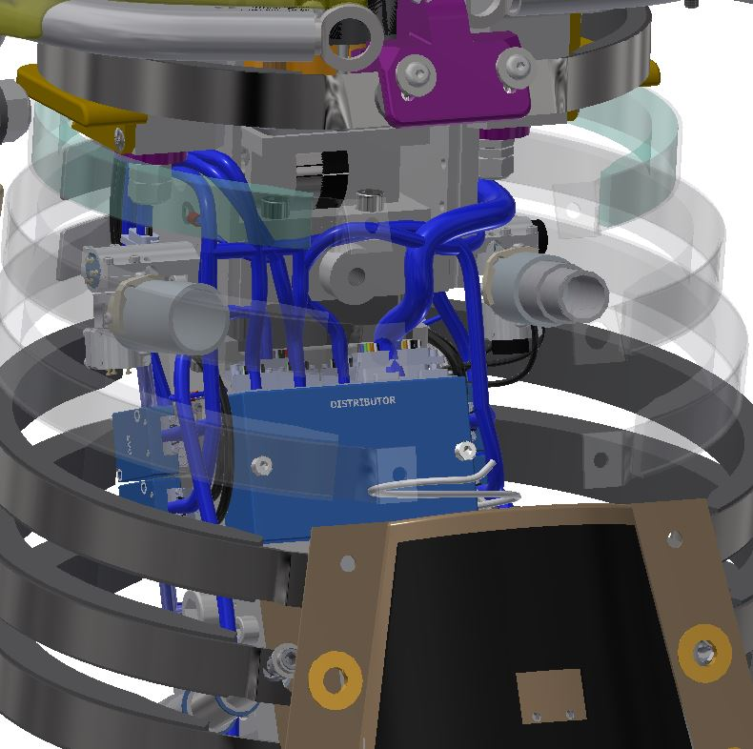
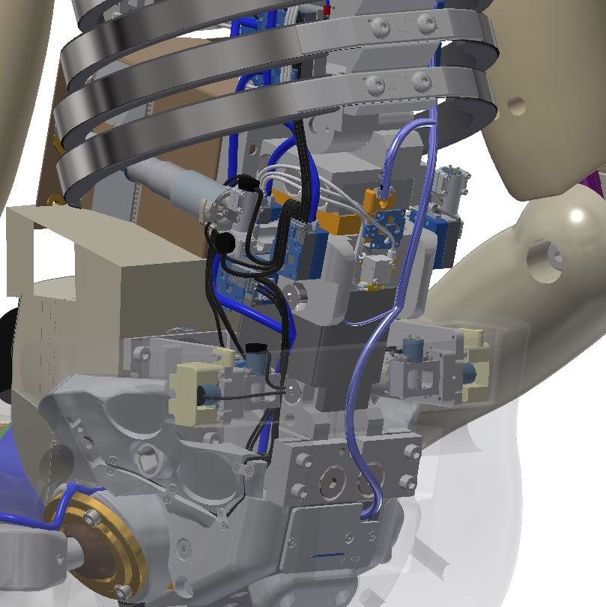

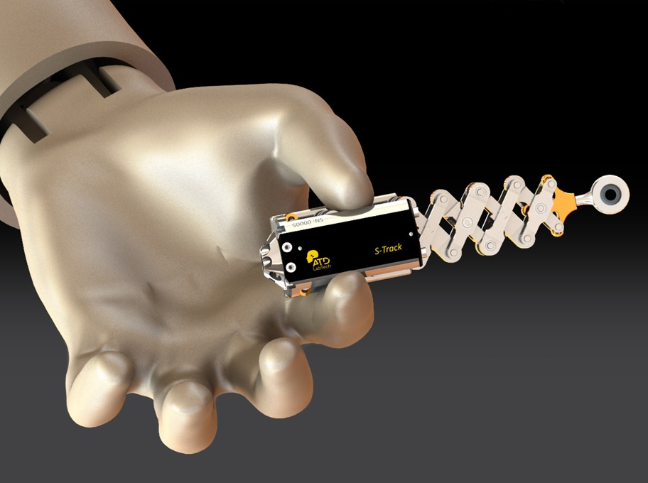

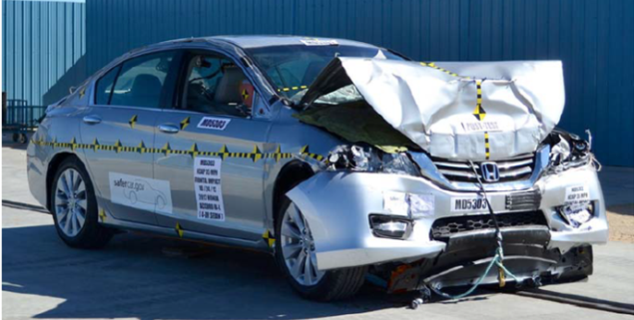
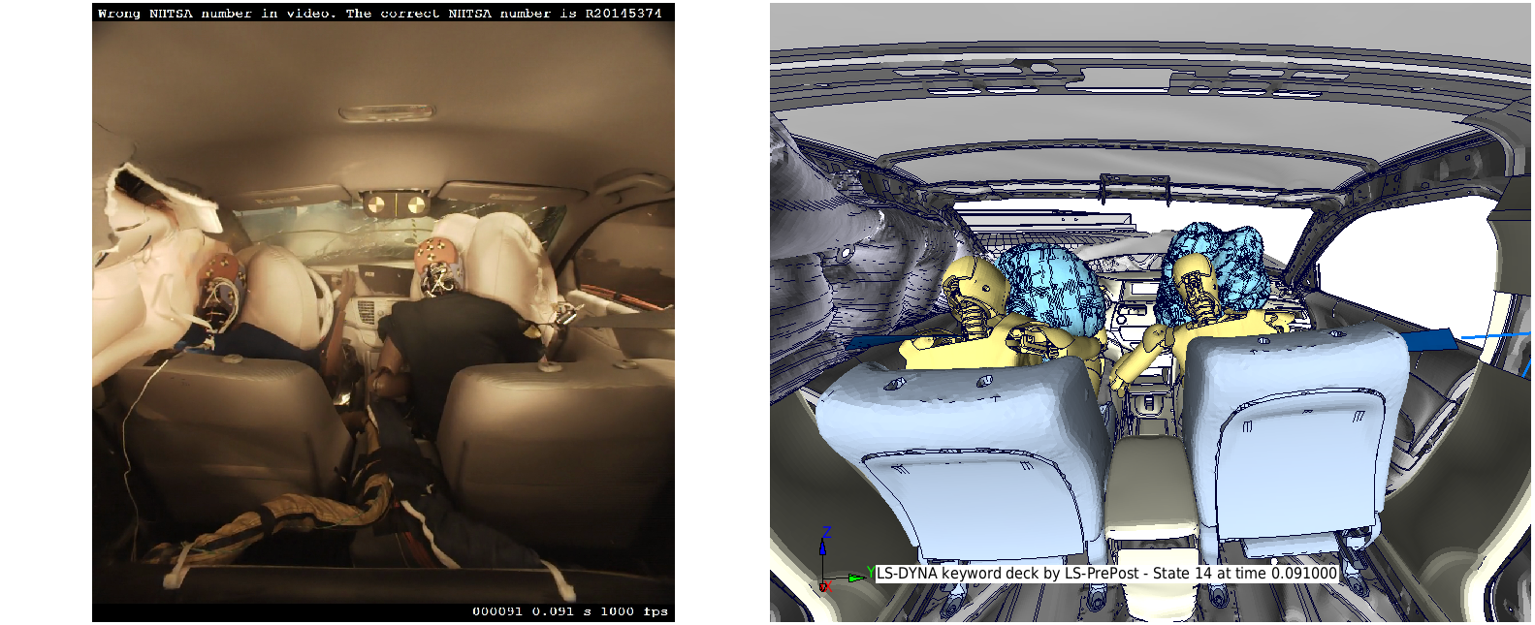
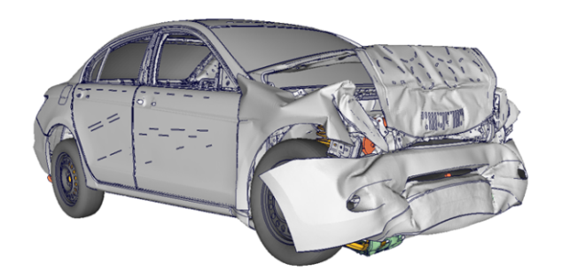
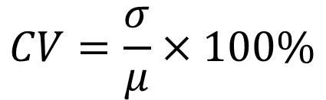
TEST DEVICE FOR HUMAN OCCUPANT RESTRAINT
THOR-50M - 50TH PERCENTILE MALE
What?
Anthropomorphic Test Device (ATD, or crash test dummy)
Represents male of average height and weight
Designed for frontal and frontal oblique crash tests
Measures risk of injury to occupants in a crash
Used in hundreds of NHTSA research tests
8
THOR-50M ATDs owned by NHTSA, used in:
Why?
THOR’s human-like characteristics in a crash and state-of-the-art measurement capability make it the best choice to evaluate the advanced safety features in today’s vehicles.
164
Vehicle Crash Tests
Human-Like Characteristics
• Neck that bends, twists, and stretches for realistic head motion
• Torso with anatomically correct ribcage and shoulder
• Flexible spine to allow proper upper body motion
• Abdomen and pelvis that mimic human seat belt interaction
• Legs that respond to impact of dashboard and pedal
348
Crash Simulation Sled Tests
Measurement Capability
Over 100 distinct measurements to help predict injury, including:
• Head acceleration and rotation
• Neck forces and moments
• Ribcage motion at four locations and three dimensions
• Abdomen motion at two locations and three dimensions
• Pelvis, thigh, shin, and ankle forces
1013
Dynamic Component Tests
History
1992
2001
2005
2011
2014
2015 - Present
TAD-50M
Prototype
THOR Alpha
THOR-NT
THOR
Mod Kit
THOR
Metric
THOR-50M
Data collected in these tests accounts for:
32,604
Sensors
282 Million
Data Points
Biofidelity
Body Region | THOR-50M | H3-50M
Head | Excellent | Poor
Neck | Good | Poor
Thorax | Excellent | Good
Abdomen | Marginal | Marginal
Knee/Thigh/Hip | Good | Poor
Lower Extremity | Good | Excellent
Whole-body | Good | Good
THOR-50M
from Lobdell, 1973
Qualification Tests
H3-50M
Data, photos, videos, and test reports are available to the public in the NHTSA Biomechanics and
NHTSA Vehicle Crash Test Databases: https://www.nhtsa.gov/research-data/databases-and-software
Parent, D., Craig, M., Moorhouse, K., “Biofidelity Evaluation of the THOR and Hybrid III 50th Percentile Male Frontal Impact Anthropomorphic Test Devices,” 61st Stapp Car Crash Conference, November 2017.
Crash Tests
Repeatability & Reproducibility
3
×
3
=
9
Application in NHTSA Research Projects
24
×
5
×
5
=
600
Test Modes
e.g. Face Impact, Neck Torsion
Left Thorax, Right Ankle
Tests per ATD
ATDs
3 ATDs at VRTC
1 ATD at 2 other labs
Qualification
Tests
Test Labs
Tests per Lab
Oblique Crash Tests
→ Qualification Specifications (Mean ±10%)
→ Assessment of Repeatability and Reproducibility:
Magnitude
Phase
Shape
Assessing Occupant Protection for Automated Vehicles
$$CV=\frac{σ}{μ}×100\%$$
Saunders et al., 2018 SAE World Congress
Finite Element Model
Allows virtual crash tests, parametric analyses
Developed by NHTSA with support from academic and industry partners
Current work (University of Virginia Center for Applied Biomechanics)
Update hardware to current drawing package
Match response to current qualification specifications
Improve computational efficiency and stability
Enhancements
Oblique Restraint Countermeasures
In-dummy Data Acquisition System (DAS)
Improved 3D thorax and abdomen measurement
Vehicle FE Model Development
For more information see Docket ID NHTSA-2019-0106 NHTSA Crashworthiness Research – THOR-50M Documentation

