Slide 1


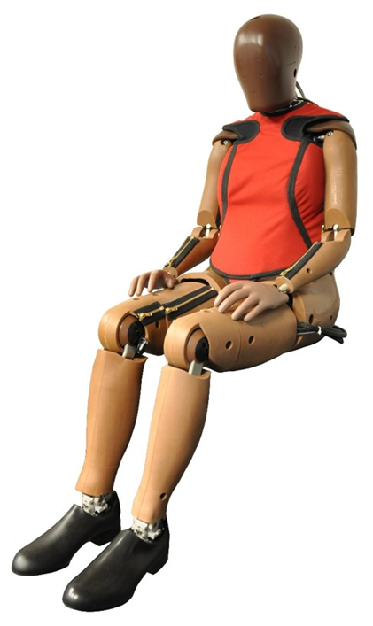
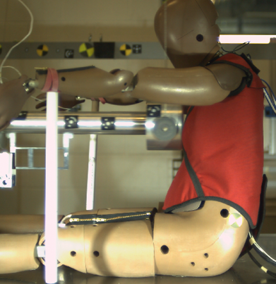
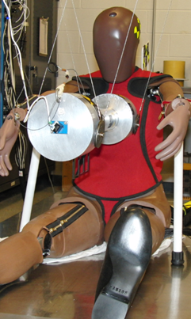
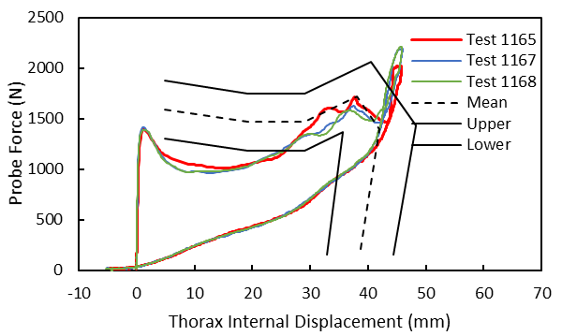
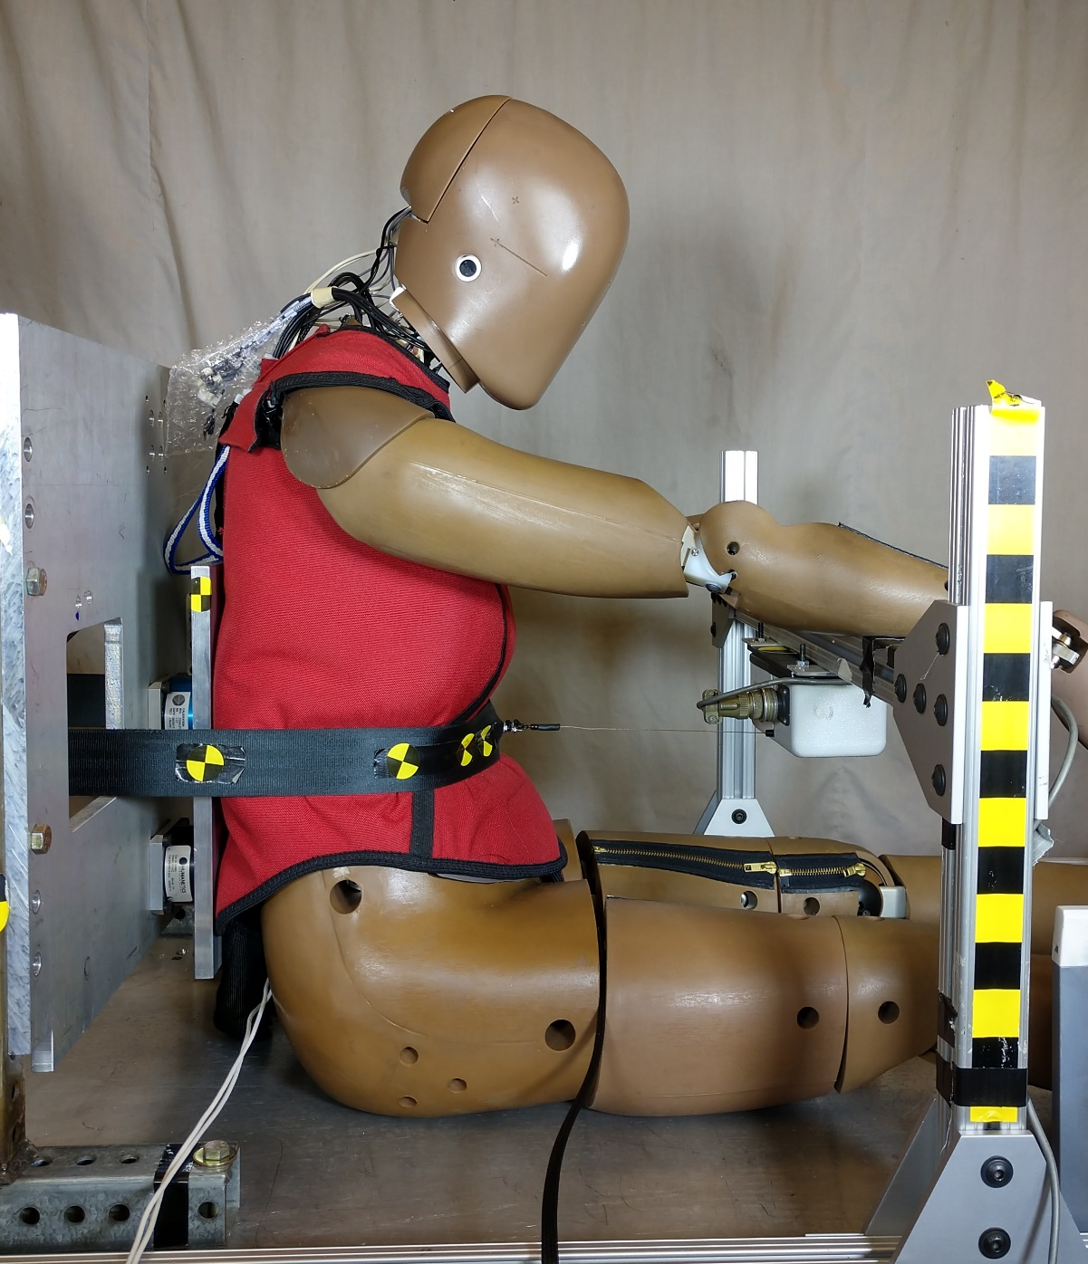
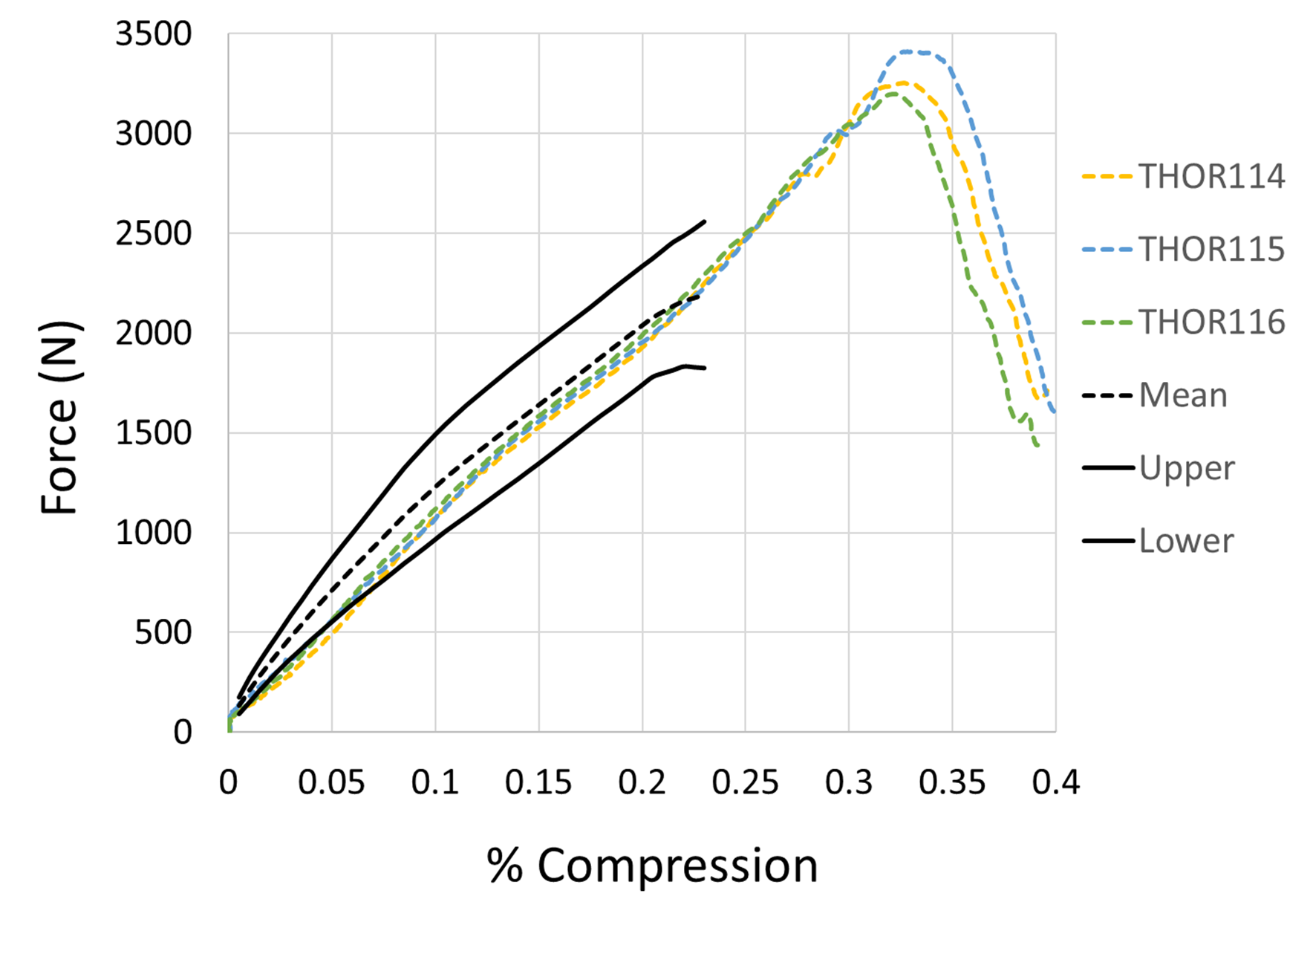
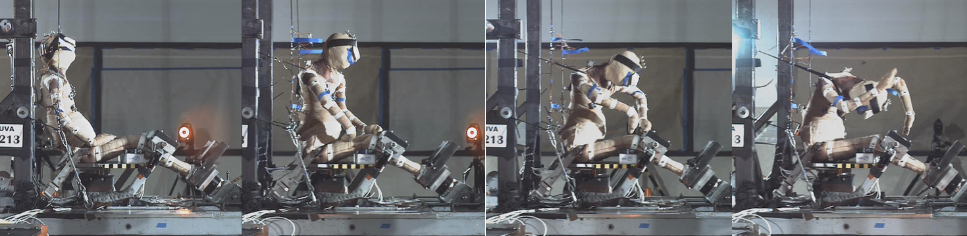
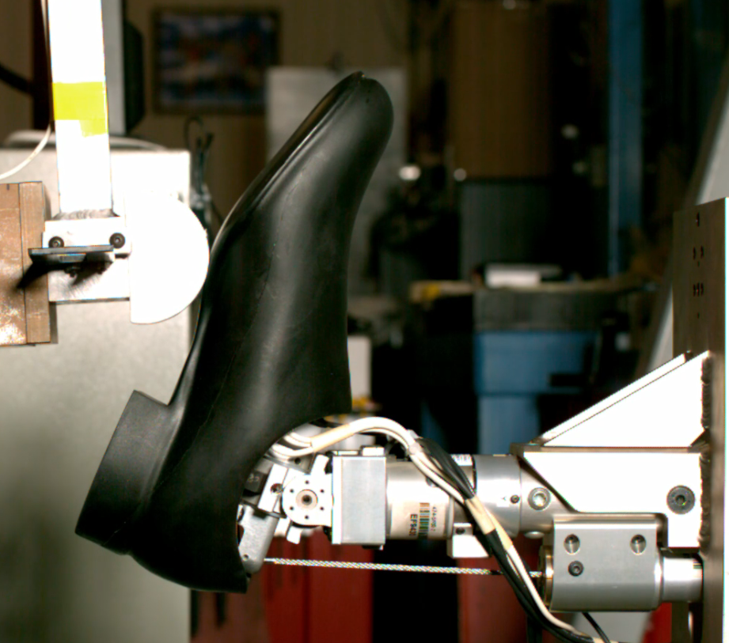
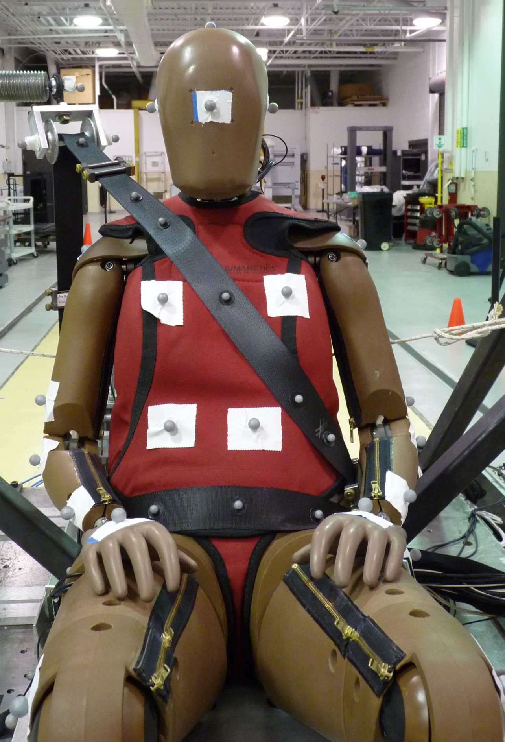
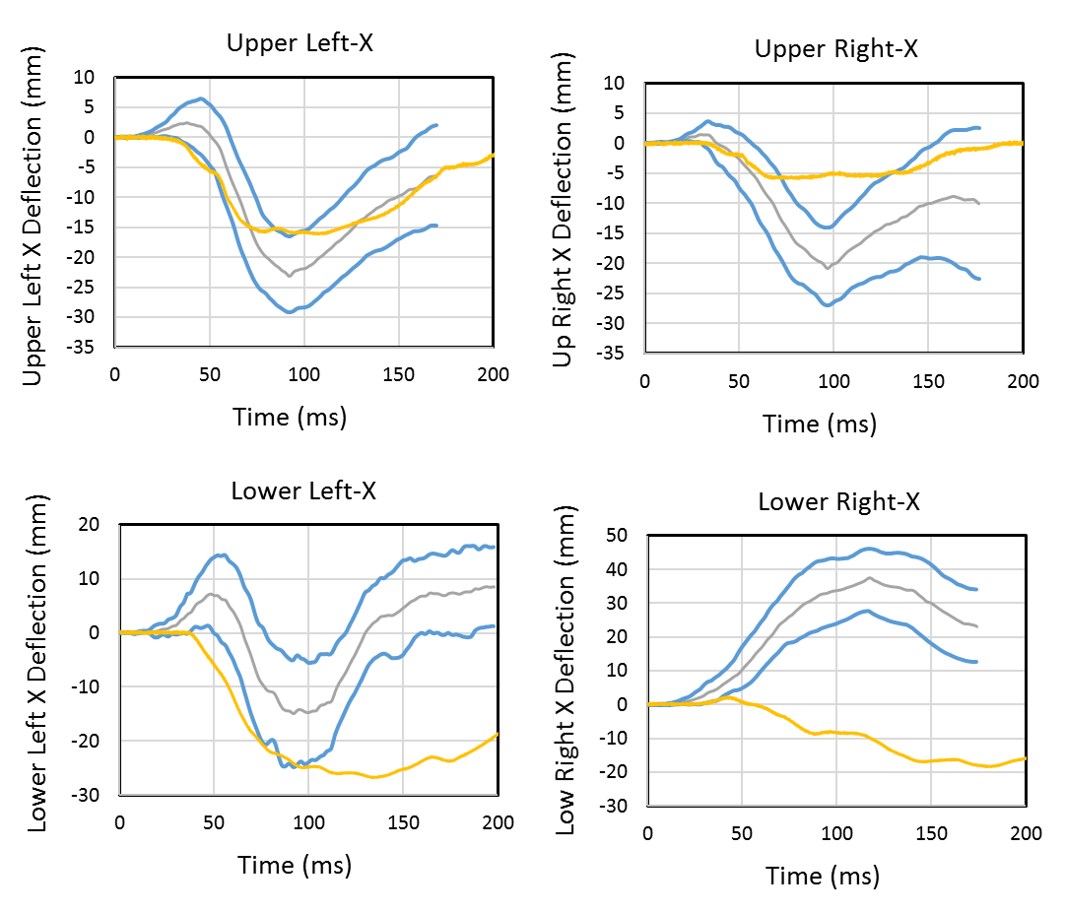
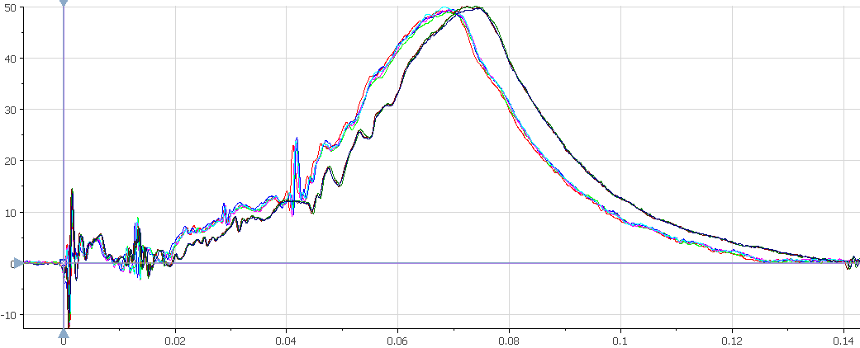
THOR-05F - 5TH PERCENTILE FEMALE
TEST DEVICE FOR HUMAN OCCUPANT RESTRAINT
What?
Anthropomorphic Test Device (ATD, or crash test dummy)
Represents small female of height 60” and weight 108 lbs
Designed for frontal and frontal oblique crash tests
Measures risk of injury to occupants in a crash
Why?
THOR’s human-like characteristics in a crash and state-of-the-art measurement capability make it the best choice to evaluate the advanced safety features in today’s vehicles.
Human-Like Characteristics
• Neck that bends, twists, and stretches for realistic head motion
• Torso with anatomically correct ribcage and shoulder
• Flexible spine to allow proper upper body motion
• Abdomen and female-specific pelvis that mimic human seat belt interaction
• Legs that respond to impact of dashboard and pedal
Measurement Capability
Over 100 distinct measurements to help predict injury, including:
• Head acceleration and rotation
• Neck forces and moments
• Ribcage motion at four locations in 3D
• Abdomen internal pressure at two locations
• Pelvis, thigh, shin, and ankle forces
Biofidelity
Body Region | Biofidelity
Head | Good
Neck | Marginal
Shoulder | Excellent
Thorax | Good
Abdomen | Marginal
Knee-Thigh-Hip | Good
Lower Extremity | Good
Overall | Good
Current Research
• Evaluating 3 prototype ATDs in Repeatability & Reproducibility (R&R), durability and usability in various conditions
• Developing Injury Risk Curves by collecting biomechanical data (post mortem human surrogates) and conducting matched pair ATD tests
• Developing technical reports and documentation
Y-Axis Ankle Moment (N∙m)
Time (s)
For more information see Docket ID NHTSA-2019-0107 NHTSA Crashworthiness Research – THOR-05F Documentation

