Slide 1
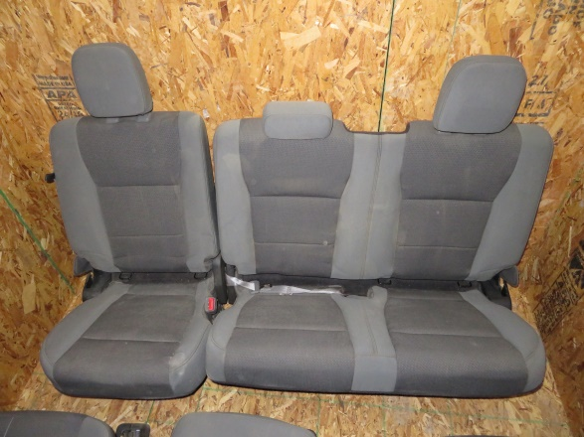
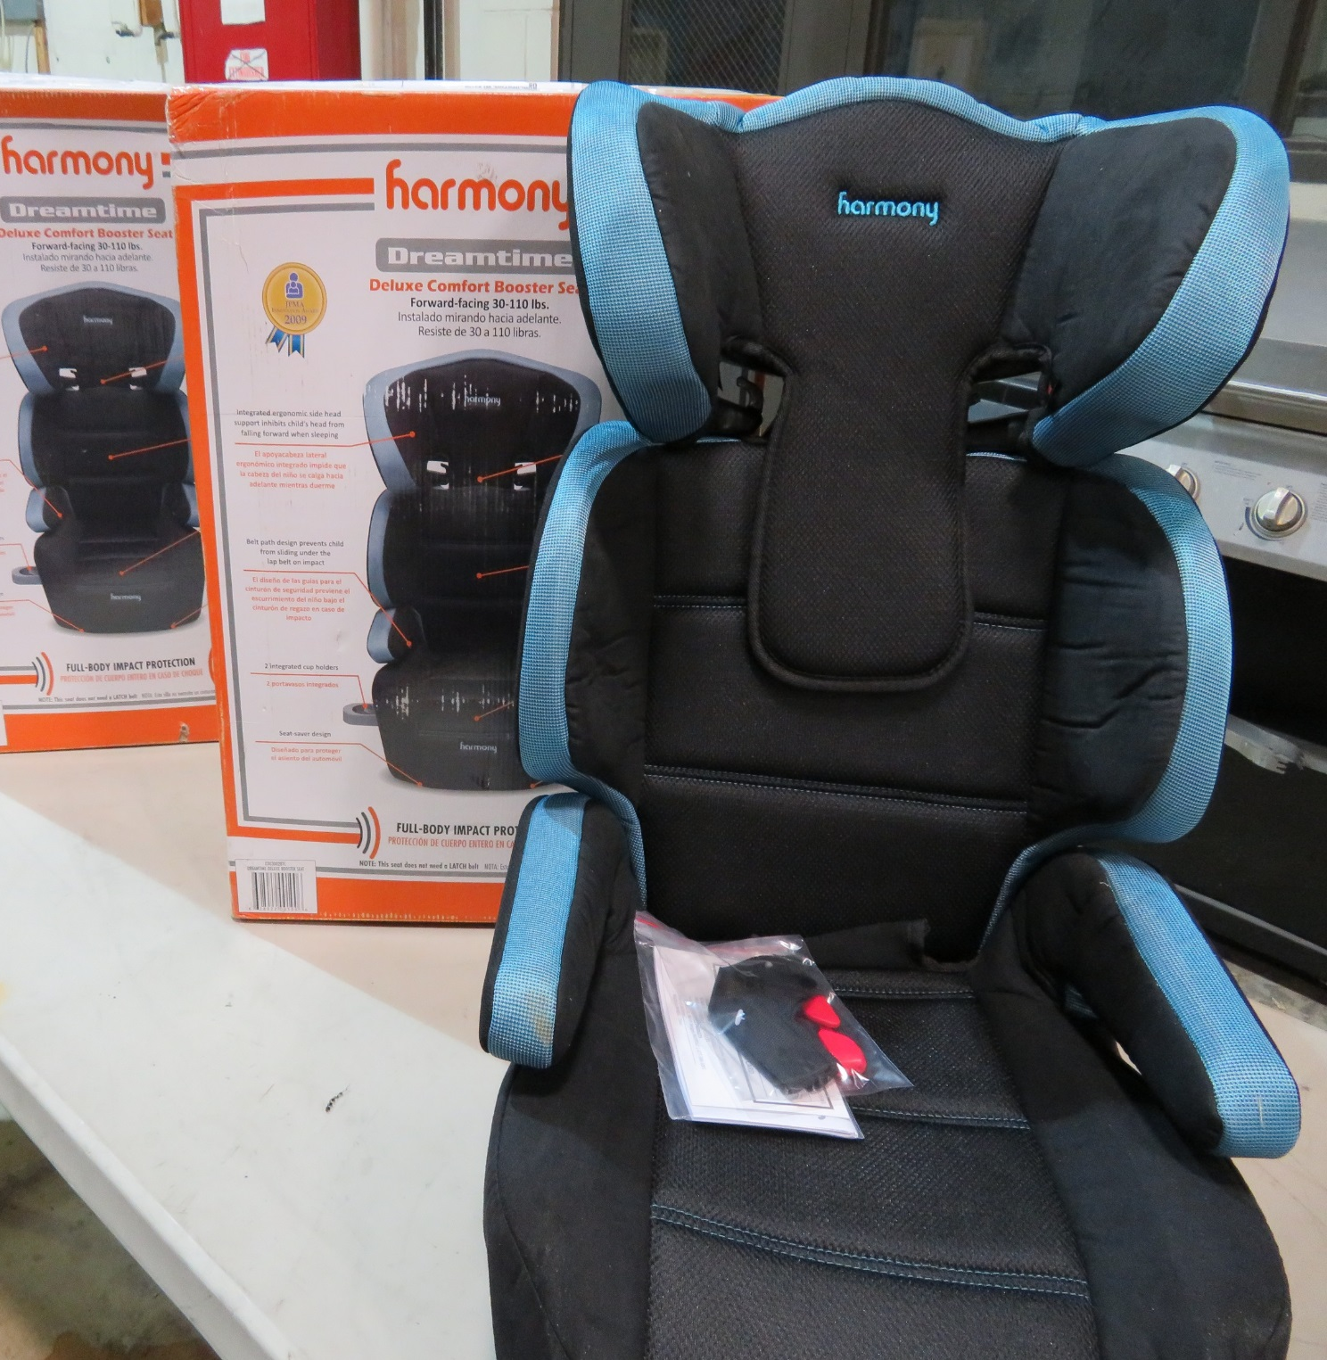
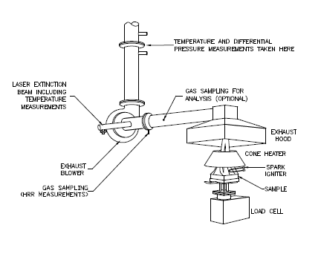
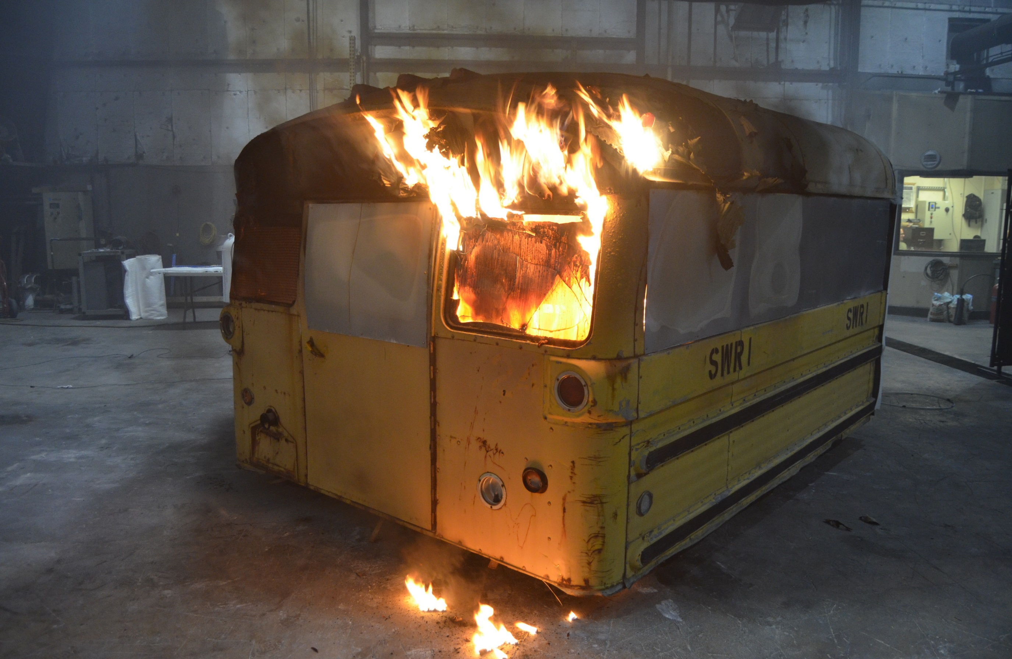
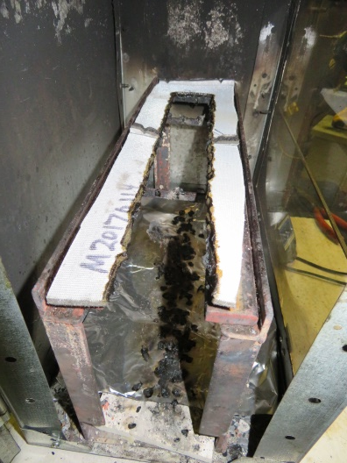
Flammability of Interior Materials Research
Introduction
Develop improved flammability tests and performance criteria for FMVSS 302 to make it a more robust, objective standard.
Methodology
Improve consistency and reproducibility of procedures and results by evaluating passenger vehicle, school
bus, motorcoach, and child seat
components to a suite of accepted fire
test protocols from microscale
calorimetry to full scale burns.
Improve measurement of fire
spread, smoke production and toxicity
of combustion products.
Pending Results Outcome will provide improved test procedures for evaluating flammability of automotive materials.
Cone Calorimeter
Flame Spread
Full Scale Burn

