Slide 1

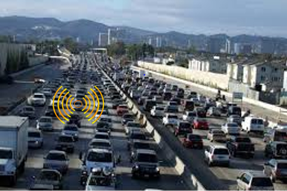
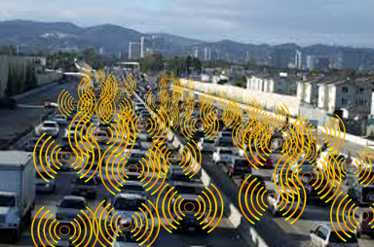
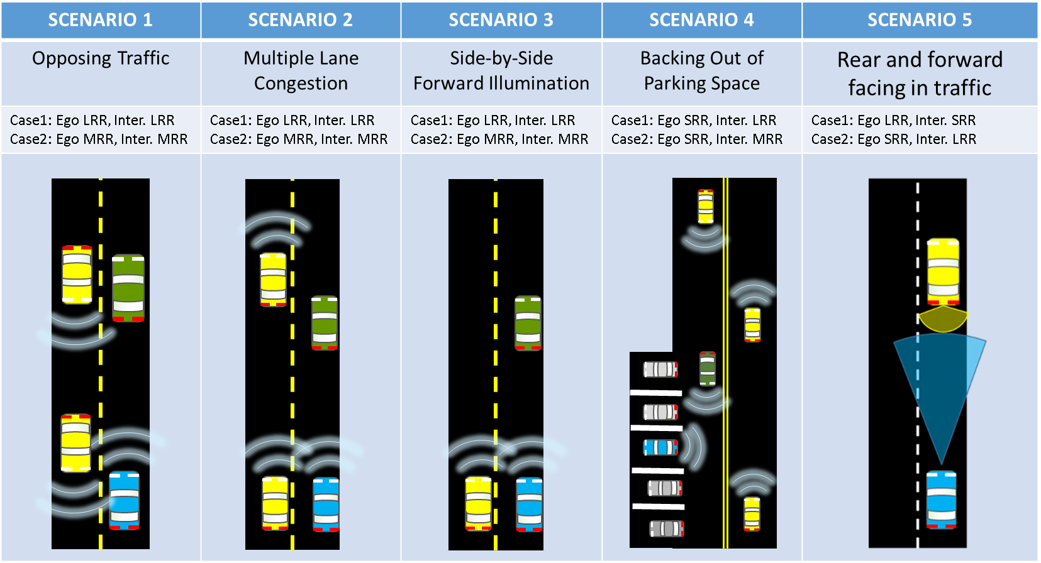
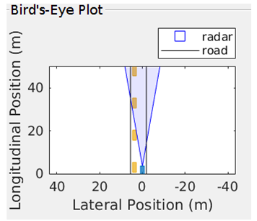
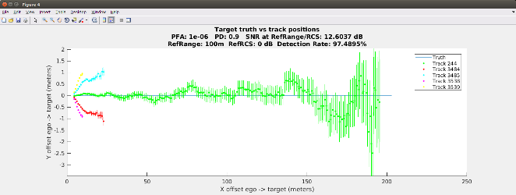
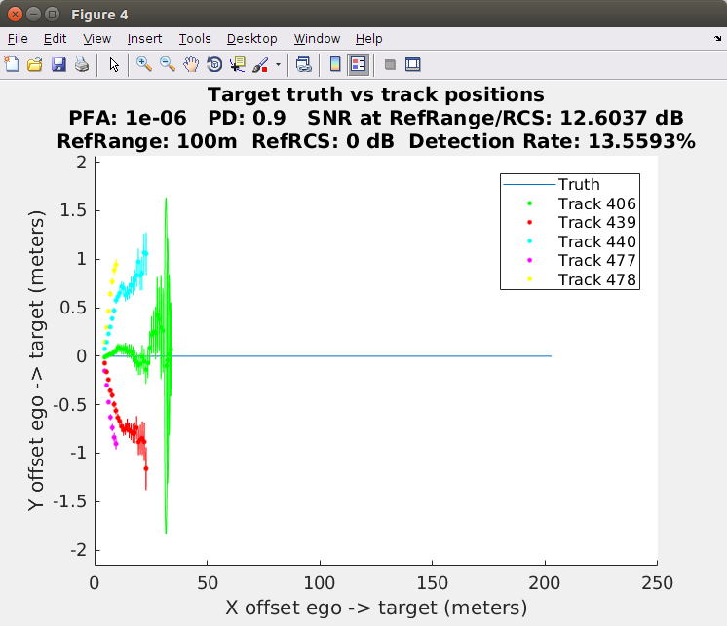
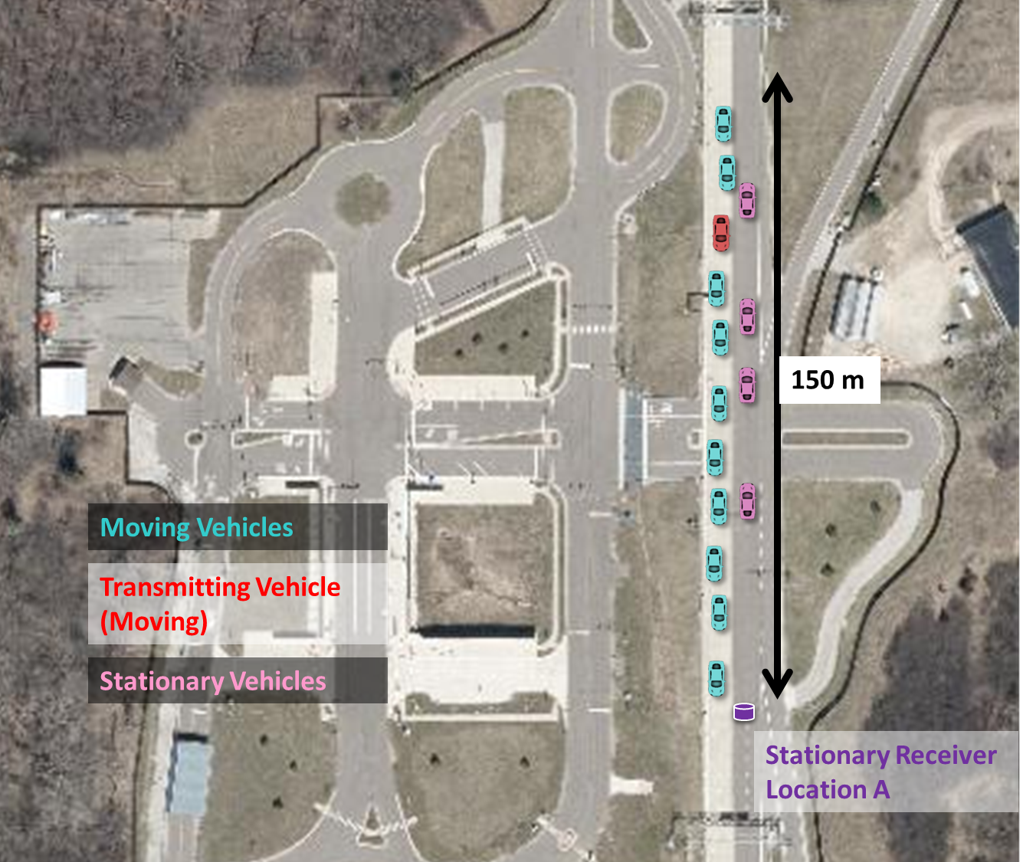
Radar Congestion Testing
Introduction
Increasing numbers of cars are being equipped with multiple radars, which may affect their performance.
This study examines the question:
How much power does a radar receive from other transmitters in a congested environment?
How does this received power impact the radar performance?
Initial Work
Model challenging scenarios for radar to measure:
Raw Interference power
Effect on radar performance
Simulation suggests that, absent mitigation, radar performance will be affected in select congested scenarios
Scenario 1- No Interference
Scenario 1- With Interference
Radar Testing
Track Testing of challenging scenarios initiated to empirically measure interference in automotive radar band 76-81 GHz
Characterize the received power in realistic environments and improve the model
Refine & validate the simulation with improved channel model
Develop test procedures to measure the impact of radar interference
Sensor and Vehicle level performance testing
Evaluate the effectiveness of production radars to mitigate interference

