Slide 1

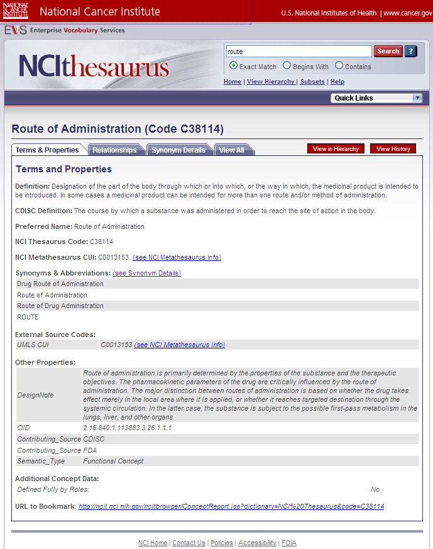

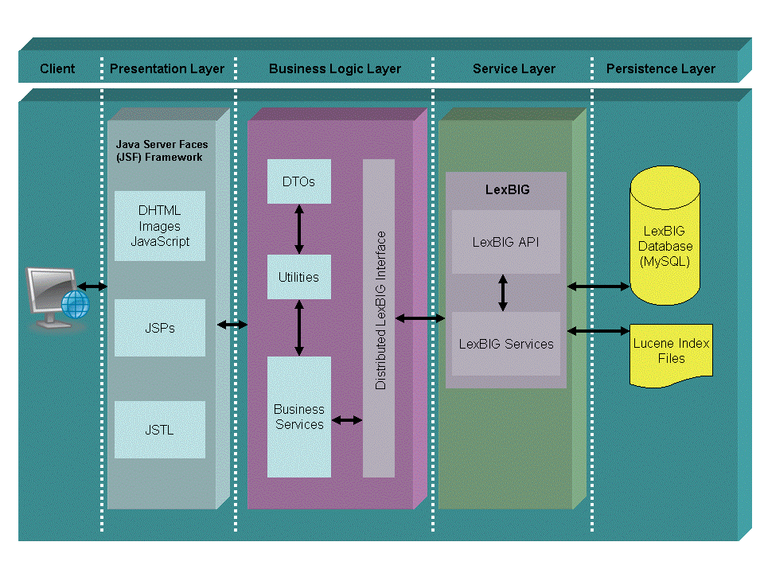
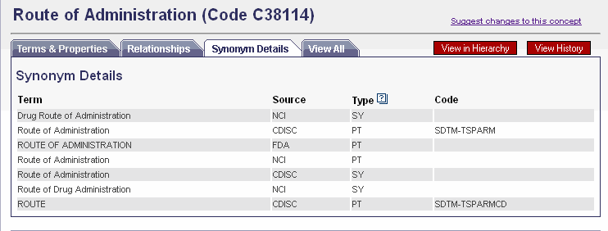


The New NCI Thesaurus (NCIt) Browser:
Bringing Terminology to NCI, Its Partners & the Public
Lawrence Wright¹, Wilberto Garcia², Steven Hunter³, Jason Lucas², Kim Ong², Tracy Safran⁴ , Robert Wynne⁵, David Yee²
¹National Cancer Institute ²Northrop Grumman ³Ekagra Software Technologies ⁴ Science Applications International Corporation ⁵Lockheed Martin
Overview
The new NCI Thesaurus (NCIt) Browser addresses both the expanding role of NCIt and shifts in underlying technologies. NCIt plays a central role in NCI and caBIG semantic infrastructure and information services, and has become a widely recognized biomedical standard used by a broad variety of public and private partners both nationally and internationally. NCIt contains over 70,000 key concepts for clinical care, translational and basic research, and public information and administrative activities. NCIt offers exceptionally rich content, including numerous synonyms and codes, definitions, history, contributions from and links to other sources, extensive concept hierarchies, and 200,000 cross-links between concepts providing formal logic-based definition of many concepts and a cross-check on NCIt’s hierarchical structure. NCIt and supporting software are freely available under an open content license.
Application
Systems Integration & Partners
NCI Thesaurus (NCIt) is the reference terminology and ontology used by NCI and many partners for coding and sharing data, metadata, and models. The NCIt Browser is designed to support this growing user base with a user-friendly interface and integrated information access and services. NCI Metathesaurus and other browsers are in development.
NCI & caBIG Integration
NCIt is tightly integrated into NCI’s caCORE and the caBIG informatics infrastructure, as seen in the caDSR training example illustrated below.
Object Class
Chemopreventive
Agent
Conceptual Domain
Agent
Architecture
Valid Values
Cyclooxygenase
Inhibitor
Doxercalciferol
Eflornithine
…
Ursodiol
Data Element Concept
Chemopreventive Agent
NSC Number
Value Domain
NSC Code
Classification Schemes
caDSRTraining
Property
NSCNumber
Representation
Code
Data Element
Chemopreventive Agent Name
Context
caCORE
Partners & Wider Adoption
NCIt is used by the FDA, CDISC, and other partners to develop and publish terminology for research, regulatory, and standards purposes; NCIt is also part of the Federal Medication Terminologies (FMT). These terminology sets are exported using an EVS Report Writer and published; integrated browser access and user-defined reports are planned .
The NCIt Browser is Java-Based n-Tier architecture, which assigns functional responsibilities to separate application layers. N-Tier architecture fosters loosely coupled and tightly cohesive architecture, in which objects in each layer are focused on specific architectural responsibilities yet cleanly integrate with the other layers.
Acknowledgements
The authors wish to acknowledge the NCI Office of Communications and Education for the initial user interface design and planning, and other Center for Biomedical Informatics and Information Technology staff, including the entire EVS team, for their help in the completion and implementation of this effort.
U.S. Food and Drug Administration uses NCIt for Structured Product Labeling (SPL) and other FDA controlled terminology (more than 10,000 FDA terms and codes are stored in NCIt.
Clinical Data Interchange Standards Consortium (CDISC) uses NCIt for its Study Data Tabulation Model (SDTM) and other global data standards for medical research.

