Slide 1
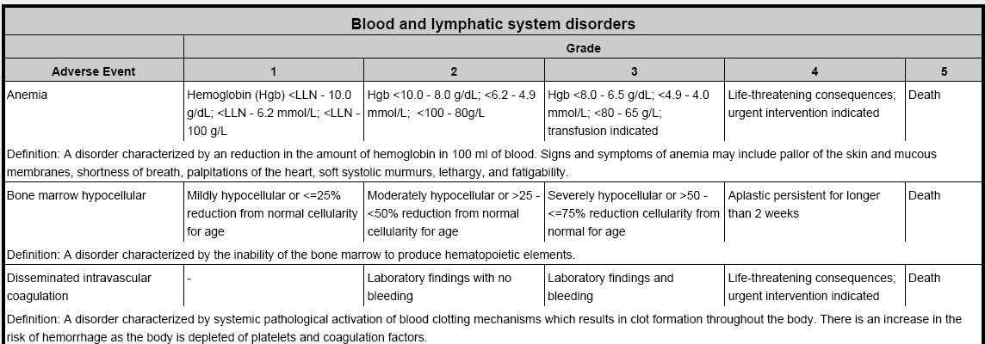
Common Terminology Criteria for Adverse Events (CTCAE) v.4: Updating a Cancer Research Standard
Ann Setser¹, Ranjana Srivastava², Lawrence Wright¹, Sherri de Coronado¹, Alice Chen³
¹ NCI Center for Biomedical Informatics and Information Technology (CBIIT) ² Booz Allen Hamilton ³ NCI Cancer Therapy Evaluation Program (CTEP)
Abstract
Background:
The NCI Cancer Therapy Evaluation Program (CTEP) Common Terminology Criteria for Adverse Events (CTCAE v3.0) is widely accepted throughout the oncology research community as the standard classification and severity grading scale for clinical trials protocol parameters, analysis and reporting concerning, e.g., maximum tolerated dose, dose modification, and comparison of safety profiles between interventions. International adoption of MedDRA (Medical Dictionary for Regulatory Activities Terminology) for adverse event coding, advances in medicine, and new standards for terminologies and electronic data systems, all pointed to the need for comprehensive update and redesign.
Methods:
The NCI Center for Biomedical Informatics and Information Technology (CBIIT) worked with CTEP and the cancer Biomedical Informatics Grid (caBIG®) initiative to involve interested stakeholders in the redesign effort. A revision process was organized, consisting of 12 expert Working Groups divided by MedDRA System Organ Class (SOC), a Steering Committee of 24 members, and a Governance Group with representatives from regulatory, pharmaceutical, and investigative organizations to oversee revision and future governance. Representatives of the MedDRA Maintenance and Support Services Organization (MSSO) provided MedDRA expertise.
Results:
The revised CTCAE v4.0 is harmonized with MedDRA at the Adverse Event (AE) level, includes revised AE terms and severity indicators to reflect clinical effects identified with current oncology interventions, and conforms with caBIG vocabulary standards. CTCAE is designed to integrate into information networks for safety data exchange, and is expected to have a significant impact in data management for AE data collection, analysis, and patient outcomes associated with cancer research and care. Adoption of the new v4 standard is expected to be widespread by the end of 2009.
Conclusions:
The CTCAE Revision Project demonstrates the advantages of broad community involvement and new technical approaches in updating a widely used adverse event terminology to better meet the needs of the international oncology community.
CTCAE Redesign Process
CTCAE v3.0 Impetus for Revision
2006 MedDRA MSSO Blue Ribbon Panel
MedDRA is used for AE reporting by biopharmaceutical industry and regulatory agencies within ICH regions
CTCAE is widely used by industry in oncology and HIV clinical research
Challenges exist when attempting to ‘translate’ or ‘convert’ CTCAE terms to MedDRA terms
Summary of recommendations
http://www.meddramsso.com/MSSOWeb/activities/archive_brp.htm
2007 CTEP and FDA Discussions regarding CTCAE v3.0 & MedDRA
Agreement to revise CTCAE v3.0 to harmonize with MedDRA
2008 caBIG® VCDE evaluation of CTCAE v3.0 as a standard terminology
Non-standardized AE terminology
Non-machine interpretable
Lack of definitions
Others
More Information
caBIG Vocabulary Knowledge Center:
https://cabig-kc.nci.nih.gov/Vocab/KC/index.php/CTCAE
Browse on BiomedGT Wiki:
http://biomedgt.nci.nih.gov/wiki/index.php/CTCAE4
CTCAE 4.0 Sample Content
MedDRA System Organ Class (SOC)
(Total: 26)
MedDRA AE Term
(Total: 764 + 26)
Term Definition
(Total: 764)
AE Grade + Definition
(Total: 3,057)

