Slide 1
EVS Terminology for Clinical Proteomic Tumor Analysis Consortium (CPTAC)
NCI Enterprise Vocabulary Services
October 2019

Slide 2
NCI Enterprise Vocabulary Services (EVS)
NCI EVS provides foundational content and technical resources to facilitate data interpretation, integration, sharing, and reuse, including:
Expert scientific/biomedical content & technical consultations
Terminology/ontology authoring, analysis, publication & distribution
Terminology services such as term request, 24 hr. rapid coding, use-specific tagging and subsetting, multi-terminology linking and mappings
Facilitation of large scale, multi-stakeholder content & technical collaborations
Full suite of open source terminology management tools

Slide 3
EVS Purpose and Scope
Terminologies and ontologies provide the foundation for clearly representing meaning to both people and computers. EVS enhances the conduct, analysis and sharing of cancer research information by providing rapid response, science based terminology and ontology resources that meet the needs of cutting edge cancer research, while also building and harmonizing with national and global standards moving towards precision medicine and a learning health system.
EVS supports all aspects of NCI’s mission, including basic science, clinical, and health research, as well as public information and administrative services. This support includes:
Encode Precise, Stable Meanings: Support best-practice, science-based, quick-response terminology/ontology resources to help researchers accurately collect, code, and analyze data.
Support Semantic Infrastructures: Support metadata, models, value sets, and mappings that provide broader, computable representations to structure meanings and make them interoperable.
Build Shared Standards: Partner and harmonize with other ICs, agencies, SDOs, and researchers in creating and improving shared standards for increasingly international, cross-cutting research.
Promote Open Content and Tools: Promote open access, open source content and tools to lower barriers, share burdens, and build shared resources.

Slide 4

3 ways to access CPTAC Terminology
NCI Thesaurus Browser : https://ncit.nci.nih.gov/ncitbrowser
NCIt Value Sets : https://ncit.nci.nih.gov/ncitbrowser/ajax?action=create_src_vs_tree&nav_type=valuesets&mode=0
EVS NCIt ftp site : https://evs.nci.nih.gov/ftp1/CPTAC/

Slide 5
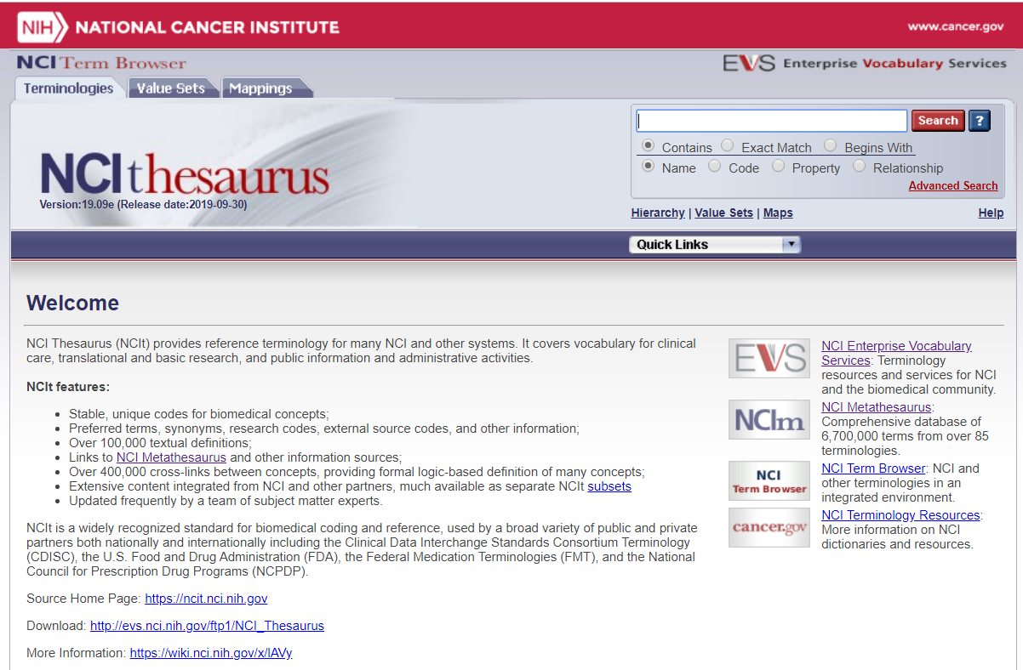
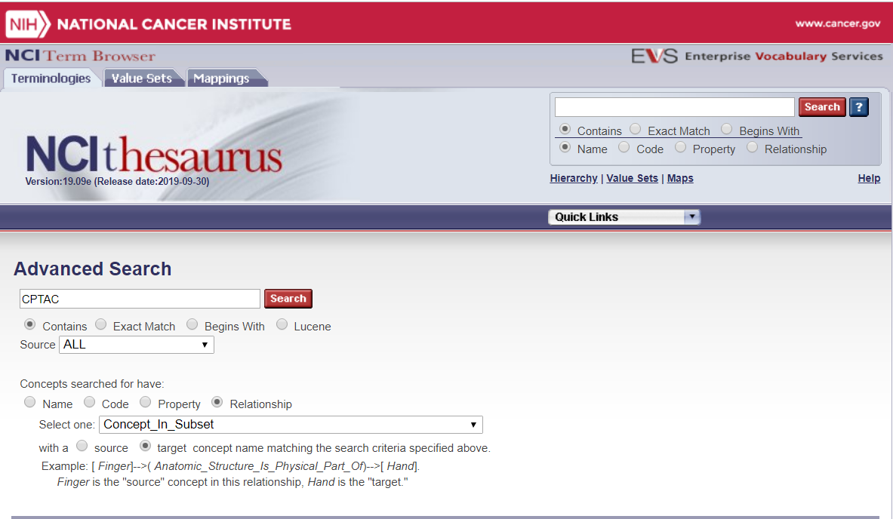
1. NCI Thesaurus Browser : https://ncit.nci.nih.gov/ncitbrowser

Slide 6
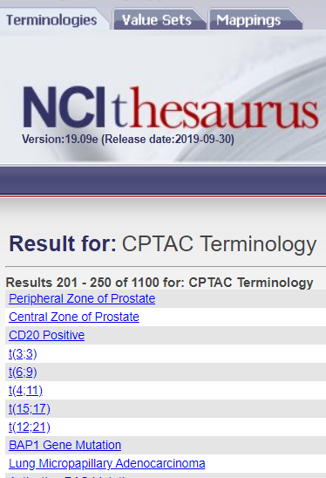
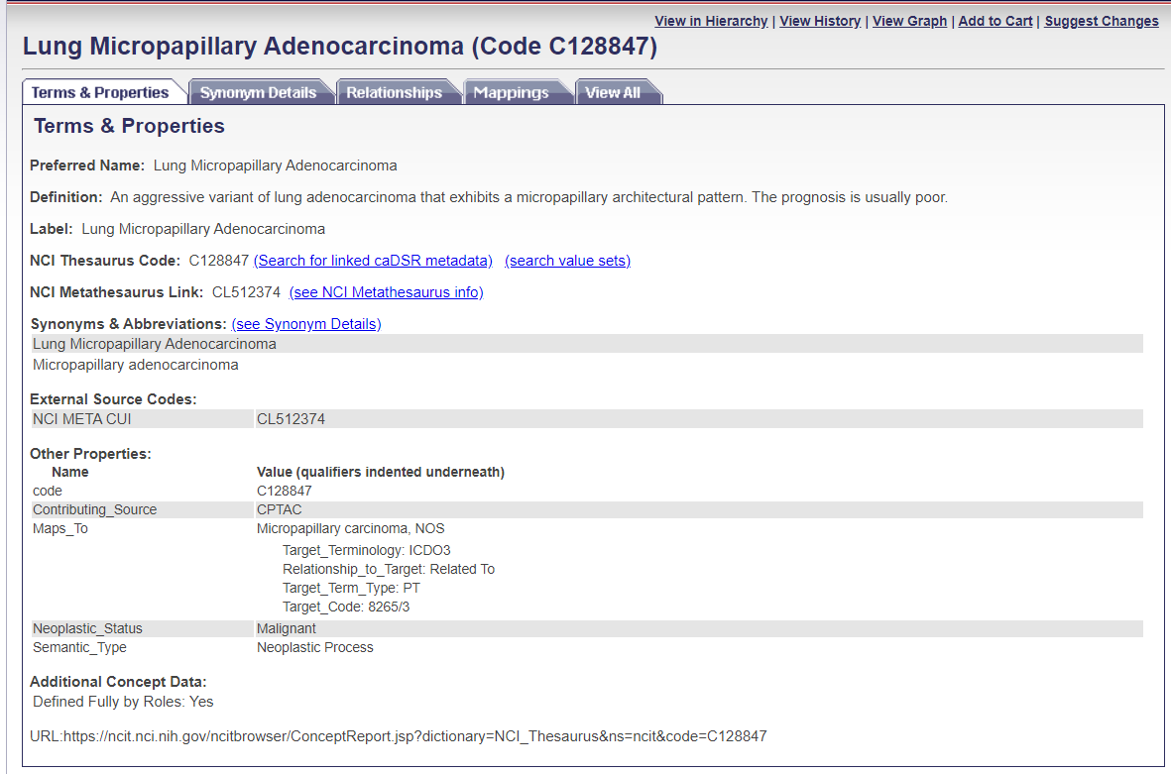
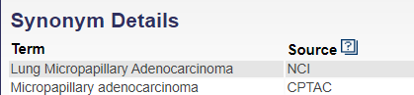
1a. Concept details for Lung Micropapillary Adenocarcinoma

Slide 7
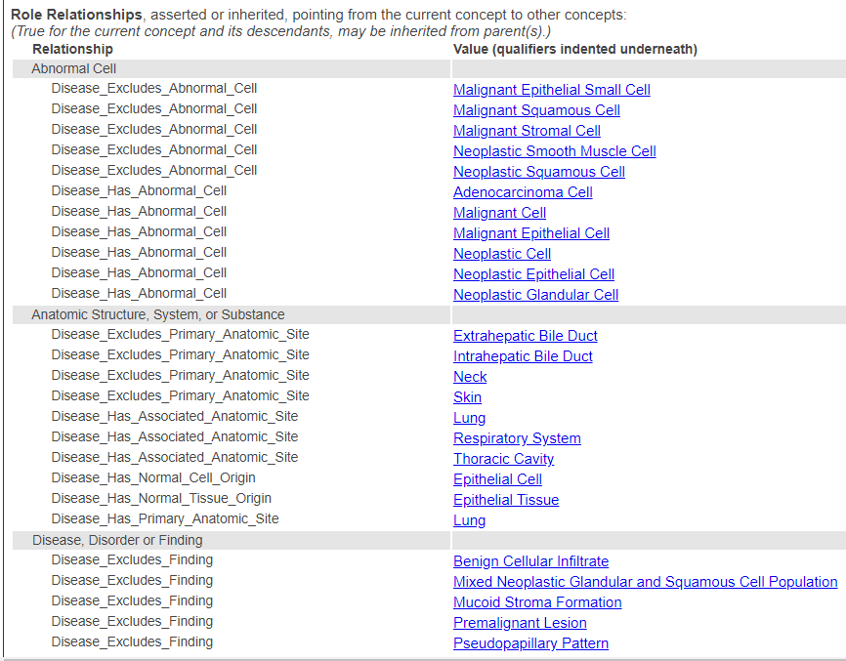
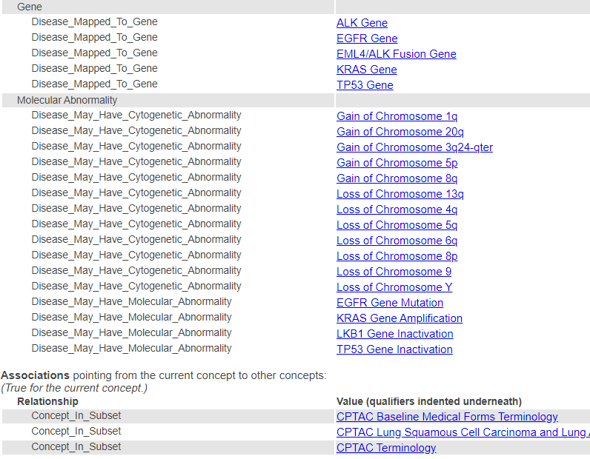
1b. Additional information about Lung Micropapillary Adenocarcinoma

Slide 8
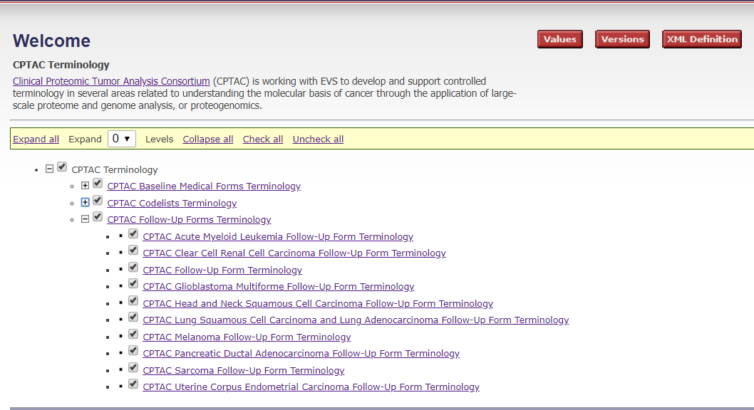
2. NCIt Value Sets : https://ncit.nci.nih.gov/ncitbrowser/ajax?action=create_src_vs_tree&nav_type=valuesets&mode=0
Click on the link for the subset of terms you want to see:

Slide 9
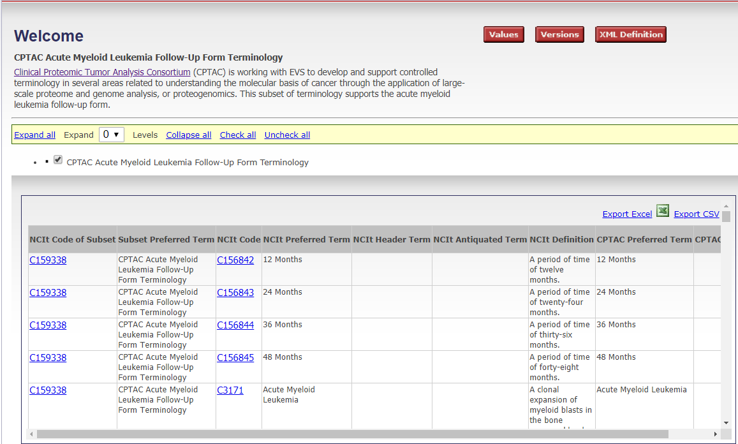
2b. Subset Data

Slide 10
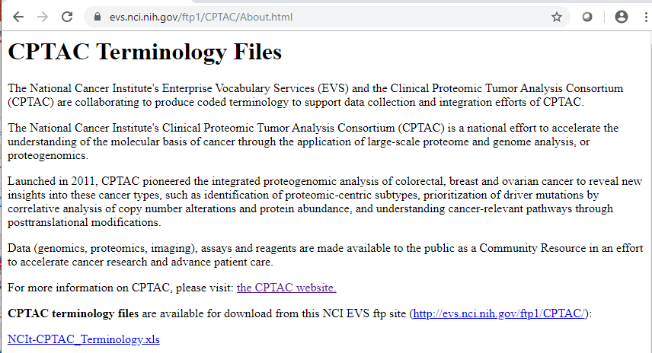
3. EVS NCIt ftp site : https://evs.nci.nih.gov/ftp1/CPTAC/
An About.html page has a link to a spreadsheet with all the terminology.
The About page provides an explanation of the data contained in the spreadsheet.

Slide 11
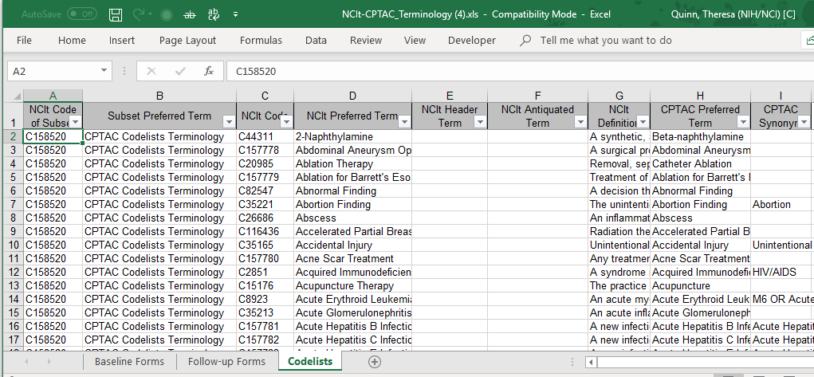
3b. Spreadsheet data
Properties defined on About page
3 sets of terminology

Slide 12
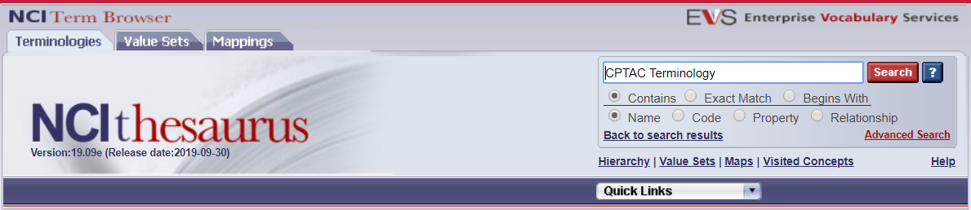
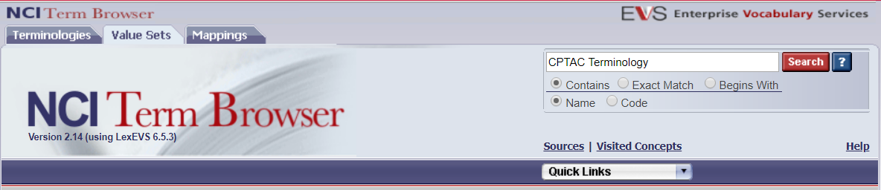
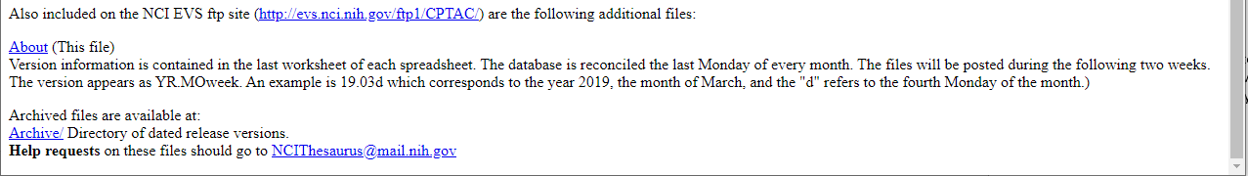
Need Help? We have you covered... NCIThesaurus@mail.nih.gov
Browser
Value Sets
ftp site

Slide 13
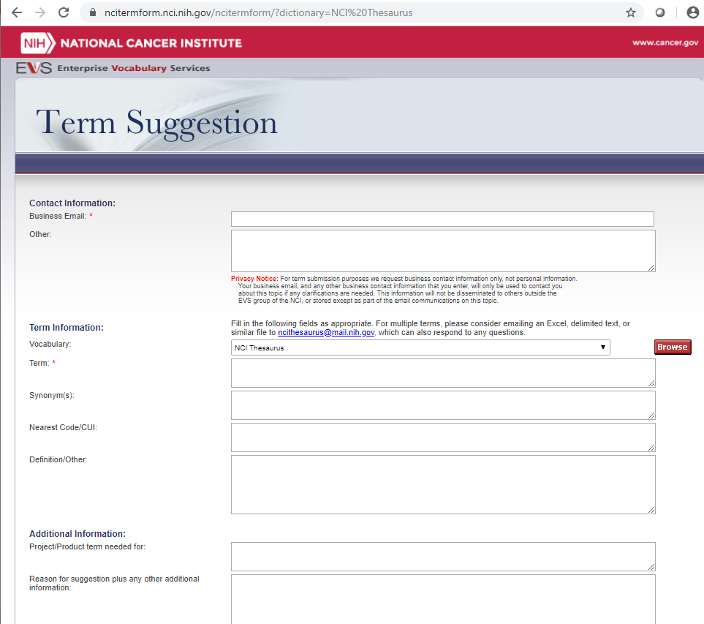
Have a suggestion?
Please let us know.

